Slide 1
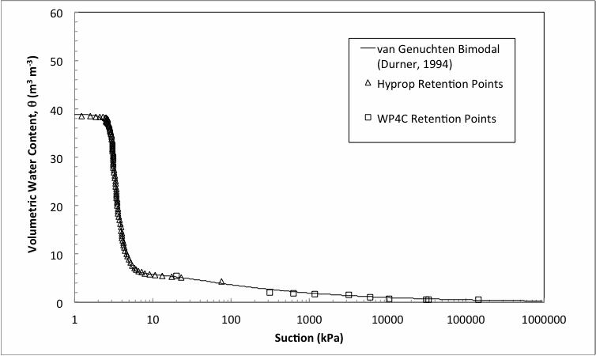
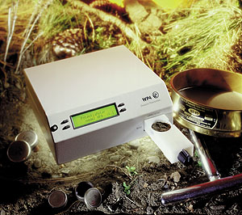
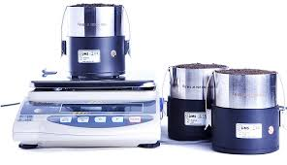
Why don’t my Hyprop and WP4C Soil Moisture Characteristic Curves align?

Slide 2
2 reasons for shift
Hysteresis
Osmotic potential offset

Slide 3
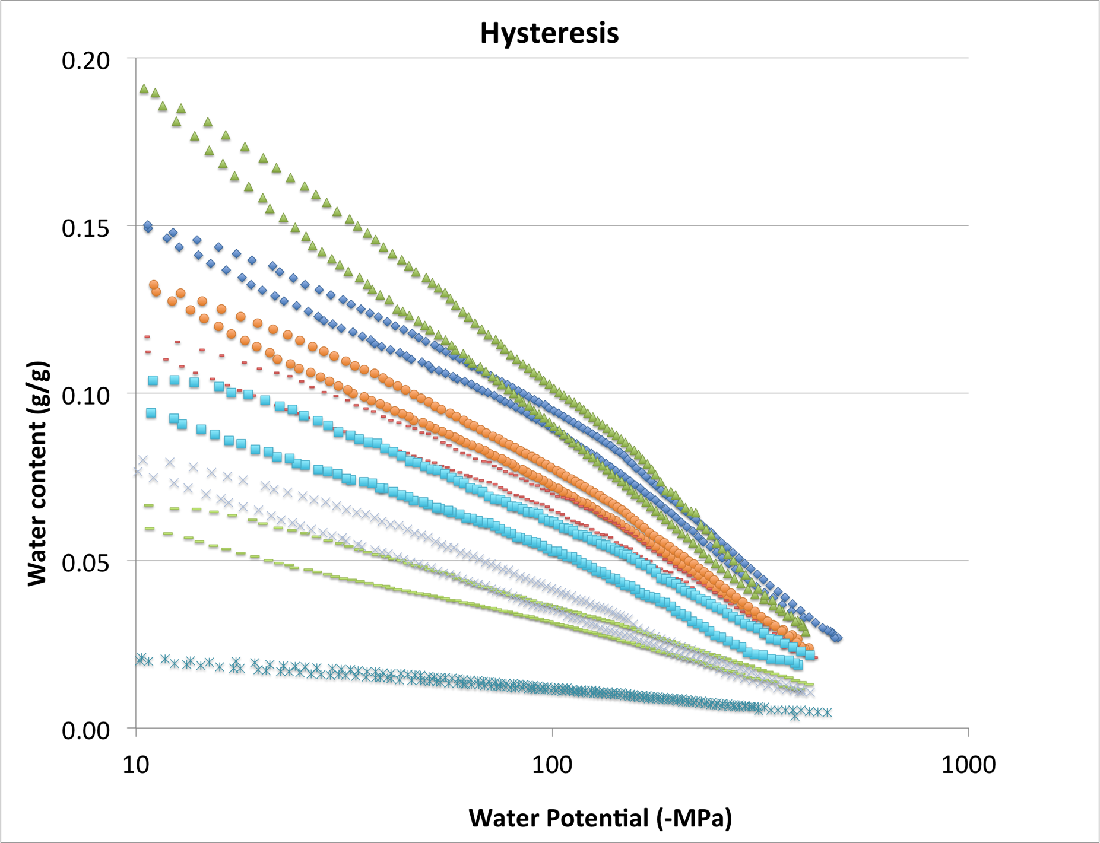
Hysteresis in SMCC

Slide 4
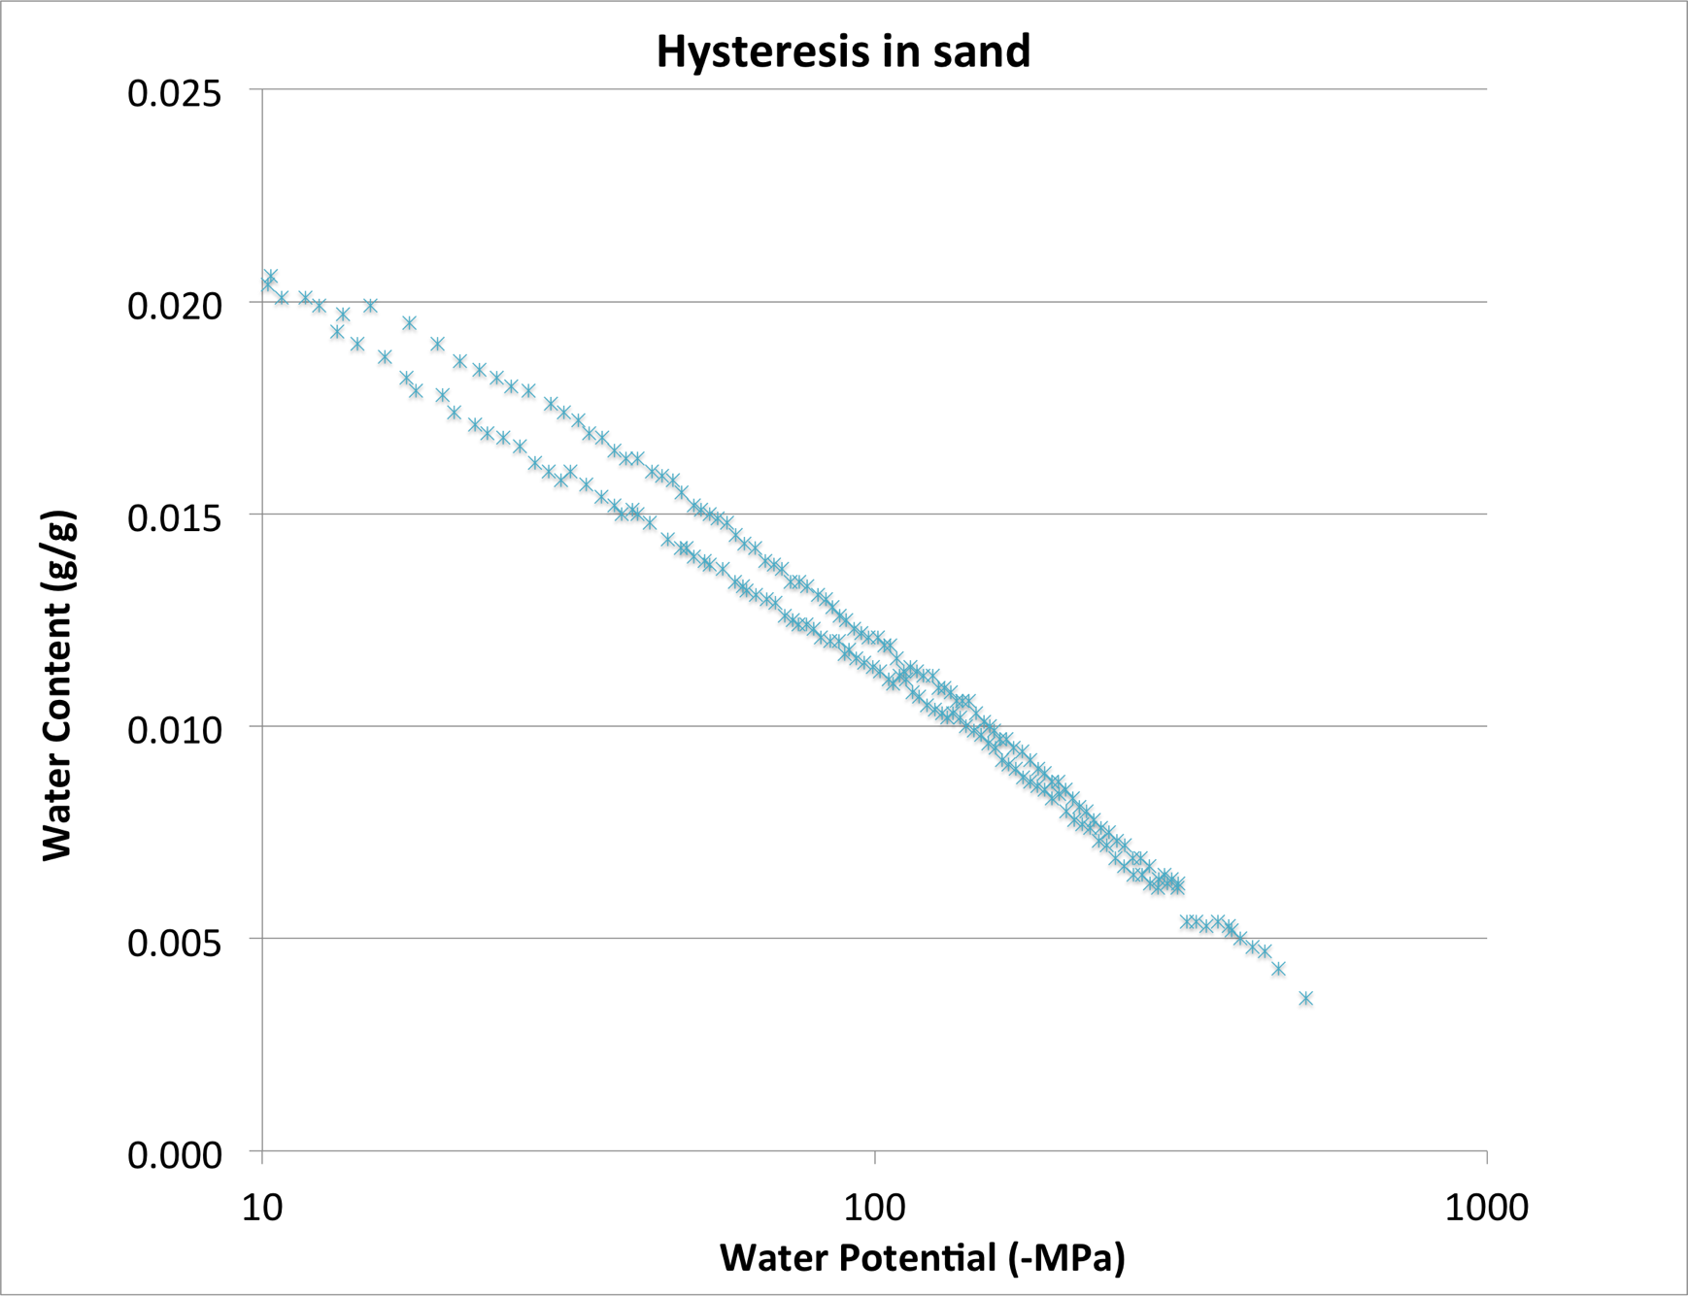
Hysteresis observed in all samples (even sand)

Slide 5
Schwana loamy fine sand

Slide 6
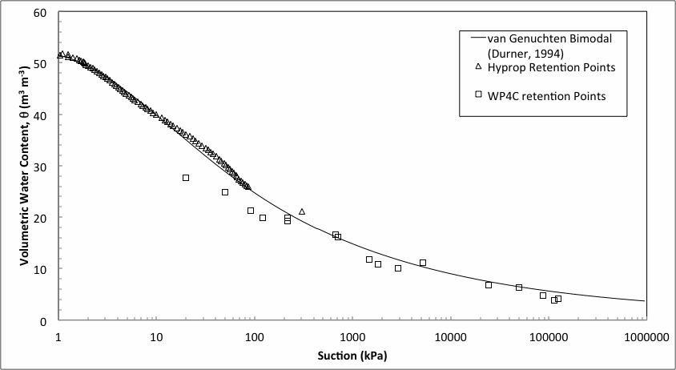
Palouse silt loam

Slide 8
How do I avoid hysteresis offset?
Make WP4C samples from drying soil instead of moistening soil
Let’s go to the lab and practice

Slide 9
Osmotic potential offset
Hyprop measures matric component of water potential
WP4C measures total water potential or matric + osmotic potential
Soils with low salinity (low EC), no problem
Saline or high EC soils, osmotic offset problem

Slide 10
Osmotic potential offset

Slide 11
Example with 1.4 dS/m saturation extract EC

Slide 12
Correcting osmotic offset
Step 1: Determine osmotic potential of saturated soil
Ψ_{os} is osmotic potential at saturation (MPa)
EC_{e} is saturation extract EC (dS/m)
Or measure Ψ_{os} of saturated soil with WP4C

Slide 13
Correcting osmotic offset
Step 2: Determine osmotic potential across all water content levels
Ψ_{o} is osmotic potential at a given water content level w
w_{s} is water content at saturation

Slide 14
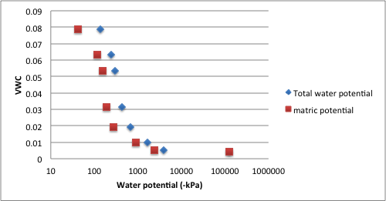
Osmotic potential example
0.46 dS/m EC_{e}

Slide 15
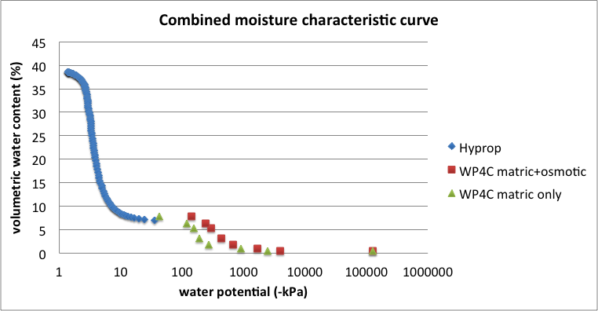
Osmotic potential example

Slide 16
Best practices for wet end SMCCs
Temperature stability is the key!
Let’s go to the lab and practice

