Slide 1
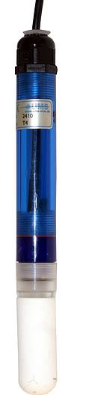
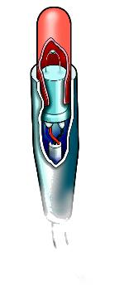
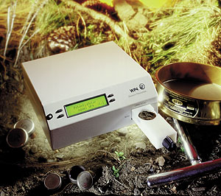
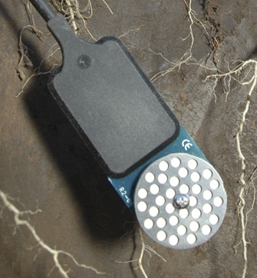
Soil Water Potential Measurement
Douglas R. Cobos, Ph.D.
Decagon Devices and Washington State University

Slide 2
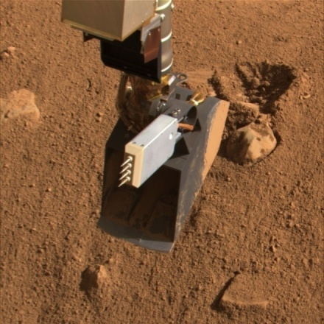
Background
About the presenter
Ph.D. in Soil Physics, 2003, University of Minnesota
Director of Research and Development, Decagon Devices, Inc.
Adjunct Faculty in Environmental Biophysics, Washington State University
Lead Engineer on TECP instrument for NASA 2008 Phoenix Mars Lander

Slide 3
Two Variables are Needed to Describe the State of Water
Water content and
Quantity
Extent
Related Measures
volume and
heat content and
charge and
Water potential
Quality
Intensity
pressure
temperature
voltage

Slide 4
Water Potential Predicts
Direction and rate of water flow in Soil, Plant, Atmosphere Continuum
Soil “Field Capacity”
Soil “Permanent Wilting Point”
Limits of microbial growth in soil and food
Seed dormancy and germination

Slide 5
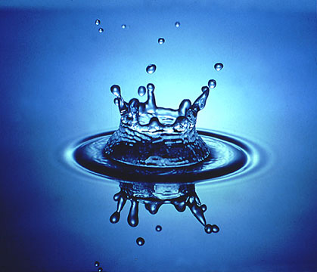
Water Potential
Energy required, per quantity of water, to transport, an infinitesimal quantity of water from the sample to a reference pool of pure, free water

Slide 6
Water Potential: important points
Energy per unit mass, volume, or weight of water
Differential property
A reference must be specified (pure, free water is the reference; its water potential is zero)

Slide 7
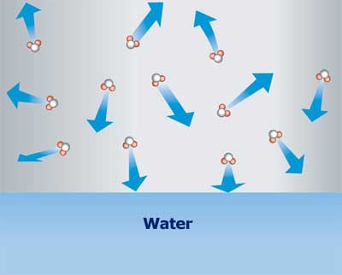

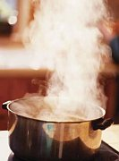
Lowering the Water Potential:
Lowers the vapor pressure of the water
Lowers the freezing point of the water
Raises the boiling point of the water

Slide 8
Water Potential is influenced by:
Pressure on the water (hydrostatic or pneumatic)
Solutes in the water
Binding of water to a surface
Position of water in a gravitational field

Slide 9
Total Water Potential = Sum of Components
ψ = ψ_{m} + ψ_{g} + ψ_{o} + ψ_{p}
m matric - adsorption forces
g gravitational - position
o osmotic - solutes
p pressure - hydrostatic or pneumatic

Slide 10
Water potential unit comparison
Condition | Water Potential (MPa) | Water Potential (m H₂O) | Relative Humidity (h_{r}) | Freezing Point (ºC) | Osmolality (mol/kg)
FC | -0.033 | -3.4 | 0.9998 | -0.025 | 0.013
 | -0.1 | -10.2 | 0.9992 | -0.076 | 0.041
 | -1 | -102 | 0.993 | -0.764 | 0.411
PWP | -1.5 | -15.3 | 0.989 | -1.146 | 0.617
 | -10 | -1020 | 0.929 | -7.635 | 4.105
 | -100 | -10204 | 0.478 | -76.352 | 41.049

Slide 11
Water Potential and Relative Humidity
Relative humidity (air)
h_{r} = p/p_{o}
where p is partial pressure of water vapor, p_{o} is air pressure
Relative humidity and water potential related by the Kelvin equation

Slide 12
Water potentials in SPAC
Atmosphere -100
-1.0
-0.7
-0.03
-0.03
-3.0
-2.5
-1.7
-1.5
Leaf
Xylem
Root
Soil
Field Capacity
(MPa)
Permanent wilt
(MPa)

Slide 13
Measuring Soil Water Potential
Solid equilibration methods
Electrical resistance
Capacitance
Thermal conductivity
Liquid equilibration methods
Tensiometer
Vapor equilibration methods
Thermocouple psychrometer
Dew point potentiameter

Slide 14

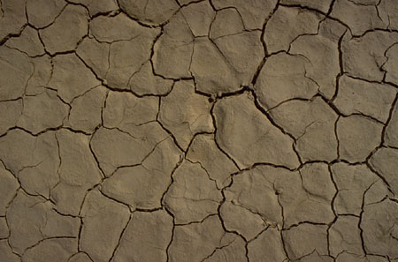

Electrical Resistance Methods for Measuring Water Potential
Standard matrix equilibrates with soil
Electrical resistance proportional to water content of matrix
Inexpensive, but poor stability, accuracy and response
Sensitive to salts in soil
Sand
Gypsum capsule

Slide 15
Capacitance Methods for Measuring Water Potential
Standard matrix equilibrates with soil
Water content of matrix is measured by capacitance
Stable (not subject to salts and dissolution
Decent accuracy from -0.01 to
-0.5 MPa (better with calibration)

Slide 16
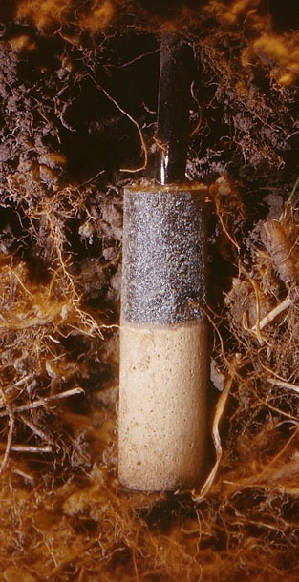

Heat Dissipation Sensor
Robust (ceramic with embedded heater and temperature sensor)
Large measurement range (wet and dry end)
Stable (not subject to salts and dissolution
Requires complex temperature correction
Requires individual calibration
Ceramic
Heater and thermocouple

Slide 17
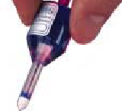
Liquid Equilibration: Tensiometer
Equilibrates water under tension with soil water through a porous cup
Measures tension of water
Highest accuracy of any sensor in wet range
Limited to potentials from 0 to -0.09 MPa
Significant maintenance requirements

Slide 18
Vapor Pressure Methods
Measure relative humidity of head space in equilibrium with sample
Measure wet bulb temperature depression of head space in equilibrium with sample
Measure dew point depression of head space in equilibrium with sample

Slide 19
Thermocouple Psychrometer
Thermocouple
output
Measures wet
bulb temperature
depression
Water potential
proportional to
cooling of wet
junction
Chromel-constantan
thermocouple
sample

Slide 20
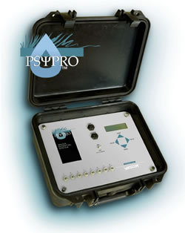
In Situ Soil Water Potential
Readout
Soil Psychrometer

Slide 21
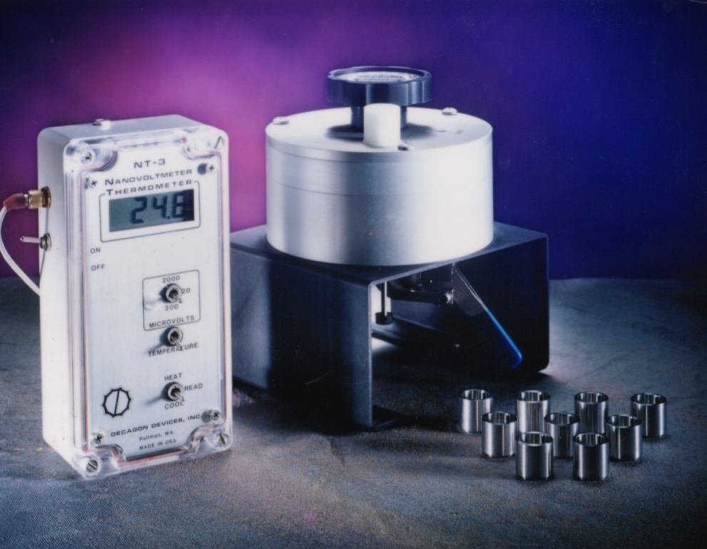
Sample Chamber Psychrometer
Measures water potential of soils and plants
Requires 0.001C temperature resolution
0 to – 6 MPa (1.0 to 0.96 RH) range
0.1 MPa accuracy

Slide 22
Chilled Mirror Dew Point
Cool mirror until dew forms
Detect dew optically
Measure mirror temperature
Measure sample temperature with IR thermometer
Water potential is approximately linearly related to Ts - Td
Fan
Optical Sensor
Mirror
Infrared Sensor
Sample

Slide 23
WP4 Dew Point Potentiameter
Range is 0 to -300 MPa
Accuracy is 0.1 MPa
Read time is 5 minutes or less

Slide 24
Some applications of soil water potential
Soil Moisture Characteristic
Plant Available Water
Surface Area
Soil Swelling
Soil and plant water relations in the field
Water flow and contaminant transport
Irrigation management

Slide 25
Soil Moisture Characteristic
Relates water content to water potential in a soil
Different for each soil
Used to determine
- plant available water
- surface area
- soil swelling

Slide 26
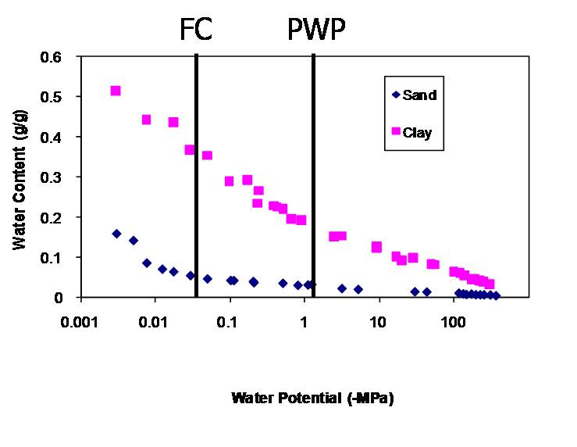
Plant Available Water
Two measurement methods needed for full range
Hyprop, tensiometer, pressure plate in wet end
Dew point hygrometer or thermocouple psychrometer in dry end
Field capacity (-0.033 Mpa)
Upper end of plant available water
Permanent wilting point (-1.5 Mpa)
Lower end of plant available water
Plants begin water stress much lower

Slide 27
Surface Area from a Moisture Characteristic

Slide 28
pF Plot to get Soil Swelling

Slide 29
Expansive Soil Classification from McKeen(1992)
Class | Slope | Expansion
I | > -6 | special case
II | -6 to -10 | high
III | -10 to -13 | medium
IV | -13 to -20 | low
V | < -20 | non-expansive

Slide 30

Field Soil-Plant Water
Requirements:
Year around monitoring; wet and dry
Potentials from saturation to air dry
Possible solutions:
Heat dissipation sensors (wide range, need individual calibration)
Soil psychrometers (problems with temperature sensitivity)
Capacitance matric potential sensor (limited to -0.5 MPa on dry end)

Slide 31
Water Flow and Contaminant Transport
Requirements:
Accurate potentials and gradients during recharge (wet conditions)
Continuous monitoring
Possible solutions:
Pressure transducer tensiometer (limited to -0.08 MPa on dry end)
Capacitance matric potential sensor

Slide 32
Irrigation Management
Requirements:
Continuous during growing season
Range 0 to -100 kPa
Relative change is important
Possible solutions:
Heat dissipation or capacitance
Tensiometer
Granular matrix

Slide 33
Bridging the gap
Requires a practical method for converting field measurements from θ to ψ
Moisture release curve
Conventional wisdom: time consuming
Most moisture release curve have been done on pressure plates
Long equilibrium times, especially at lower ψ
Labor intensive

Slide 34
Bridging the gap

Slide 35
Summary
Knowledge of water potential is important for
Predicting direction of water flow
Estimating plant available water
Assessing water status of living organisms (plants and microbes)

Slide 36
Summary
Water potential is measured by equilibrating a solid, liquid, or gas phase with soil water and measuring the pressure or water content of the equilibrated phase
Solid phase sensors
Heat dissipation
Capacitance
Granular matrix

Slide 37
Summary
Liquid equilibrium - tensiometers
Vapor equilibration
Thermocouple psychrometers
Dew point potentiameters
No ideal water potential measurement solution exists. Sensors must be chosen to fit the requirements of the experiment or application

