Slide 1
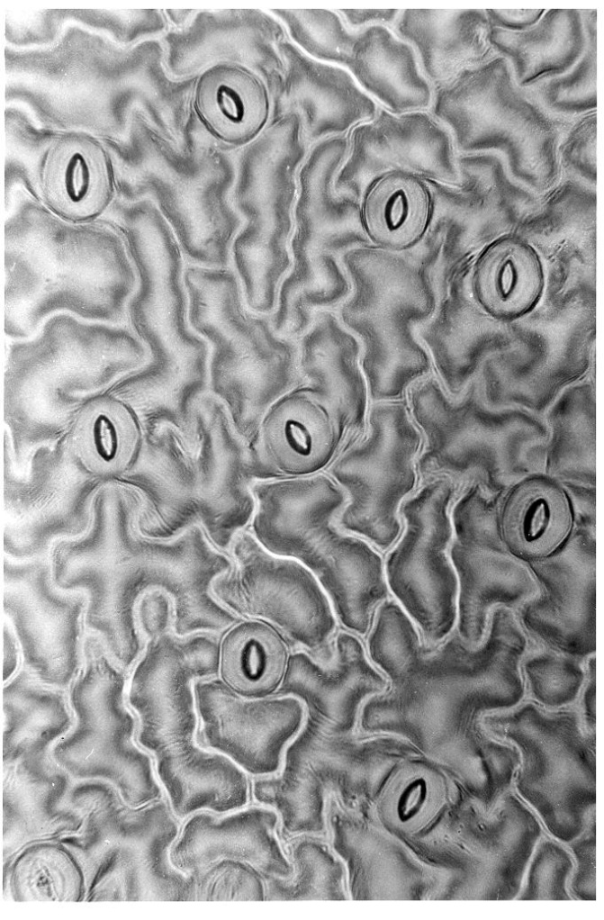
Stomatal Conductance and Porometry
Theory and Measurement

Slide 2
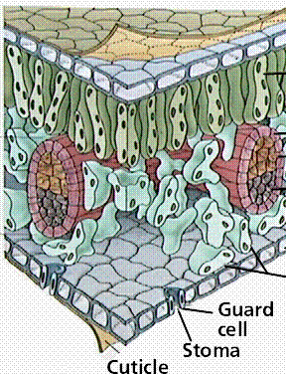
Stomatal conductance
Describes gas diffusion through plant stomata
Plants regulate stomatal aperture in response to environmental conditions
Described as either a conductance or resistance
Conductance is reciprocal of resistance
1/resistance

Slide 3
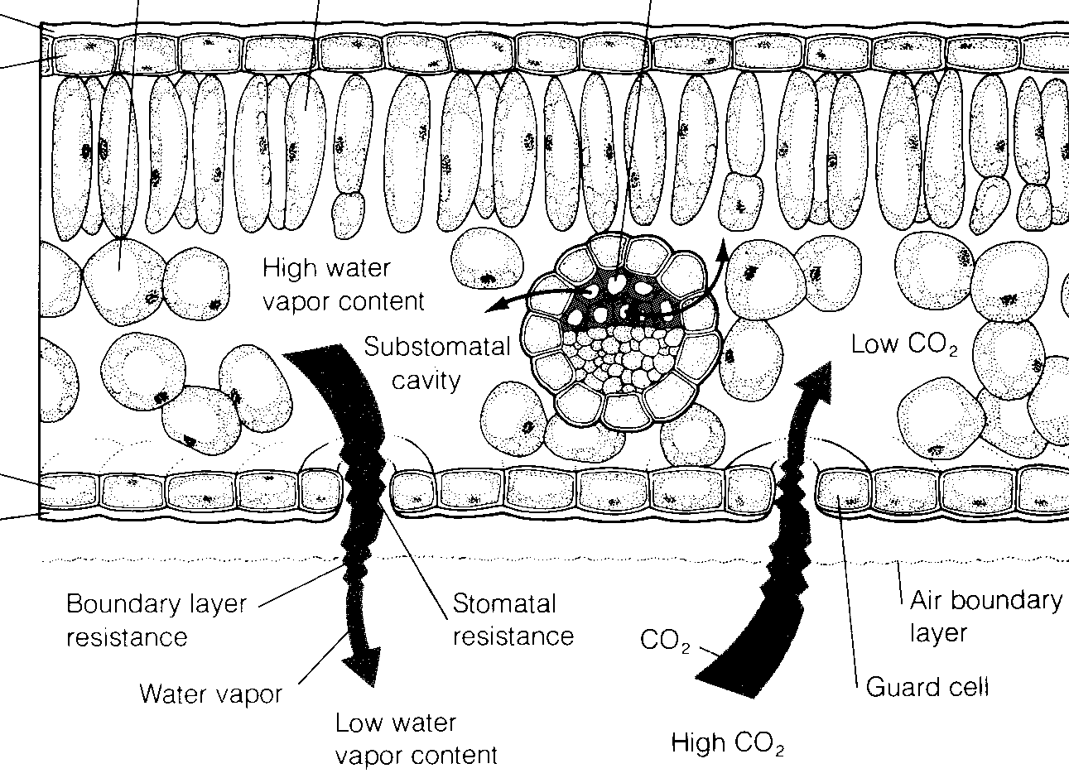
Stomatal conductance
Can be good indicator of plant water status/stress
Many plants regulate water loss through stomatal conductance

Slide 4
Fick's Law for gas diffusion
E Evaporation (mol m⁻² s⁻¹)
C Concentration (mol mol⁻¹)
R Resistance (m² s mol⁻¹)
L leaf
a air

Slide 5
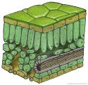
C_{vt}
stomatal resistance of the leaf
r_{vs}
C_{vs}
r_{va}
Boundary layer resistance
of the leaf
C_{va}

Slide 6
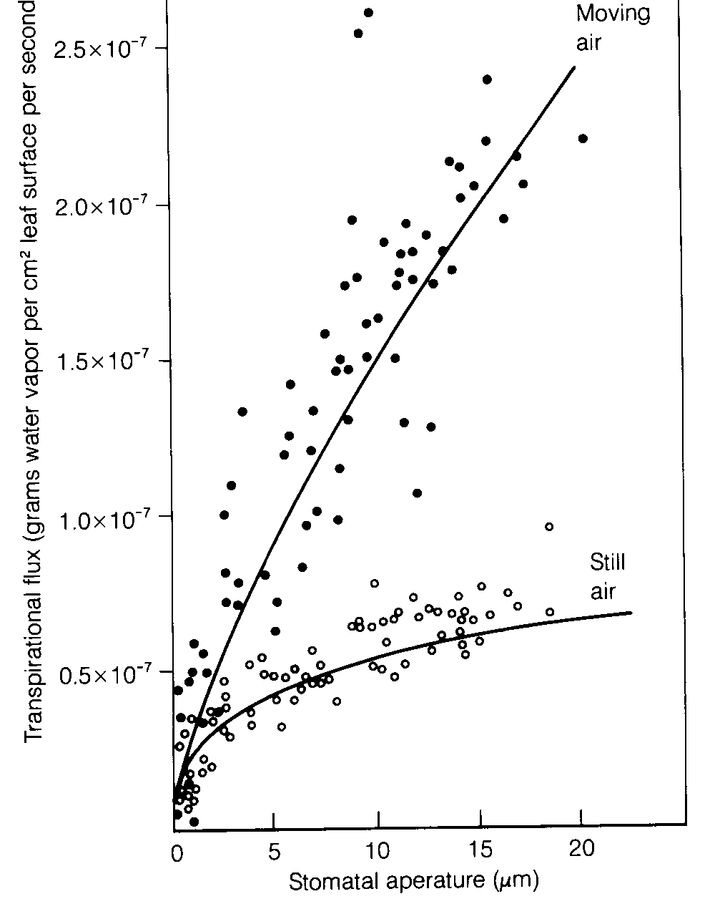
Do stomata control leaf water loss?
Bange (1953)
Still air: boundary layer resistance controls
Moving air: stomatal resistance controls

Slide 7
Obtaining resistances (or conductances)
Boundary layer conductance depends on wind speed, leaf size and diffusing gas
Stomatal conductance is measured with a leaf porometer

Slide 8
Measuring stomatal conductance – 2 types of leaf porometer
Dynamic - rate of change of vapor pressure in chamber attached to leaf
Steady state - measure the vapor flux and gradient near a leaf

Slide 9
Dynamic porometer
Seal small chamber to leaf surface
Use pump and desiccant to dry air in chamber
Measure the time required for the chamber humidity to rise some preset amount
Stomatal conductance is proportional to:
ΔC_{v} = change in water vapor concentration
Δt = change in time

Slide 10
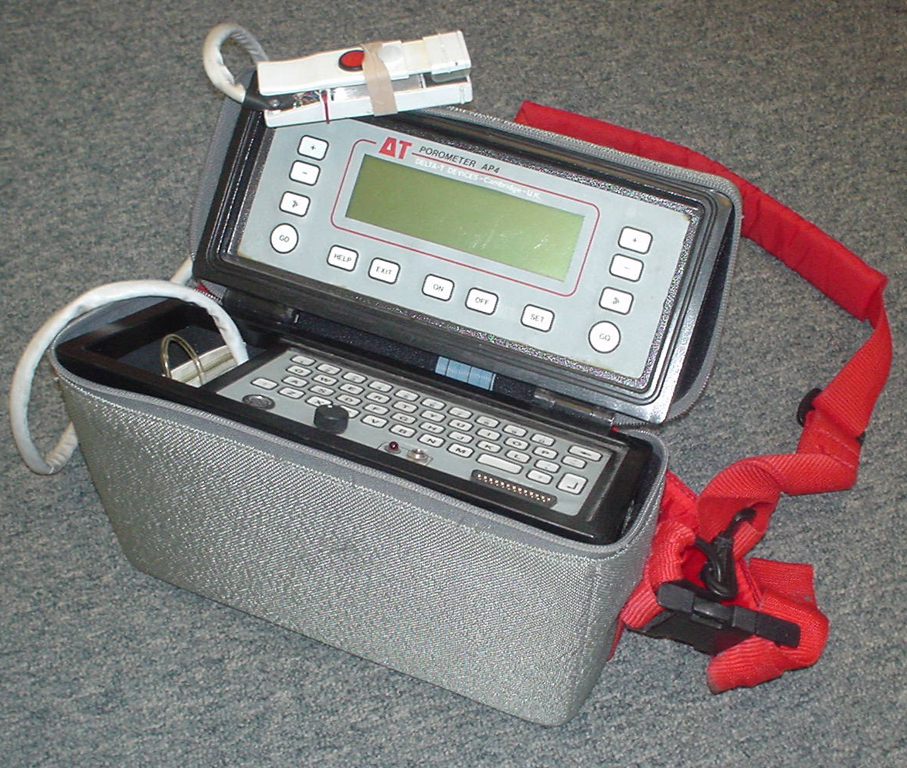
Delta T dynamic diffusion porometer

Slide 11
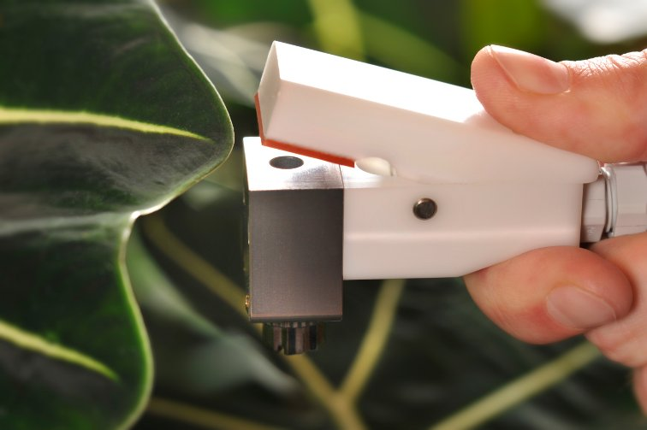
Steady state porometer
Clamp a chamber with a fixed diffusion path to the leaf surface
Measure the vapor pressure at two locations in the diffusion path
Compute stomatal conductance from the vapor pressure measurements and the known conductance of the diffusion path
No pumps

Slide 12
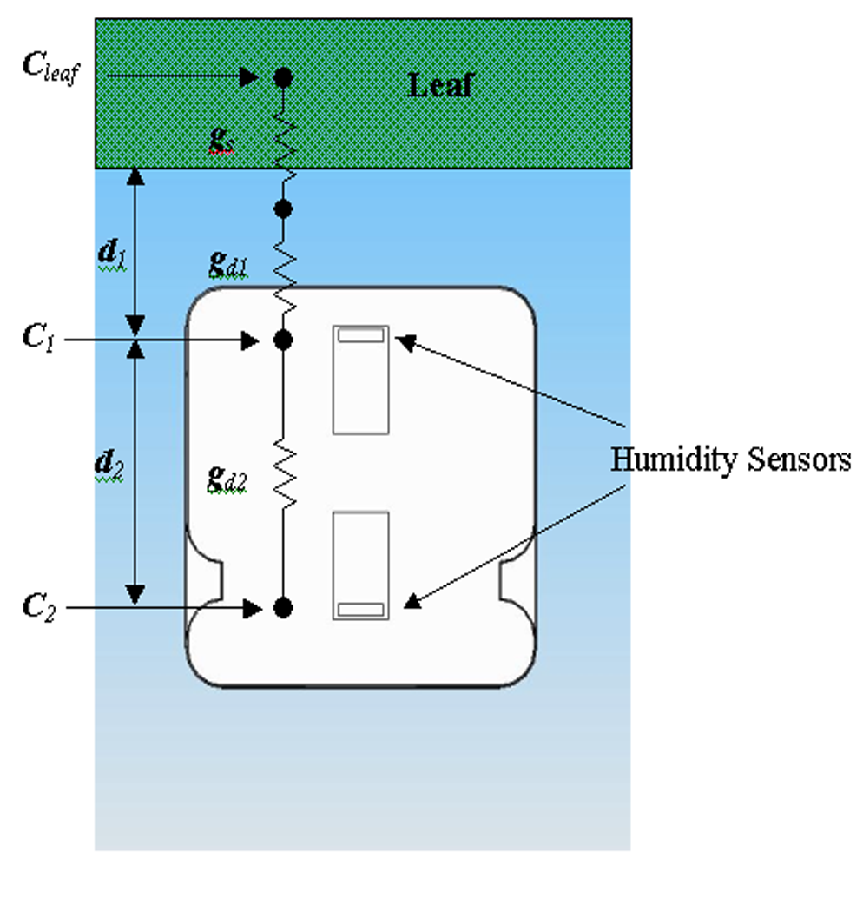
Steady state porometer
A chamber with a fixed diffusion path is clamped to the leaf surface
Steady-state technique; measures vapor pressure at two locations in a fixed diffusion path
Calculates flux and gradient from the vapor pressure measurements and the known conductance of the diffusion path.
Teflon
filter
Desiccant
Atmosphere

Slide 13
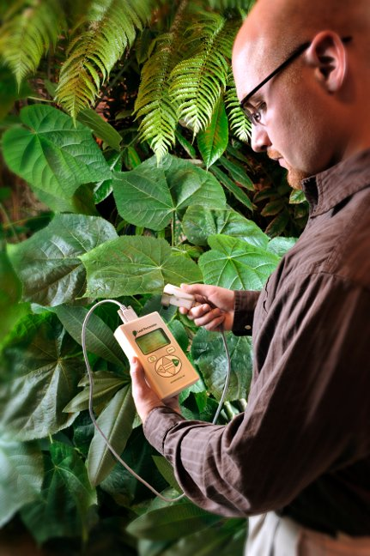
Decagon steady state porometer
Model SC-1

Slide 14

Environmental effects on stomatal conductance: Light
Stomata normally close in the dark
The leaf clip of the porometer darkens the leaf, so stomata tend to close
Leaves in shadow or shade normally have lower conductances than leaves in the sun
Overcast days may have lower conductance than sunny days

Slide 15
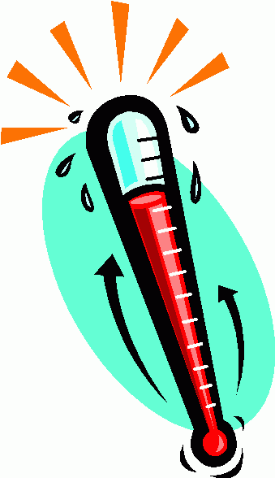
Environmental effects on stomatal conductance: Temperature
High and low temperature affects photosynthesis and therefore conductance
Temperature differences between sensor and leaf affect all diffusion porometer readings. All can be compensated if leaf and sensor temperatures are known

Slide 16
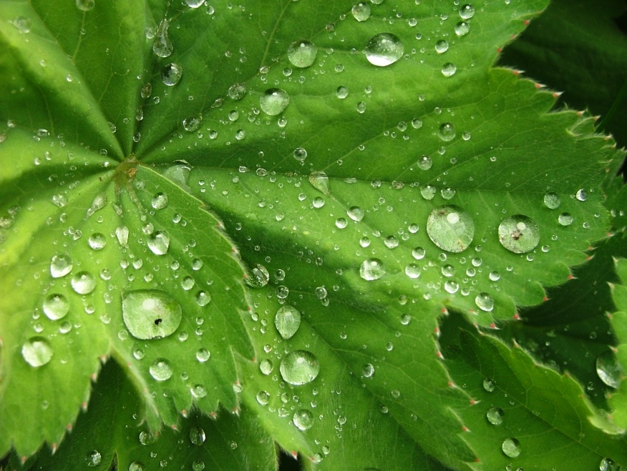
Environmental effects on stomatal conductance: Humidity
Stomatal conductance increases with humidity at the leaf surface
Porometers that dry the air can decrease conductance
Porometers that allow surface humidity to increase can increase conductance.

Slide 17

Environmental effects on stomatal conductance: CO₂
Increasing carbon dioxide concentration at the leaf surface decreases stomatal conductance.
Photosynthesis cuvettes could alter conductance, but porometers likely would not
Operator CO₂ could affect readings

Slide 18
What can I do with a porometer?
Water use and water balance
Use conductance with Fick’s law to determine crop transpiration rate
Develop crop cultivars for dry climates/salt affected soils
Determine plant water stress in annual and perennial species
Study effects of environmental conditions
Schedule irrigation
Optimize herbicide uptake
Study uptake of ozone and other pollutants

Slide 19
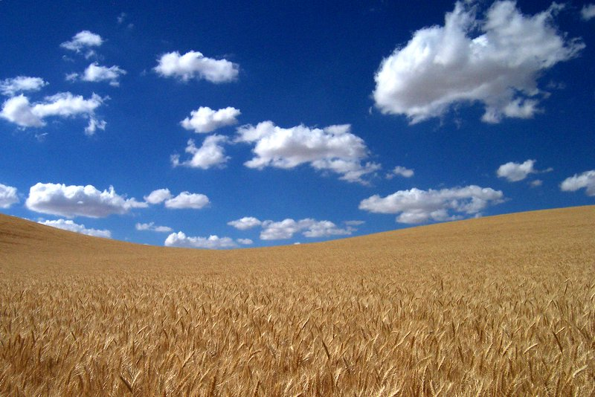
Case study #2 Washington State University wheat
Researchers using steady state porometer to create drought resistant wheat cultivars
Evaluating physiological response to drought stress (stomatal closing)
Selecting individuals with optimal response

Slide 20
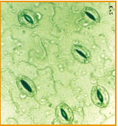
Case study #3 Chitosan application
Evaluation of effects of Chitosan on plant water use efficiency
Chitosan induces stomatal closure
Leaf porometer used to evaluate effectiveness
26 – 43% less water used while maintaining biomass production

Slide 21
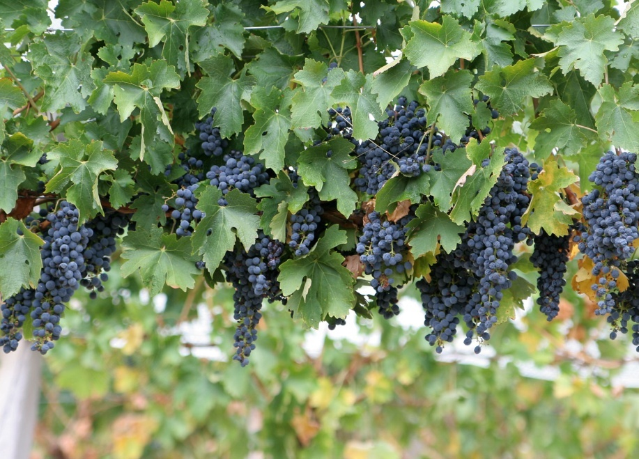
Case Study 4: Stress in wine grapes

