Slide 1

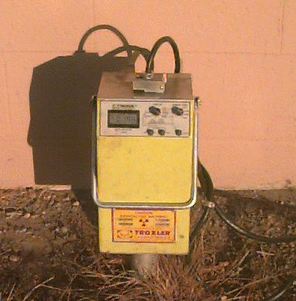
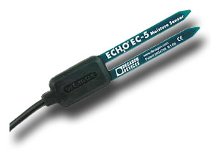

Water Content Measurement Methods and Field Applications
Colin S. Campbell Ph.D.
Research Scientist
Decagon Devices, Inc.

Slide 2
Outline
Direct vs. Indirect measurements
Water content: Gravimetric vs. Volumetric
Water content measurement techniques
Neutron probe
Dual-needle heat pulse
Gravimetric sampling
Dielectric sensors
Time Domain
Frequency Domain
Sensor installation methods
Field applications/examples

Slide 3
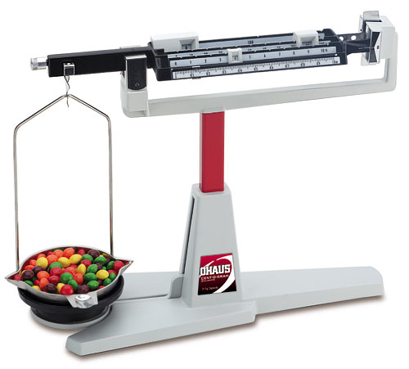
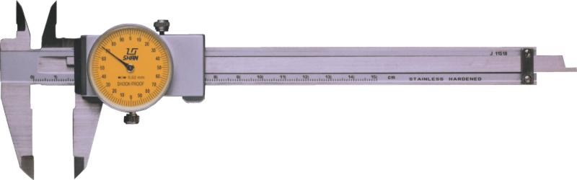
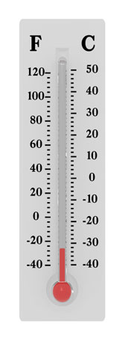
Measurement Techniques
Direct measurements
Evaluate property directly
Length with calipers
Mass on a balance
Indirect measurements
Measure another property and relate it to the property of interest through a calibration
Expansion of liquid in a tube to determine temperature

Slide 4
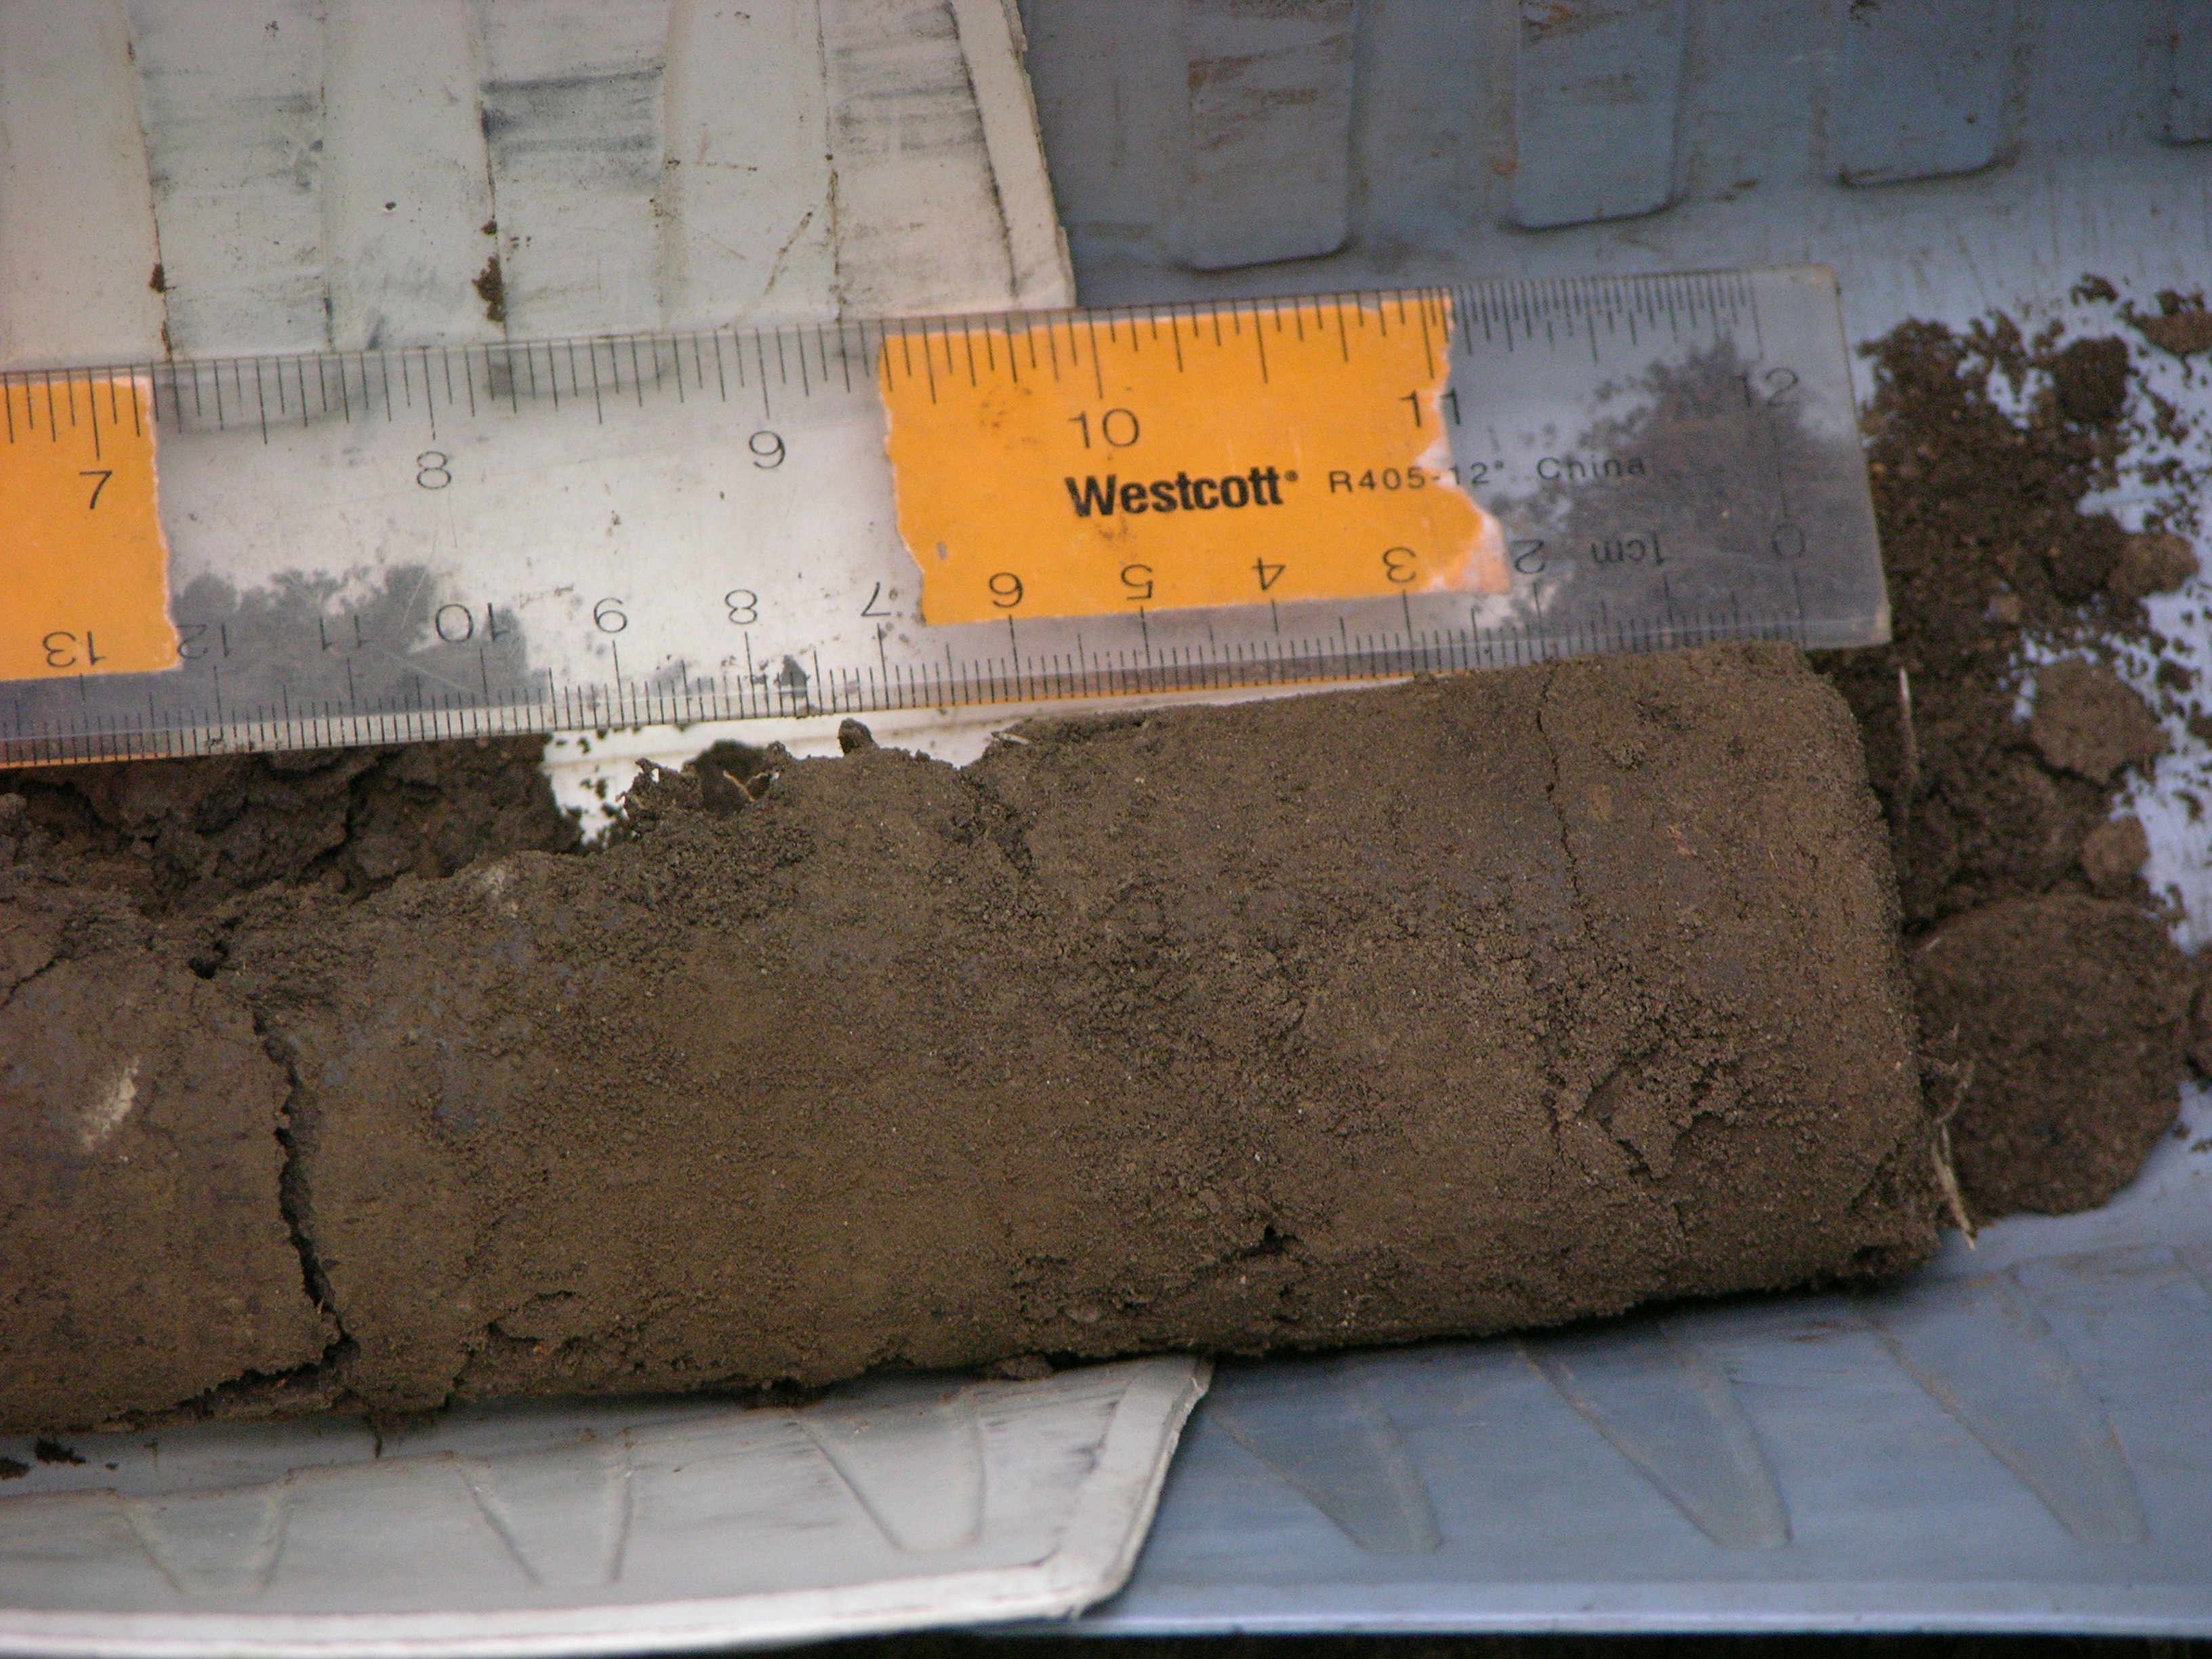

Definition: Volumetric Water Content
θ is volumetric water content (VWC),
V_{w} is the volume of water
V_{T} is total sample volume
Air
15%
35%
Water
35% VWC
Separate into constituent parts
50%
Soil

Slide 5

Definition: Gravimetric water content
Gravimetric water content (w)
m – mass
w – water
d – dry solids

Slide 6
Volumetric vs. Gravimetric Water Content
Volumetric Water Content (VWC)
Water volume per unit total volume
Gravimetric Water Content (GWC)
Water weight per unit dry soil weight
Soil bulk Density, ρ_{b}
Two important notes:
In situ field measurement methods can only measure volumetric water content
You must take soil cores of known volume in the field to measure VWC from gravimetric method

Slide 7
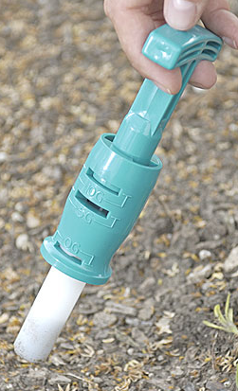
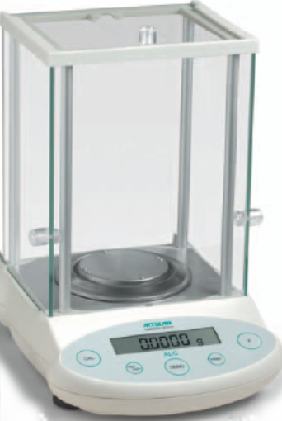
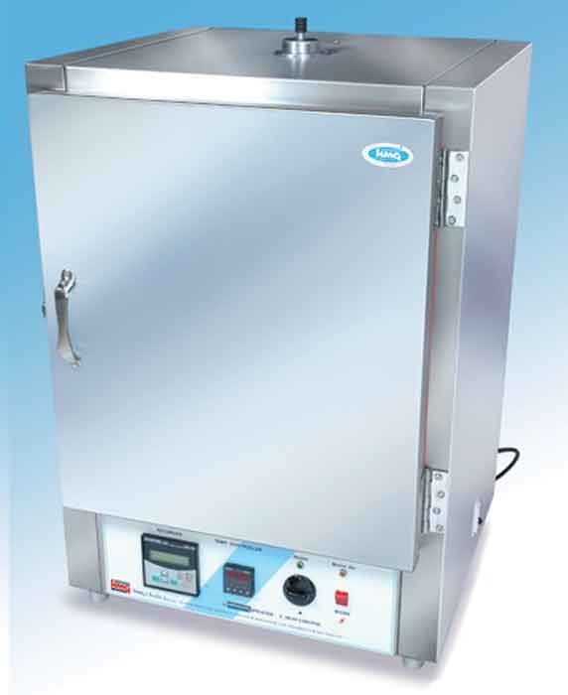
Direct Water Content: Gravimetric (w) Technique
Generate volumetric water content
Same as gravimetric except soil is sampled with known volume
Calibration instructions:
www.decagon.com/appnotes/CalibratingECH2OSoilMoistureProbes.pdf

Slide 8
Direct Water Content Measurements
Advantages
Simple
Direct measurement
Can be inexpensive
Disadvantages
Destructive
does not account for temporal variability
Time consuming
Requires precision balance & oven

Slide 9
Instruments for Measuring in situ Water Content (indirect)
Neutron thermalization
Neutron probes
Dual needle heat pulse probe
Dielectric measurement
Capacitance/Frequency Domain Reflectometery (FDR)
Time Domain Reflectometry (TDR)

Slide 10
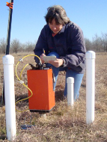
Neutron Thermalization Probe: How They Work
Radioactive source
High-energy epithermal neutrons
Releases neutrons into soil
Interact with H atoms in the soil
slowing them down
Other common atoms
Absorb little energy from neutrons
Low-energy detector
Slowed neutrons collected
“thermal neutrons”
Thermal neutrons directly related to H atoms, water content

Slide 11
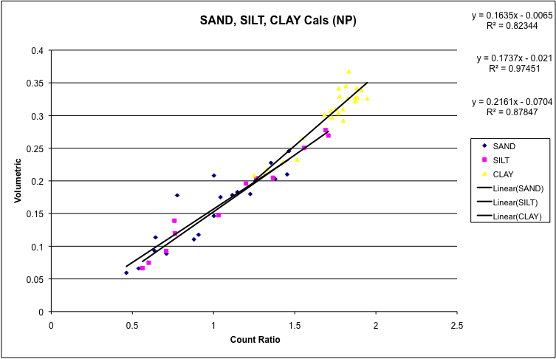
Neutron Thermalization Probe: Installation and Calibration
Installation
Auger installation hole
Manual auger or Giddings probe
Install access tube
Calibrate sensor
Gravimetric method with cores of known volume
Single representative site
Data courtesy of Scott Stanislav, Leo Rivera and Cristine Morgan, Texas A&M University

Slide 12
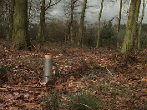
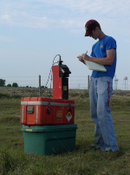
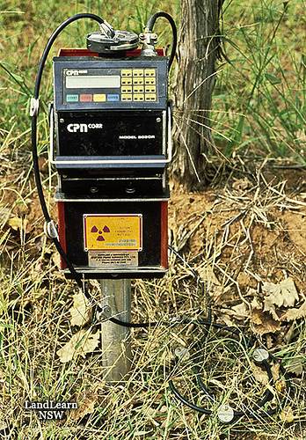
Neutron Probe Measurements
Measurements
Uncap hole
Lower probe to specific depth
Take reading at each depth
14 s to 2 min per reading
Longer read times give better accuracy

Slide 13
Neutron Thermalization Probe
Advantages
Large measurement volume
10 to 20 cm radius, depending on water content
Gets away from issues with spatial variability
Single instrument can measure multiple sites
Insensitive to salinity, temperature
Disadvantages
No continuous record
Requires radiation certification to use
Expensive
Heavy

Slide 14
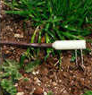

Dual Needle Heat Pulse (DNHP) Technique
Theory
Changes in heat capacity of soil is strongly dependent on water content
Create calibration that relates VWC to heat capacity
Measurement
Use dual needle probe
One needle contains a heater, the other a temperature measuring device
Heat one needle and record temperature over time on the other
Use maximum temperature rise (delta T) to calculate heat capacity and convert to VWC

Slide 15

Dual Needle Heat Pulse Technique
Installation
Push sensor into soil
Make sure needs do not bend during insertion
Connect to datalogger with precision temperature and data analysis/manipulation capabilities

Slide 16
Dual Needle Heat Pulse Technique
Advantages
Small measurement volume
Most location-specific method available
Can measure water content around growing seed
Disadvantages
Requires datalogger with precise temperature measurement and analysis
Can be susceptible to temperature gradients in soil
time
depth
Integrates small soil volume
Fragile
Young et at. (2008) Correcting Dual-Probe Heat-Pulse Readings for Changes in Ambient Temperature, Vadose Zone Journal 7:22-30

Slide 17
Dielectric Theory: How it works
In a heterogeneous medium:
Volume fraction of any constituent is related to the total dielectric permittivity
Changing any constituent volume changes the total dielectric
Because of its high dielectric permittivity, changes in water volume have the most significant effect on the total dielectric
Material | Dielectric Permittivity
Air | 1
Soil Minerals | 3 - 7
Organic Matter | 2 - 5
Ice | 5
Water | 80

Slide 18
Dielectric Mixing Model: FYI
The total dielectric of soil is made up of the dielectric of each individual constituent
The volume fractions, V_{x}, are weighting factors that add to unity
Where ε is dielectric permittivity, b is a constant around 0.5, and subscripts t, m, a, om, i, and w represent total, mineral soil, air, organic matter, ice, and water.

Slide 19
Volumetric Water Content and Dielectric Permittivity
Rearranging the equation shows water content, θ, is directly related to the total dielectric by
Take home points
Ideally, water content is a simple first-order function of dielectric permittivity
Generally, relationship is second-order in the real world
Therefore, instruments that measure dielectric permittivity of media can be calibrated to read water content

Slide 20
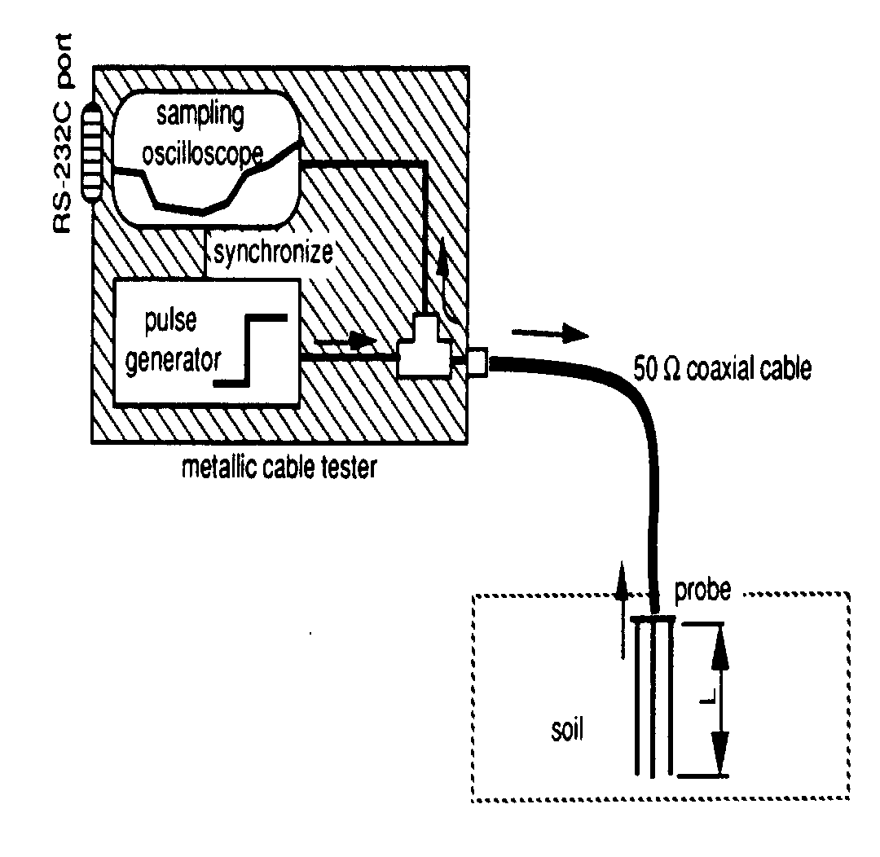

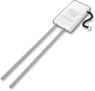
Dielectric Instruments: Time Domain Reflectometry

Slide 21
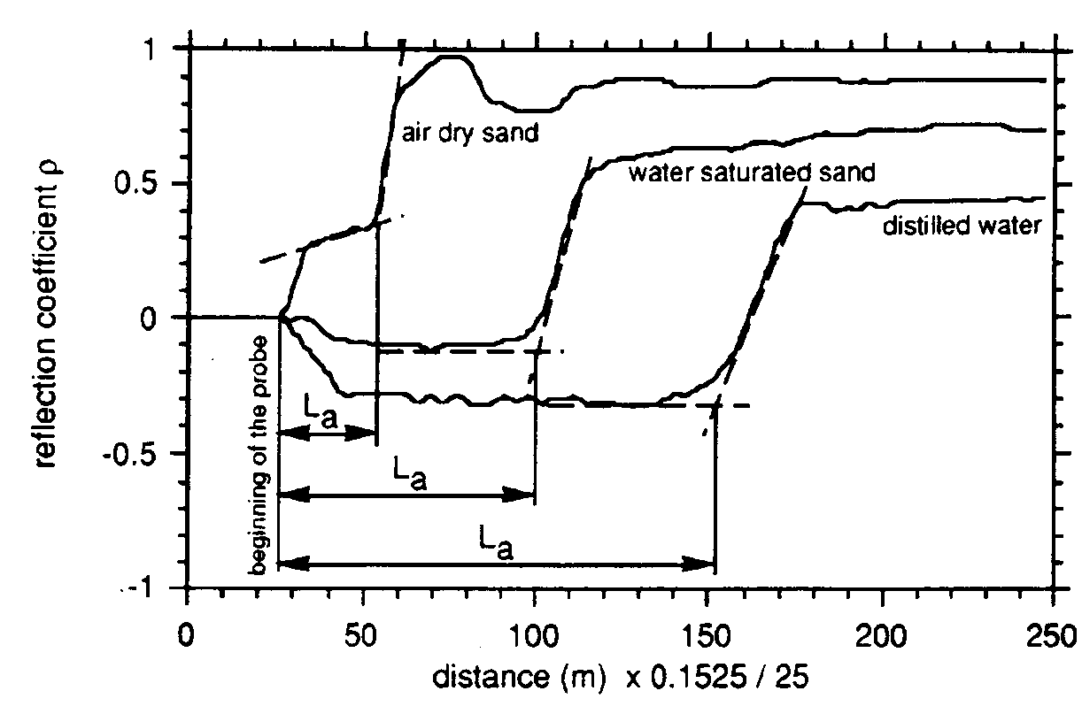
Dielectric Instruments: Time Domain Reflectometry
Measures apparent length (L_{a}) of probe from an EM wave propagated along metallic rods
L_{a} is related to ε and therefore θ

Slide 22
Time Domain Reflectometery
Advantages
Calibration is relatively insensitive to textural difference
Output wave provides electrical conductivity information
Good accuracy
Insensitive to salinity changes when EC is low to moderate.
Disadvantages
Expensive
Does not work at high EC (trace will flatten)
Requires waveform analysis (comes with most packages)
Sensitive to gaps in soil contact

Slide 23
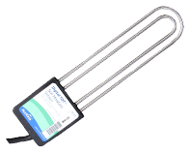
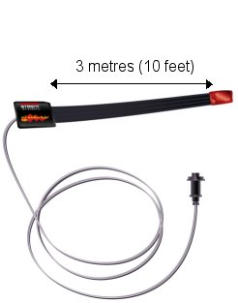
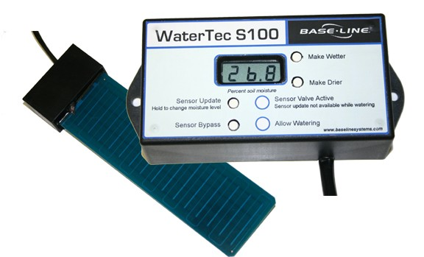
Time Domain Transmission Sensors
Variation of time domain reflectometry
Look at transmission of wave around loop instead of reflection
Utilize fast response circuitry to digitize waveform using onboard sensor
Output dielectric permittivity

Slide 24
Time Domain Transmission
Advantages
Lower sensitivity to temperature variation
Little salinity affect at low to medium electrical conductivity (EC) levels
Lower cost
Disadvantages
Small volume of influence
Limited field in the soil
Cannot be installed into undisturbed soil
Lose signal at high soil ECs

Slide 25
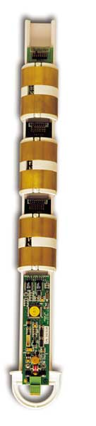

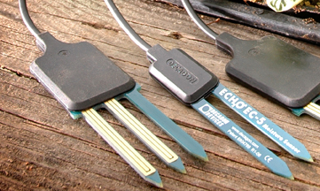

Dielectric Instruments: Capacitor/FDR Sensor Basics
Sensor probes form a large capacitor
Steel needles or copper traces in circuit board are capacitor plates
Surrounding medium is dielectric material
Electromagnetic (EM) field is produced between the positive and negative plates

Slide 26
Typical Capacitor
Capacitor
Dielectric Material
Positive Plate
Negative Plate
Electromagnetic Field

Slide 27
Example: How Capacitance Sensors Function
2 cm
Sensor (Side View)
1 cm
EM Field
0 cm

Slide 28
Getting to Water Content
Charging of capacitor directly related to dielectric
Sensor circuitry converts capacitor charge to an output of voltage or current
Sensor output is calibrated to water content using the direct volumetric water content method discussed earlier

Slide 29
Capacitance/FDR
Advantages
Lower cost
Require simple readout device
Easy to install/use
Best resolution to changes in water content of any method
Resolve changes of 0.00001 m³ m⁻³
Low Power
Disadvantages
Some probes are sensitive to soil texture and temperature fluctuations
Depends on probe measurement frequency
Some require down-hole installation
Sensitive to air gaps in soil contact

Slide 30
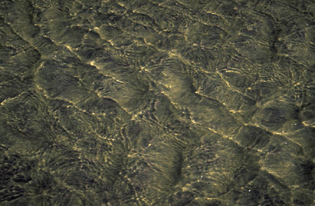
Sensor Installation
Three types of instruments
Access tube
Permanent installation
“Push-in and Read”
Access Tube
Auger hole to installation depth
Insert access tube sleeve into hole
Air gaps MUST be minimized during installation of sleeve
Install dielectric probe in sleeve and seal OR lower dielectric probe into sleeve at depths of interest

Slide 31
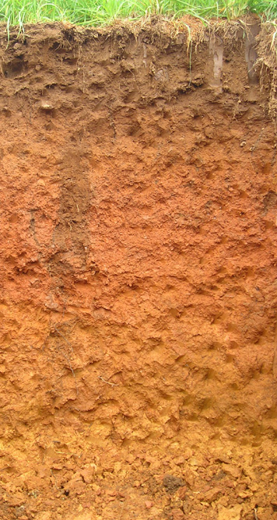

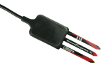
Permanent Installation
4
2
3
Many techniques for sensors installation
Trench wall
5 cm diameter auger hole: bottom
10 cm diameter auger hole: side wall
45º angled 5 cm auger hole: bottom
Sensor insertion
Sensor width must be vertical not horizontal
1
Install video: www.decagon.com/videos
Notes:
I will not be spending a lot of time on installation.
It is important, but was covered in another virtual seminar.
Still, I would like to discuss some techniques to give some background to our case studies.

Slide 32
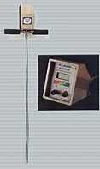
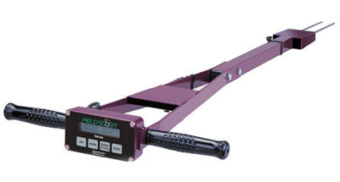
Sensor Installation
“Push-in and Read” Sensors
Purpose
Spot measurements of VWC
Many measurements over large area
No need for data on changes in VWC over time
Technique
Push probe into soil
Ensure adequate soil to probe contact
Take reading from on-board display

Slide 33
Question: What Technique is Best for My Research?
Answer: It depends on what you want.
Every technique has advantages and disadvantages
All techniques will give you some information about water content
So what are the important considerations?
Experimental needs
How many sites? How many probes at each site?
Current inventory of equipment
What instruments are available or can by borrowed
Budget
How much money can be spent to get the data?
Required accuracy/precision
Manpower available to work
Certification
People available certified to work with radioactive equipment

Slide 34
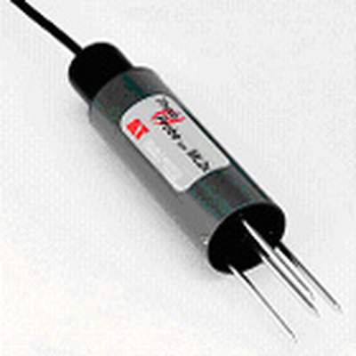
Examples: Applying Techniques to Field Measurement
Case 1: Irrigation scheduling/monitoring
Details
20+ sites, measurements from .25 m to 2 m
Spread over field system
Continuous data collection is desirable
Money available for instrumentation
Eventually moving to controlling irrigation water
Choice
Capacitance sensors
Good accuracy
Inexpensive
Easy to deploy into undisturbed soil
Radio telemetry available to simplify data collection

Slide 35
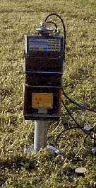
Examples: Applying Techniques to Field Measurement
Case 2: Plot monitoring
Details
20 measurement locations, 4 m spacing
VWC measurements at several depths in each location
Measurements required at least daily
Labor available to collect data
Limited budget
Decision
Neutron probe
Accurate
Cost is price of instrument
Measures at multiple depths in access tube
Reliable

Slide 36
Examples: Applying Techniques to Field Measurement
Case 3: Geostatistical survey of catchment water content
Details
Point measurement of water content at statistically significant intervals across a catchment
Low budget
Labor available to take measurements
Spatial variability key to analysis
Decision
Single “Push-in and Read” capacitance instrument
Low cost, easy to use
No installation necessary
Standard calibration available

Slide 37

Examples: Applying Techniques to Field Measurement
Case 4: Ecosystem water balance
Details
Studying water balance in ecosystem
Soil texture changes significantly with depth
Need detailed analysis of water moving through single profile
Point measurements of water content at several other locations throughout ecosystem
Budget available
Decision
TDR or multifunctional sensor at detailed water content site
Calibration relatively insensitive to textural changes
Output can be analyzed for salinity changes
Capacitance at remote locations
Datalogging and sensors much less expensive
Improved sensing technology has made some capacitance sensors relatively insensitive to textural changes too.

Slide 38
Conclusion
Many choices for field water content measurement
Several things must be considered to get the right system
Many resources available to make decisions
Manufacturer’s websites
Listservs/Google Group
http://www.sowacs.com
AgSciences Google Group: send email to agscience@googlegroups.com
Application scientists

Slide 39
Which Measurement Technique is Best? Comparison Chart
 | Neutron Probe | TDR | TDT | Capacitance
Sensor Costs | Readout and Probe: $5000 | Reader: $4-8K Probe: $100+ | Reader: $600++, Probe: $180 - $1000 | Reader: $150++ Probe: $60-$2000
Time to Install | 30 min to 1 h per site | 15 to 2 h per site | 15 to 2 h per site | 15 min to 2 h per site
Installation Pitfalls: Air gaps | Minor problem | Major problem | Major problem | Major problem
Sphere of influence: Radius | Dry: 50 cm Wet: 10 cm | 0.5 to 2 cm radius | 0.5 cm radius | 0.5 to 2 cm radius
Install into undisturbed soil? | Yes | Yes | No | Yes

Slide 40
Which Measurement Technique is Best? Comparison Chart
 | Neutron Probe | TDR | TDT | Capacitance
Data Logging? | None | Specialized reader | Digital communication | Standard data logger
Calibration | Required for best accuracy | Required for best accuracy | Required for best accuracy | Required for best accuracy
Accuracy | +/- 0.03 m³ m⁻³ Increases with calib. | +/- 0.03 m³ m⁻³ Increases with calib. | +/- 0.03 m³ m⁻³ Increases with calib. | +/- 0.03 m³ m⁻³ Increases with calib.
Temperature Sensitivity | Insensitive | Soil dependent, can be significant | Soil dependant, can be significant | Soil/sensor dependent, can be significant
Salinity Sensitivity | Insensitive | Low levels: low; High levels: Fails | Low levels: low; High levels: Fails | Low levels: low; High levels: low to high, probe specific

Slide 41
Appendix: Real and Imaginary Dielectric
Apparent permittivity contains a capacitive and conductive component
Ionic conductivity (σ) is driven by ions in the soil and charged clay surfaces
σ is strongly dependent on temperature
Ionic affect decreases with measurement frequency
Where:
κ_{a} is apparent dielectric permittivity
κ’ and κ’’ are the real and imaginary portion of dielectric constant, respectively
σ is the ionic conductivity
ω is angular frequency and ε_{o} is permittivity of free space

Slide 42
Applications
Irrigation scheduling and control
Ecosystem/crop water balance
Water use, efficiency
Hydrologic monitoring
Hydropedology
Catastrophic event monitoring

Slide 43
What can I expect to see in the field?
Data courtesy of W. Bandaranayake and L. Parsons,
Univ. of Florida Citrus Research and Education Center

