Slide 1
Why does my soil moisture sensor read negative?
Improving accuracy of dielectric soil moisture sensors
Douglas R. Cobos, Ph.D.
Decagon Devices and
Washington State University

Slide 2
Outline
Introduction
  VWC definition
  Direct vs. indirect measurement methods
  Dielectric permittivity for measuring VWC
Accuracy
  Definitions and scope
  Approach to accuracy analysis (mixing model)
Sensor (dielectric permittivity) accuracy
Converting dielectric permittivity to VWC
Installation quality and techniques

Slide 3

Volumetric water content
Volumetric Water Content (VWC): Symbol – θ
V_{water} /V_{soil}
Air
0.15 m³
0.35 m³
Water
0.50 m³
Soil minerals
= 0.35 m³ water / 1 m³ total soil volume
= 0.35 m^{3/}m³ or 35% VWC

Slide 4
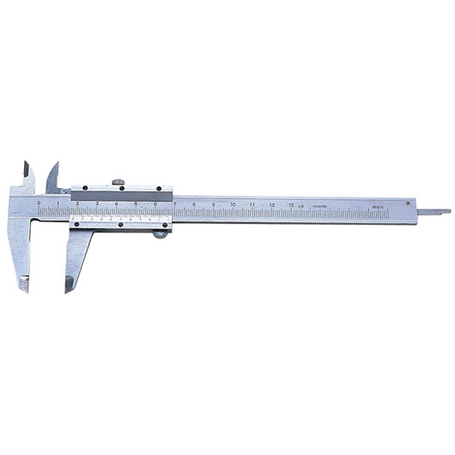
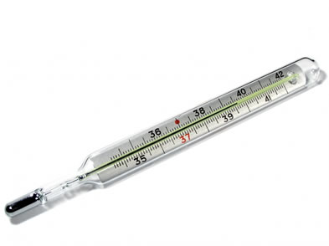
Measurement techniques
Direct measurements
  Directly measure the property
  e.g. length with calipers
Indirect measurements
  Measure another property and relate it to the property of interest through a calibration
  e.g. expansion of liquid in a tube to determine temperature

Slide 5
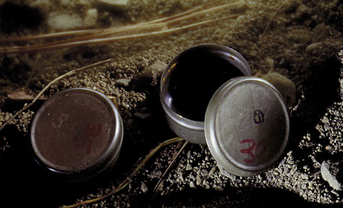
Direct measurement of VWC
Volumetric water content (θ)
  Obtain moist soil sample with known volume
  Weigh moist sample
  Dry sample at 105º C for 24 h
  Weigh dry sample

Slide 6
Dielectric theory: How it works
In a heterogeneous medium:
  Volume fraction of any constituent affects total (bulk)dielectric permittivity
  Changing any constituent volume changes the total dielectric
  Changes in water volume have the most significant effect on the total dielectric
Material | Dielectric Permittivity
Air | 1
Soil Minerals | 3 - 16
Organic Matter | 2 - 5
Ice | 5
Water | 80

Slide 7
Relating dielectric permittivity to VWC

Slide 8
Outline
Introduction
  VWC definition
  Direct vs. indirect measurement methods
  Dielectric permittivity for measuring VWC
Accuracy
  Definitions and scope
  Approach to accuracy analysis (mixing model)
Sensor (dielectric permittivity) accuracy
Converting dielectric permittivity to VWC
Installation quality and techniques

Slide 9

Accuracy
Resolution - The smallest change that can be detected
Precision - The degree of reproducibility of measurement
Accuracy - How close the measured value is to the actual (absolute) value

Slide 10
Accuracy (of what measurement?)
What does it mean?
  Dielectric permittivity accuracy?
  VWC accuracy
Questions:
Why might a sensor read a negative VWC?
Can a sensor really have 2% VWC accuracy for all soils?

Slide 11
Approach to accuracy analysis
Use generalized dielectric mixing model
Set default mixing model parameters to realistic values
Vary model parameters over normal values and see how they affect measured VWC

Slide 12
Generalized dielectric mixing model
ε is the apparent dielectric permittivity.
x is the volume fraction.
The subscripts b, a, m, and w refer to bulk, air, mineral and water

Slide 13
Generalized dielectric mixing model
By rearranging, we can get an equation relating θ to:
ε_{b} Bulk soil permittivity (sensor accuracy)
ρ_{b} Bulk density of soil
ε_{m} Permittivity of minerals
ρ_{s} Particle density
ε_{w} Permittivity of water

Slide 14
Mixing model default parameters
Mixing model parameter | Value
α | 0.65
ε_{air} | 1
ε_{mineral} | 4
ε_{water} | 78.5
ρ_{b} | 1.4 g/cm³
ρ_{mineral} | 2.65 g/cm³

Slide 15
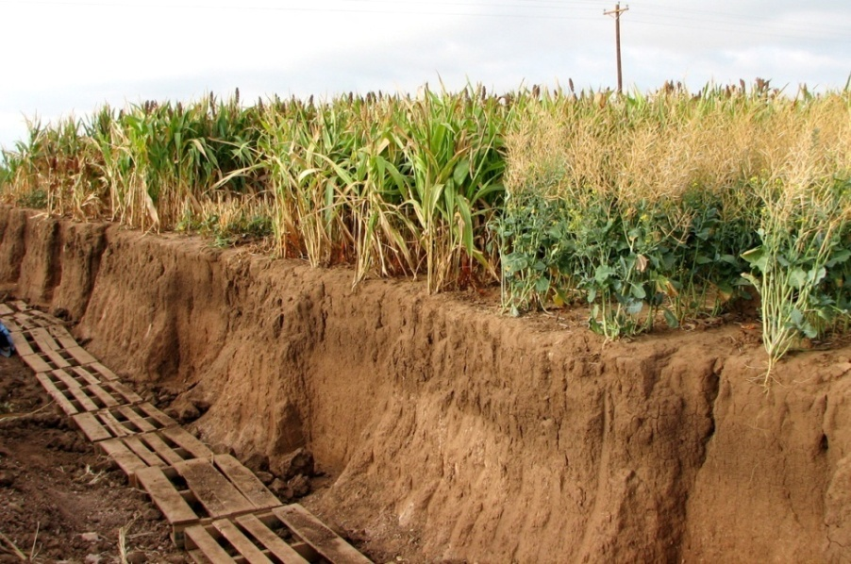
Factors affecting VWC accuracy
Sensor’s ability to measure dielectric permittivity accurately (sensor accuracy)
Relationship between dielectric permittivity and VWC
Installation quality

Slide 16
Outline
Introduction
  VWC definition
  Direct vs. indirect measurement methods
  Dielectric permittivity for measuring VWC
Accuracy
  Definitions and scope
  Approach to accuracy analysis (mixing model)
Sensor (dielectric permittivity) accuracy
Converting dielectric permittivity to VWC
Installation quality and techniques

Slide 17
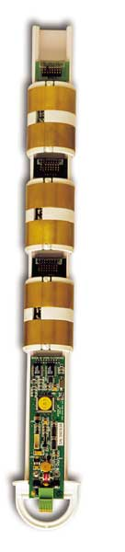
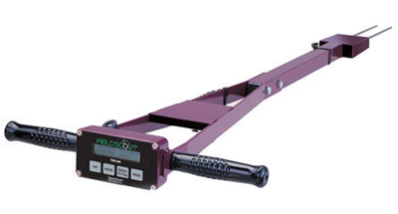
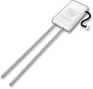
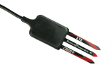
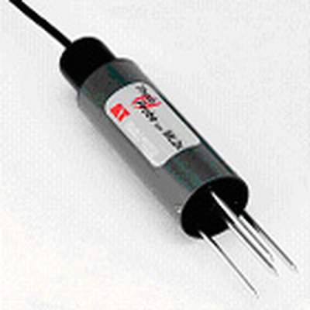
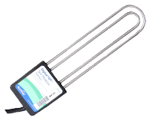
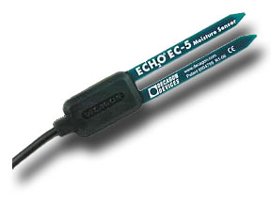

Sensor accuracy
Accuracy with which sensor measures dielectric permittivity
This is the ONLY specification that the sensor manufacturer can give

Slide 18
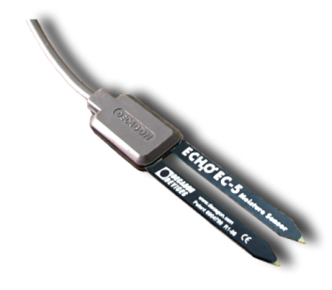



Sensor accuracy:
Sensor-sensor repeatability
Manufacturer must control processes so that all sensors read the same
  EC-5, 10HS
Some sensors are calibrated against dielectric permittivity standards to improve repeatability
  Calibration drives up cost
  5TE, 5TM, GS3, RS3

Slide 19
Sensor Accuracy:
Electrical conductivity (salt) effects
Depends on the ability of the sensor to separate real (capacitive) and imaginary (conductive) components of dielectric permittivity
Low frequency sensors, such as the discontinued EC-10 and EC-20 (5 MHz) have high sensitivity to salts
With new higher frequency sensors (70-100 MHz), effects are small except in saline soils

Slide 20
Sensor Accuracy:
Temperature effects
Sensor electronics must have negligible inherent temperature sensitivity
Permittivity of water is temperature dependent (negative correlation)
Electrical conductivity of soil solution is highly temperature dependent (positive correlation)
Impossible to compensate in electronics
Must do correction during data analysis

Slide 21
Sensor (ε) accuracy effect on θ_{meas} accuracy
Sensor accuracy spec for 5TE/5TM sensor: ±1 ε (unitless) from ε = 1 to 40
Resulting error ±0.03 m³/m³ at dry end to ±0.01 m³/m³ at wet end
Mixing model parameter | Value
α | 0.65
ε_{air} | 1
ε_{mineral} | 4
ε_{water} | 78.5
ρ_{b} | 1.4 g/cm³
ρ_{mineral} | 2.65 g/cm³

Slide 22
Outline
Introduction
  VWC definition
  Direct vs. indirect measurement methods
  Dielectric permittivity for measuring VWC
Accuracy
  Definitions and scope
  Approach to accuracy analysis (mixing model)
Sensor (dielectric permittivity) accuracy
Converting dielectric permittivity to VWC
Installation quality and techniques

Slide 23
Converting dielectric permittivity to VWC
Commonly called a calibration equation
Each soil has a different relationship
  Most mineral soils have similar relationship
  Relationship generally determined empirically
  Topp equation used extensively
Sensor manufacturer cannot control or specify this relationship

Slide 24
Errors from ε to θ_{meas} conversion
Effect of bulk density on accuracy
Bulk density of soils varies widely
  Agricultural soils can range from 0.8 to 1.8 g/cm³
  This represents ±2% VWC error
  In organic, volcanic, or compacted soils the error can be much larger
Mixing model parameter | Value
α | 0.65
ε_{air} | 1
ε_{mineral} | 4
ε_{water} | 78.5
ρ_{b} | 0.8 to 1.8 g/cm³
ρ_{mineral} | 2.65 g/cm³

Slide 25
Errors from ε to θ_{meas} conversion
Effect of mineral permittivity on accuracy
Dielectric permittivity of minerals typically 3-7
  This represents ±2.5% VWC error
  Titanium minerals can have permittivity of over 100!
Mixing model parameter | Value
α | 0.65
ε_{air} | 1
ε_{mineral} | 3 - 7
ε_{water} | 78.5
ρ_{b} | 1.4 g/cm³
ρ_{mineral} | 2.65 g/cm³

Slide 26
Errors from ε to θ_{meas} conversion
Effect of permittivity of water on accuracy
Dielectric Permittivity ~80 at room temperature.
  The dielectric decreases with increasing temperature at about 0.5%/ºC
  Error 0 in dry soil to ±0.03 m³/m³ in wet soil
Mixing model parameter | Value
α | 0.65
ε_{air} | 1
ε_{mineral} | 4
ε_{water} | 71 – 85 (45 to 5 °C)
ρ_{b} | 1.4 g/cm³
ρ_{mineral} | 2.65 g/cm³

Slide 27
Accuracy of permittivity/VWC relationship
Effect of dielectric permittivity of water (continued)
Water that is “bound” to particles or organic matter has lower apparent permittivity than “free” water
  Largest error in clay soils or high organic soils
  Higher frequency dielectric sensors (TDR, TDT) more significantly affected
  Capacitance or frequency domain sensors generally not affected

Slide 28
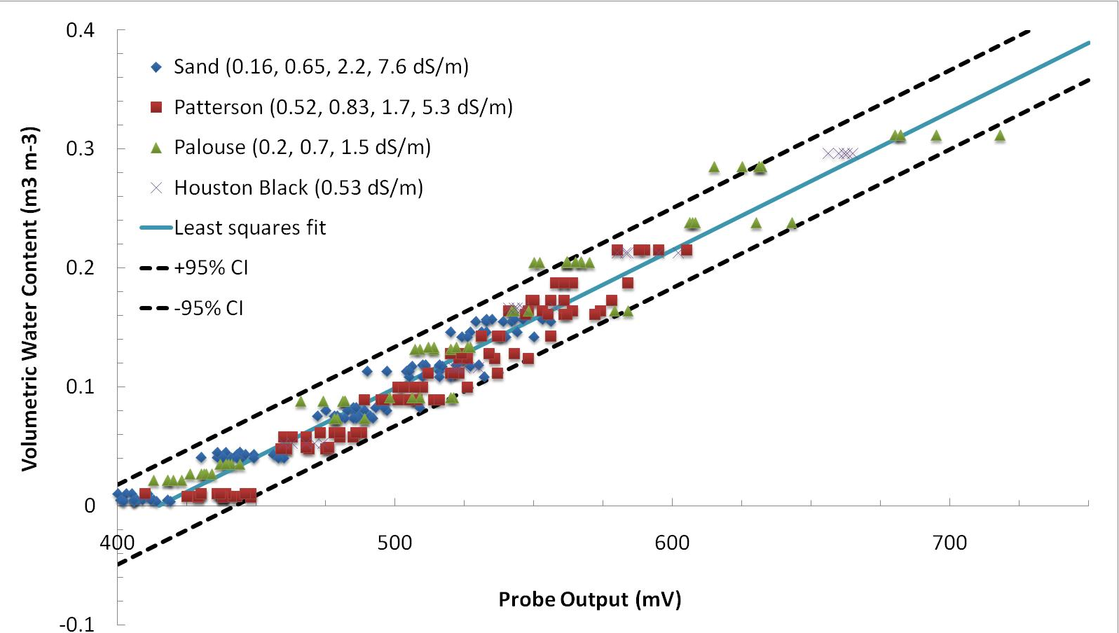
Generic calibrations
What we typically expect in mineral soil
Kizito et. al (2008)

Slide 29
Generic calibrations fail when:
Saturation extract EC is greater than ~8 dS/m
Your soils are not “typical” soils
  Organic soils
  Volcanic soils
  Odd mineralogy (e.g. titanium) soils
  Non-soil media (potting soil, peat, rockwool, perlite, cocus, etc.)
Your study requires better than about 0.03 m³/m³ accuracy

Slide 30
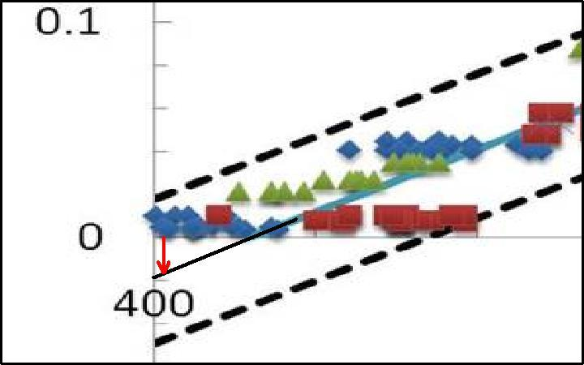
Why do my sensors read negative?
Generic calibration doesn’t match your soil
Kizito et. al (2008)

Slide 31
Soil-specific calibrations
  Several methods are commonly tried
  Some produce good results, some don’t
    Dry down method (and modifications of this method)
    Homogenized soil calibration

Slide 32
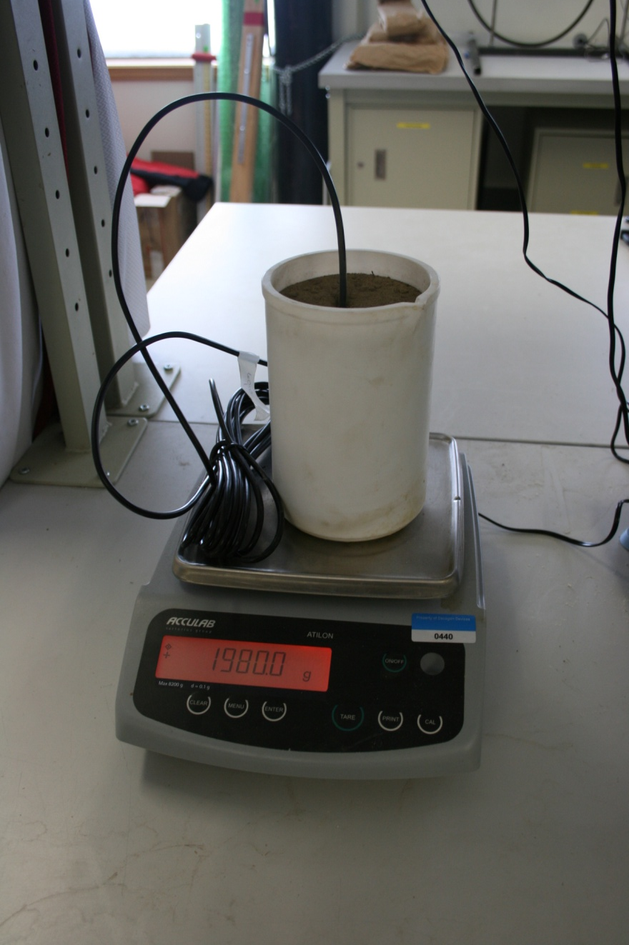
Soil-specific calibrations
Dry down method
  Sensors are placed in saturated soil in a large container
  Container is weighed to calculate actual volumetric water content
  “Actual volumetric water content” is correlated with sensor output

Slide 33
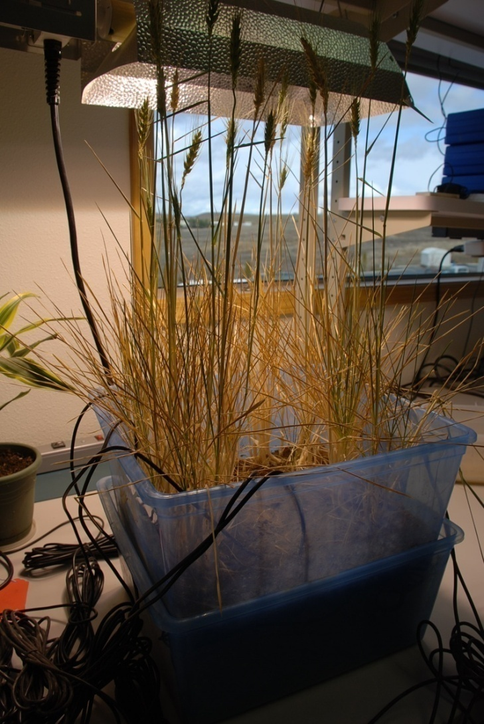
Soil-specific calibrations
Dry down method
Benefits
Appears to mimic environmental conditions
Soil disturbance is minimized
Limitations
Results highly dependent upon where the sensor is within the container (drying front)
Drying can take weeks
Almost never gives good results

Slide 34
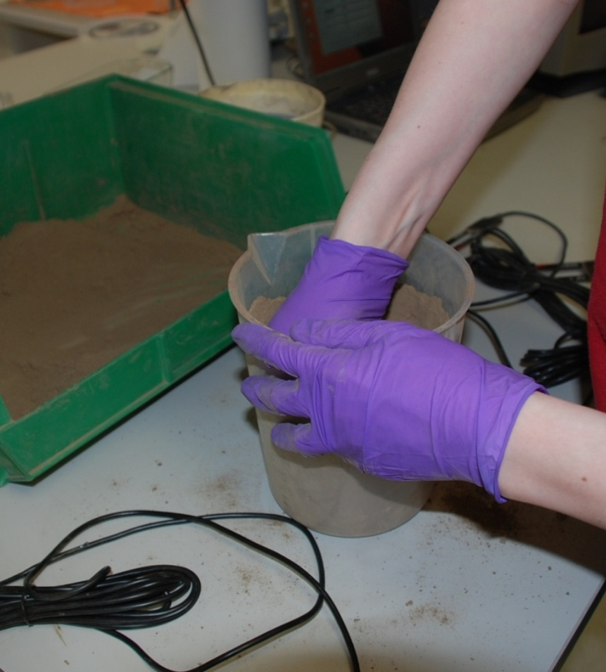
Soil-specific calibrations
Homogenized soil method (recommended)
Pack dry soil to desired bulk density

Slide 35
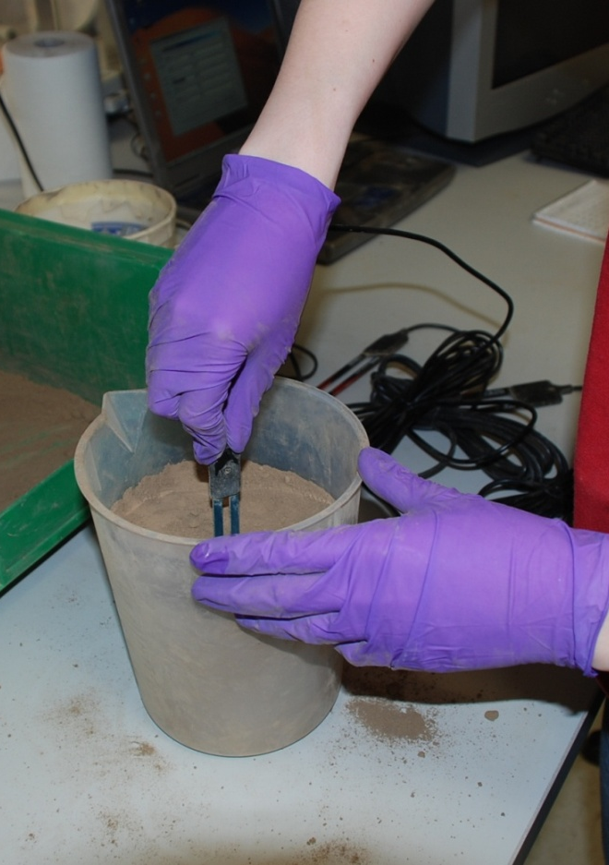
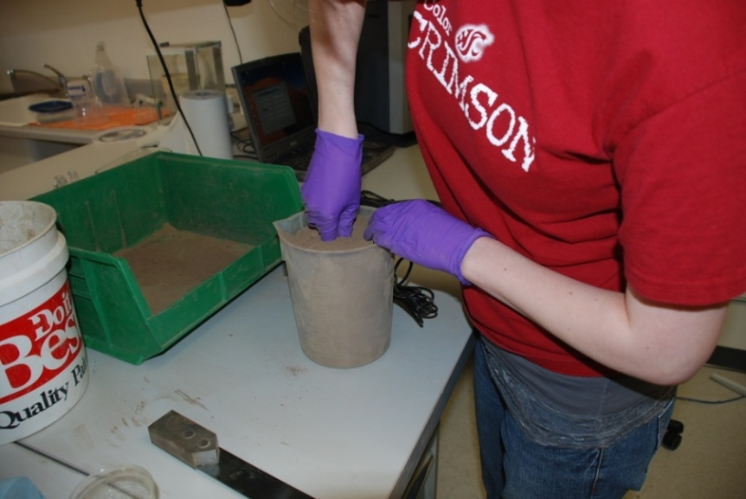
Soil-specific calibrations
Homogenized soil method (recommended)
Carefully insert sensor and record output (multiple times)

Slide 36
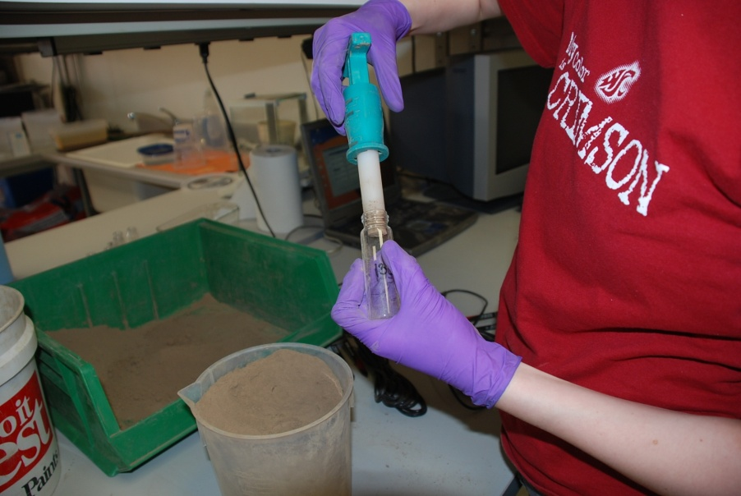
Soil-specific calibrations
Homogenized soil method (recommended)
Collect known volume(s) of soil to obtain true (absolute) VWC by oven drying

Slide 37
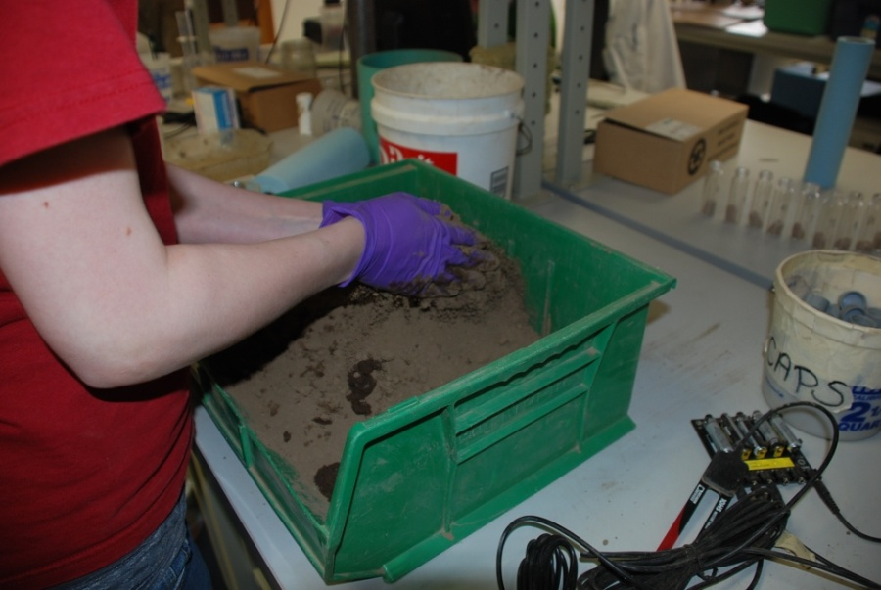
Soil-specific calibrations
Homogenized soil method (recommended)
Add enough water to increase VWC by about 0.1 m³/m³ and thoroughly homogenize
Repeat

Slide 38
Soil-specific calibrations
Homogenized soil method
Benefits
Homogenized soil prevents VWC heterogeneity in sample
Volumetric sub-samples give true VWC by direct oven drying method
No specialized equipment needed
Limitations
Disturbed soil sample
Bulk density hard to control as water is added to soil
Volumetric sub-samples impossible to collect in some materials

Slide 39
Soil-specific calibrations
Homogenized soil method
We highly recommend the homogenized method to customers
  Step-by-step instructions at www.Decagon.com
  Calibration service offered (hundreds of soils/non-soil media calibrated)
With care, should be able to get VWC accuracy to ±0.01 m³/m³

Slide 40
Outline
Introduction
  VWC definition
  Direct vs. indirect measurement methods
  Dielectric permittivity for measuring VWC
Accuracy
  Definitions and scope
  Approach to accuracy analysis (mixing model)
Sensor (dielectric permittivity) accuracy
Converting dielectric permittivity to VWC
Installation quality and techniques

Slide 41
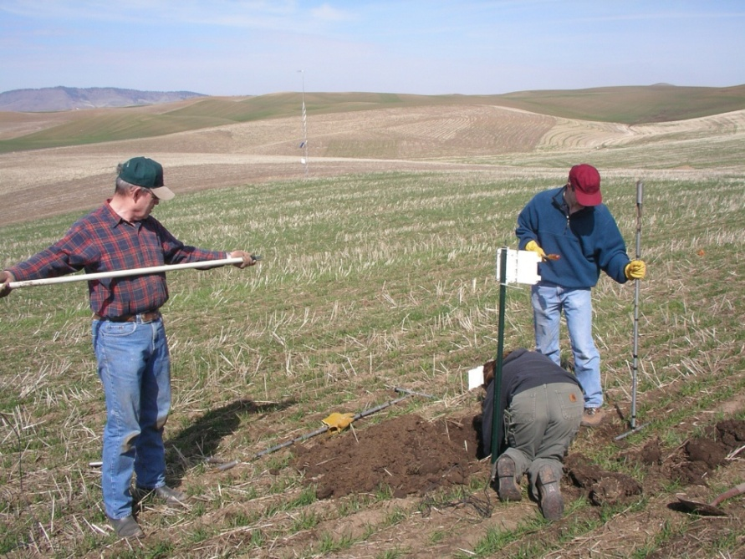
Installation quality
The single largest source of error in measured VWC is poor installation!

Slide 42
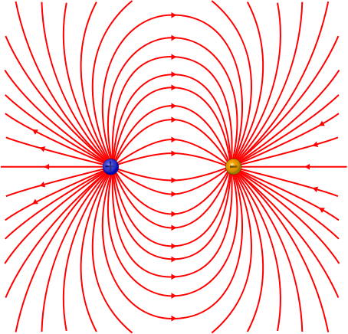
Installation – sensitivity of measurement

Slide 43
Installation quality
Voids
Typically occur near sensor where sensitivity is greatest
  VWC underestimated
  Often results in negative VWC measurement
    Error can be 0.1 m³/m³ or more

Slide 44
Installation quality
Bulk density
Earlier analysis showed effect of bulk density on measured dielectric/VWC
Disturbed or repacked soil often has different bulk density
Insert sensor into undisturbed soil

Slide 45
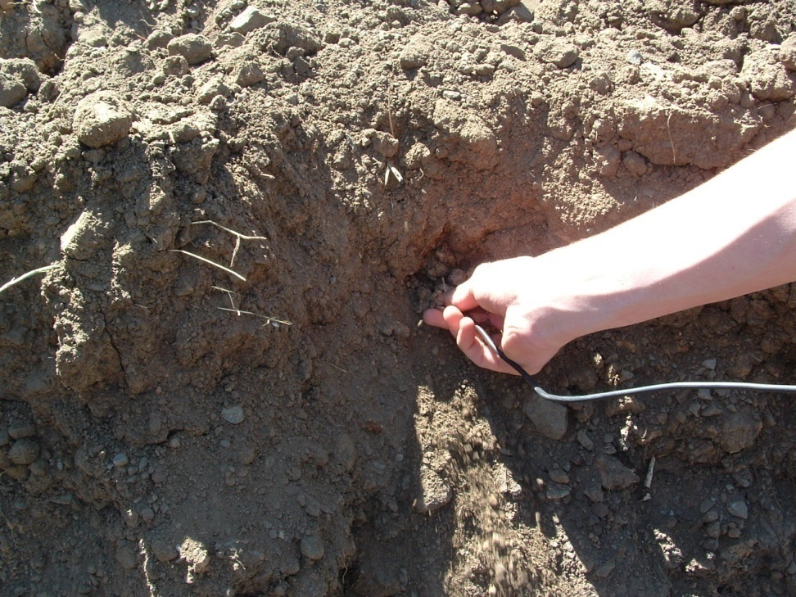
Proper installation
Sidewall
Dig trench to desired depth
Carefully insert sensor into undisturbed side wall
Backfill trench at native bulk density

Slide 46
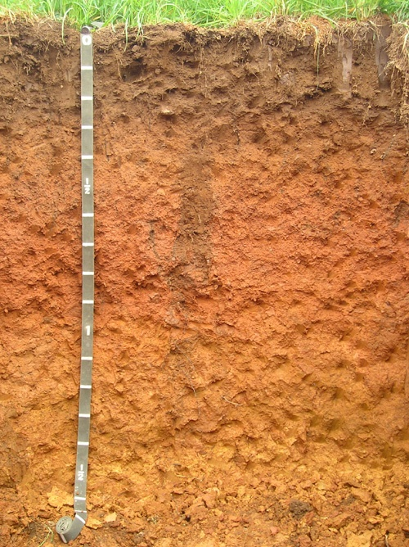
Proper installation
Sidewall
Advantages
  Visual and tactile confirmation of quality insertion
  Undisturbed soil above sensor
  Horizontal insertion measures VWC at discrete depth
  Common and accepted method
Disadvantages
  Large excavation (effort)
  Large scale soil disturbance

Slide 47

Proper installation
Down hole
Auger hole to desired depth
  Often 45˚ angle
Insert sensor into undisturbed soil in bottom of hole
Carefully backfill hole at native bulk density

Slide 48
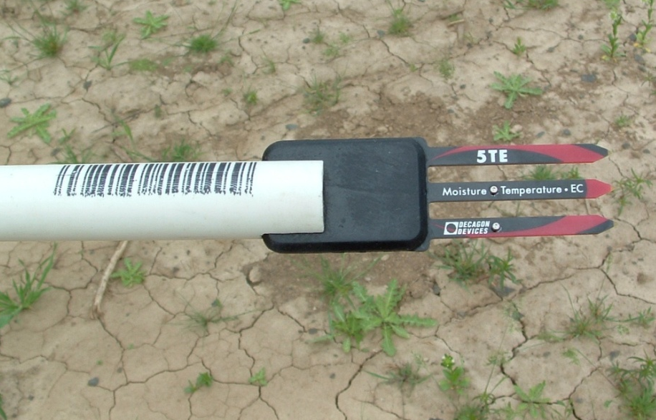
Proper installation
Down hole
Advantages
  Deep installations possible
  Minimal soil disturbance
Disadvantages
  Impossible to verify quality installation
  One hole per sensor
  Installation tool necessary

Slide 49
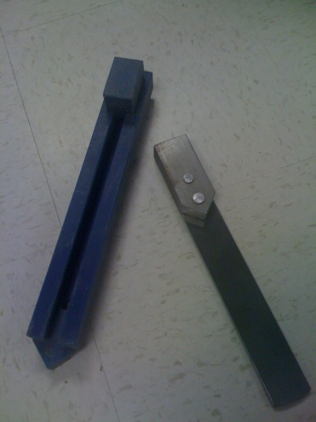
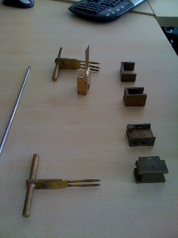
Installation
Hard or stony soils
Hard soils
  Use tool to make pilot hole
  Must be slightly smaller than sensor
Stony soils
  Sieve stones from a volume of soil
  Re-pack sieved soil around sensor
    Disturbed sample
    Possible poor accuracy
    Still measures dynamics well

Slide 50
4th source of error – point vs. field scale
(I know I said I was only going to talk about 3)
All dielectric sensors have small measurement volume (10’s to 100’s of cm³)
Scaling point measurements to representative field scale measurement is difficult
  Replicated measurements and averaging
  Other strategies available
  Whole topic is outside the scope of this discussion

Slide 51
Take-home points
3 sources of error in VWC measurement
  Sensor error
    How accurately the sensor measures dielectric permittivity
    Only factor that can be controlled by manufacturer
  Dielectric permittivity to VWC conversion
    Depends on bulk density, temperature, mineralogy
    Generic calibrations work for most “typical” soils
    Soil-specific calibration necessary in some cases

Slide 52
Take-home points

Slide 53
Take-home points

