Slide 1
Decagon Devices Environmental Research Instruments
Matt Galloway
Decagon Devices, Inc.
Pullman, WA USA

Slide 2
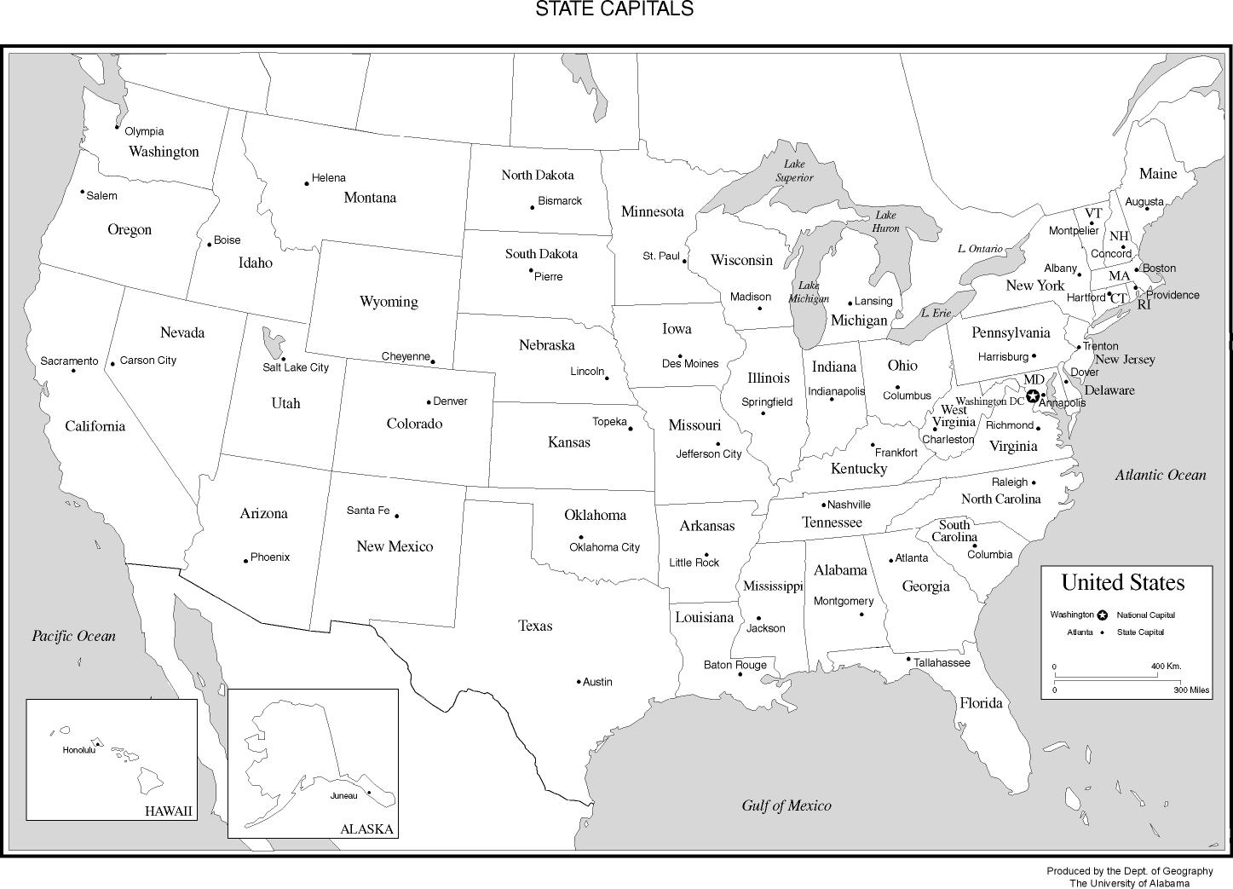
Where is Decagon?

Slide 3

Washington State University, Pullman

Slide 4

The Palouse region, Washington, USA

Slide 5
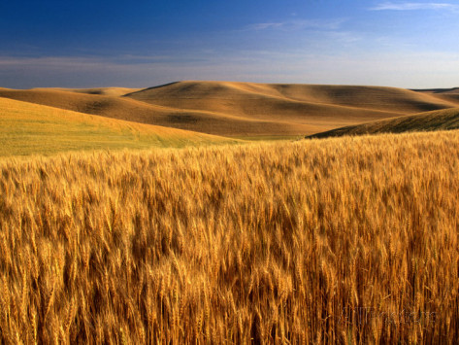

Slide 6
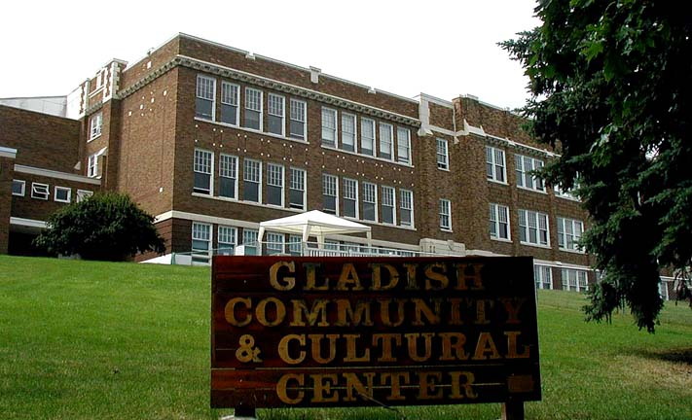
Decagon History

Slide 7
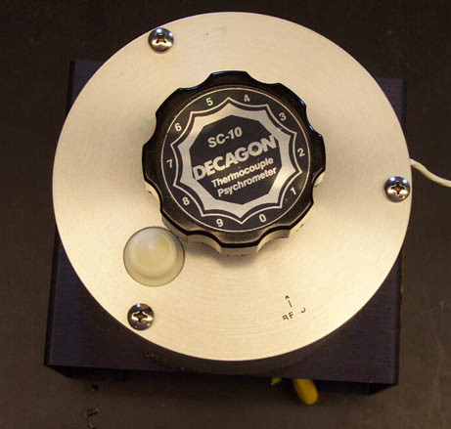

Slide 8
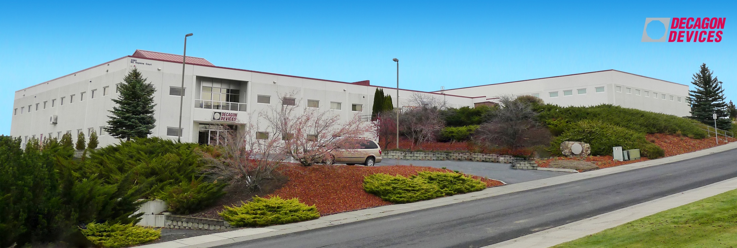
Now 180+ employees
Notes:
8

Slide 9
Decagon’s Mission
Develop innovative, simple, and accurate instruments that solve problems for environmental researchers

Slide 10
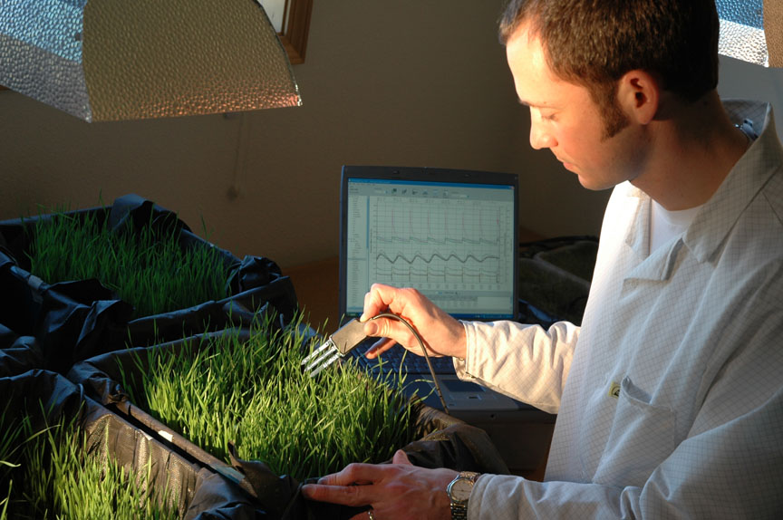
Decagon’s assets: Scientific Expertise

Slide 11
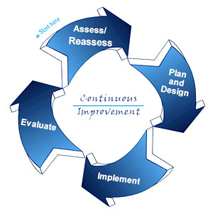
Decagon’s Assets: 改善: Kaizen
Continual improvement: in design, manufacturing, and all processes

Slide 12
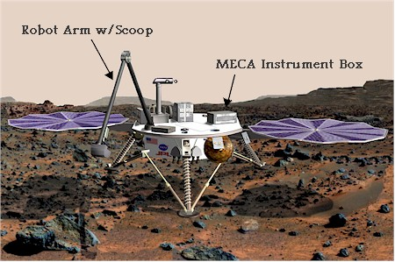
Decagon’s Thermal and Electrical Conductivity Probe (TECP): 2007 Mars Lander
Notes:
12

Slide 13
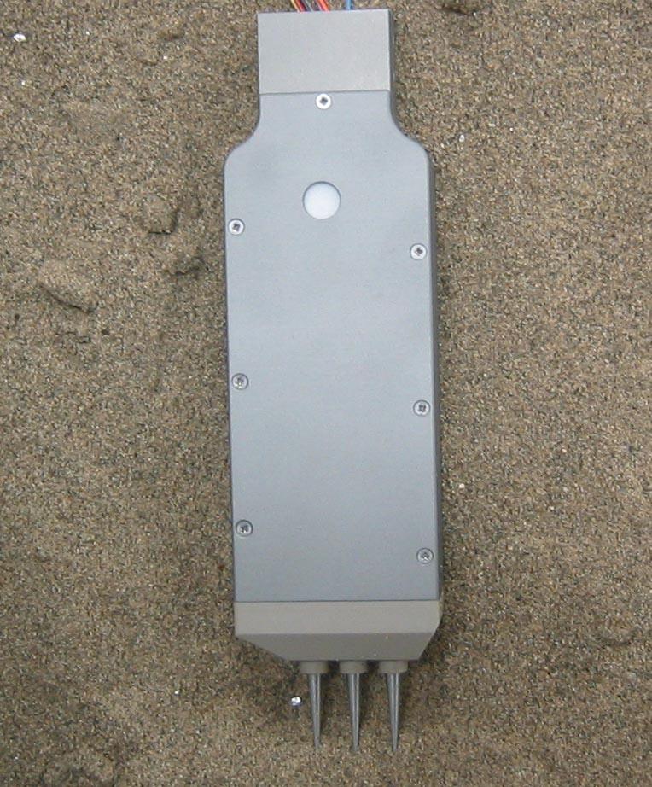
TECP objectives
Learn more about how heat flows in Martian regolith
Ground-truth for plentiful remote sensing data
Determine if unfrozen water may exist under sunlit conditions in trench
Answers: “Can liquid water occur on Mars?”
Study vapor phase water transport
Examine how ice migrates from pole to pole
Prototype TECP probe
Notes:
13

Slide 14
Plant Canopy Measurements

Slide 15
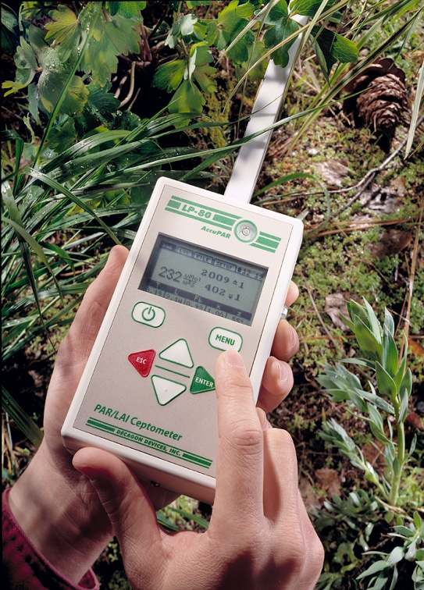
AccuPAR Ceptometer model LP-80
Decagon invented this type of instrument in 1988 (Sunread, Sunscan, PAR-80, LP-80)
What does the AccuPAR Measure?
PAR (Photosynthetically Active Radiation
LAI (Leaf Area Index) calculated using PAR measurements above and below the canopy, and using other variables.

Slide 16
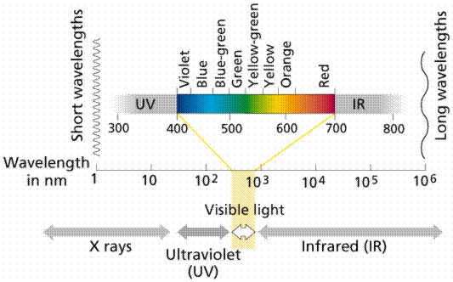
What is PAR?
Acronym for Photosynthetically Active Radiation.
Defined as the light in the 400 to 700 nm range of the spectrum (visible range).
Light that is most useful to plants for photosynthesis.
Expressed by AccuPAR as μmol m⁻² s⁻¹, a measure of photon flux density
Electromagnetic Spectrum

Slide 17
Leaf Area Index (LAI)
What is LAI?
Defined as: total leaf area per unit ground area
Indication of Canopy density, biomass
Used to monitor growth, infestation
Often used for ground-truthing Remote Sensing LAI data

Slide 18
Calculating LAI
AccuPAR calculates LAI based on equations from Goudraan, Norman, and Campbell using measured and supplied data:
Above-canopy PAR
Below-canopy PAR
x (leaf distribution parameter)
Zenith angle (automatically calculated)
F_{b} (fraction of beam radiation)

Slide 19
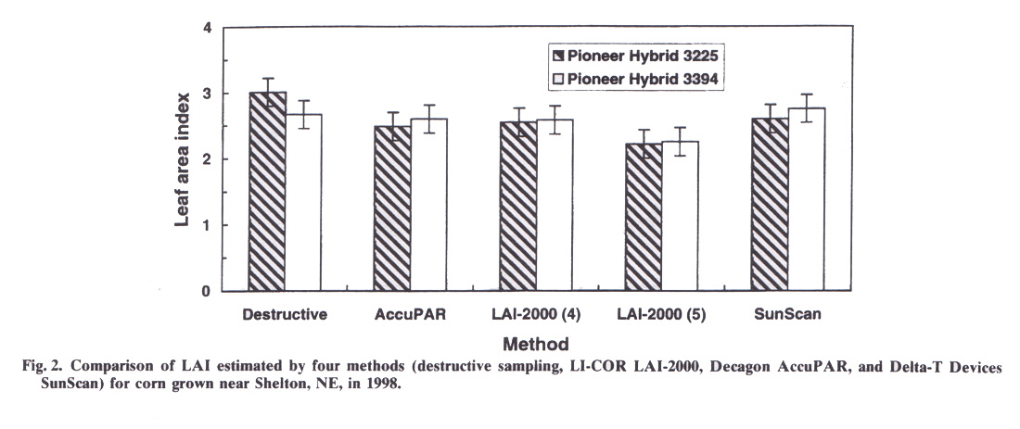
Comparison Studies
“Comparisons of three Leaf Area Index Meters in a Corn Canopy” by W.W. Wilhelm, K. Ruwe, M.R. Schlemmer in Crop Science 40:1179-1183 (2000)
Shows that all three types are similar, AccuPAR/SunScan somewhat better than LAI-2000.

Slide 20
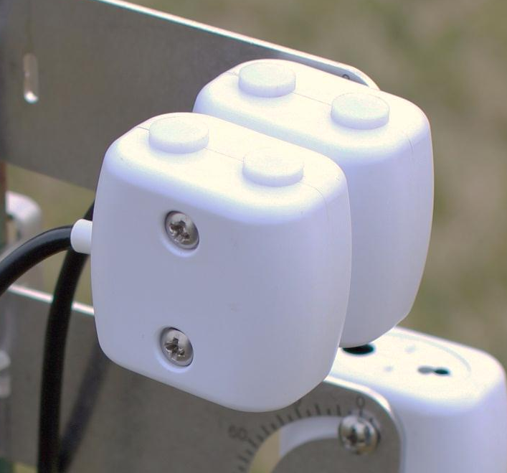
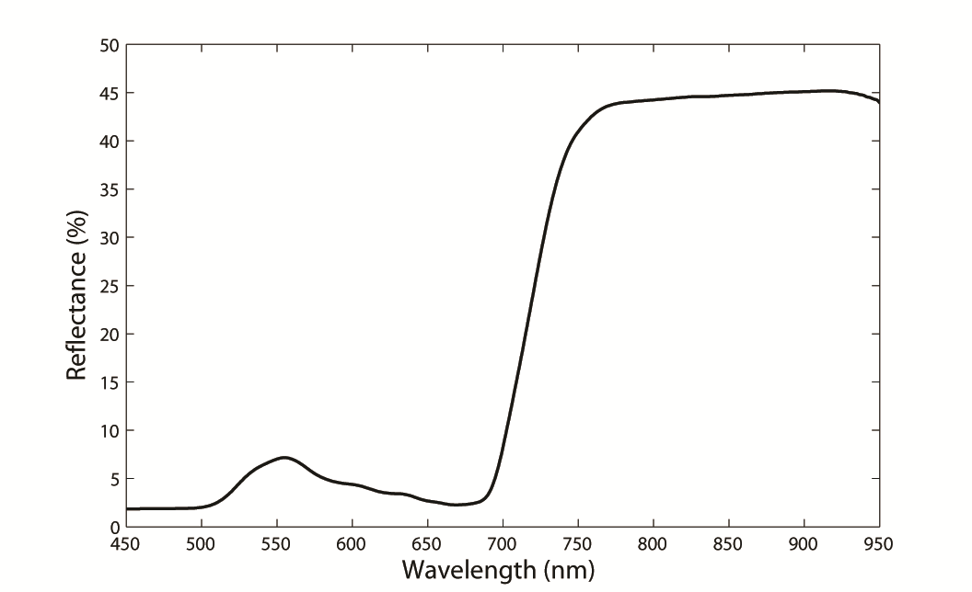
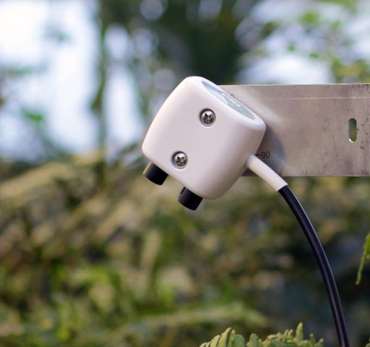
Spectral Reflectance
Sensors (SRS)
NDVI bands: 630 nm and 800 nm center wavelengths
PRI bands: 532 nm and 570 nm center wavelengths
NIST traceable calibration stored onboard
Cosine diffusers for hemispherical measurement
36° sealed field stops for directional measurements
Dimensions: 43 x 40 x 27 mm
Epoxy-sealed sensor body – robust design
SDI-12 digital sensor
Decagon Em50 and CSI datalogger compatible
Stacked SRS sensors
NDVI + PRI
Hemispherical view sensors
PRI
PRI
NDVI
NDVI
Directional field stop sensor

Slide 21
How to Measure NDVI and PRI
PRI
PRI
NDVI
NDVI
NDVI
Only two bands are needed to calculated NDVI or PRI.

Slide 22
Calculating NDVI
NDVI is calculated from measurements of percent reflectance (ρ) in the red and near-infrared (NIR) regions of the electromagnetic spectrum.
Percent reflectance is the ratio between upwelling (from the canopy) to downwelling (from the sky) radiation. Requires a measurement of both.
Red band is related to chlorophyll content (high absorption), NIR band is related to leaf cell structure (high scattering).
NDVI values range from -1 to 1.
Typical canopy reflectance spectrum
red
NIR

Slide 23
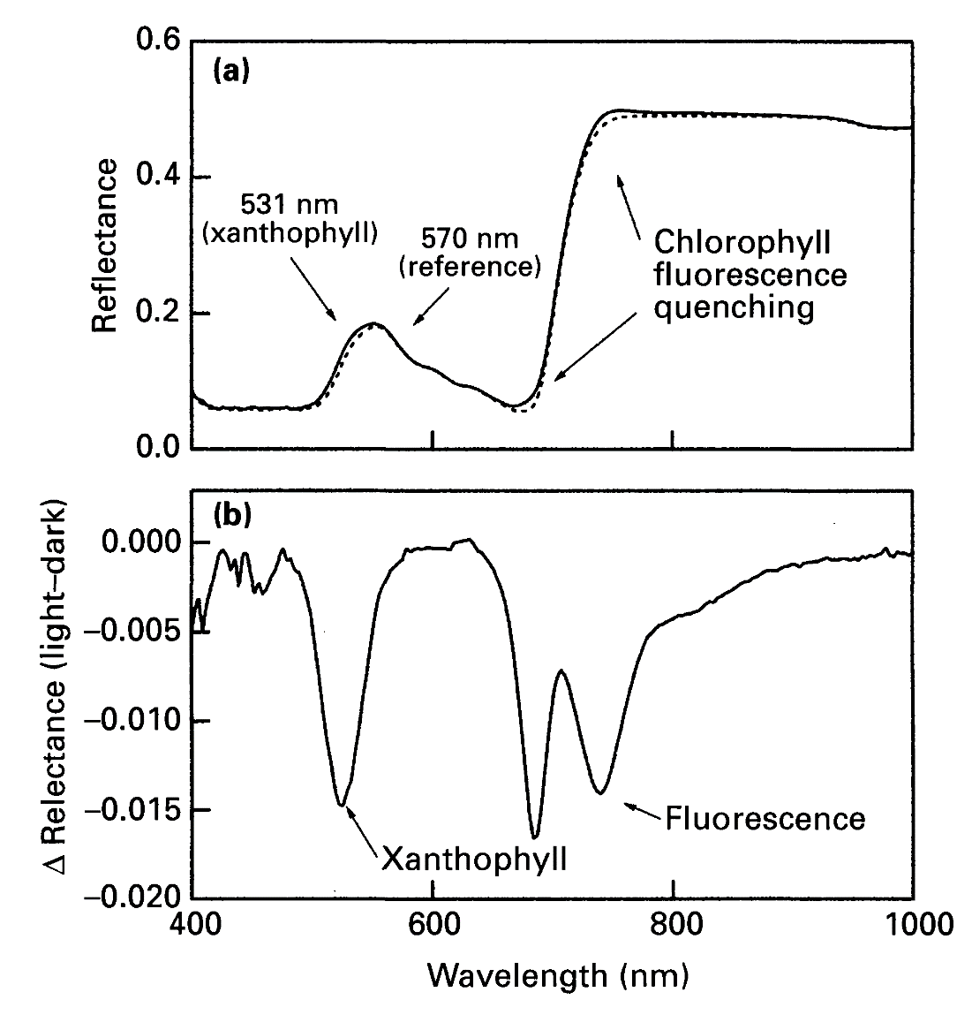
Calculating PRI
PRI values range from -1 to 1.
PRI (Photochemical Reflectance Index) was designed to estimate Light Use Efficiency (LUE) by detecting changes in the xanthophyll cycle
Xanthophyll pigments change rapidly in response to environmental conditions
Gamon & Surfus (1999) New Phyt.

Slide 24
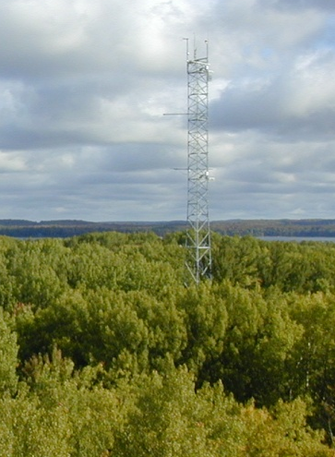
Measurement Considerations
Downwelling
radiation
Reflectance measurements require a top-down view of the canopy to measure upwelling radiance.
Up-looking sensors require unobstructed view of the sky.
Dual-view instruments (up/down) are a convenient way of measuring both incident and reflected light for calculating percent reflectance. They also account for changing sky conditions (e.g., clear vs. cloudy sky conditions).
SRS are lightweight, low power, and have a small footprint, making them easy to mount almost anywhere.
Upwelling radiation
Image credit: Chris Gough

Slide 25
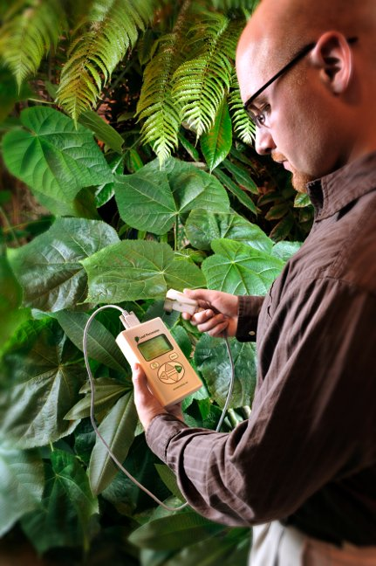
Leaf Porometer
Model SC-1
For measurement of stomatal conductance
Steady-state technique
Stomatal conductance is a primary indicator of plant stress under drought conditions

Slide 26
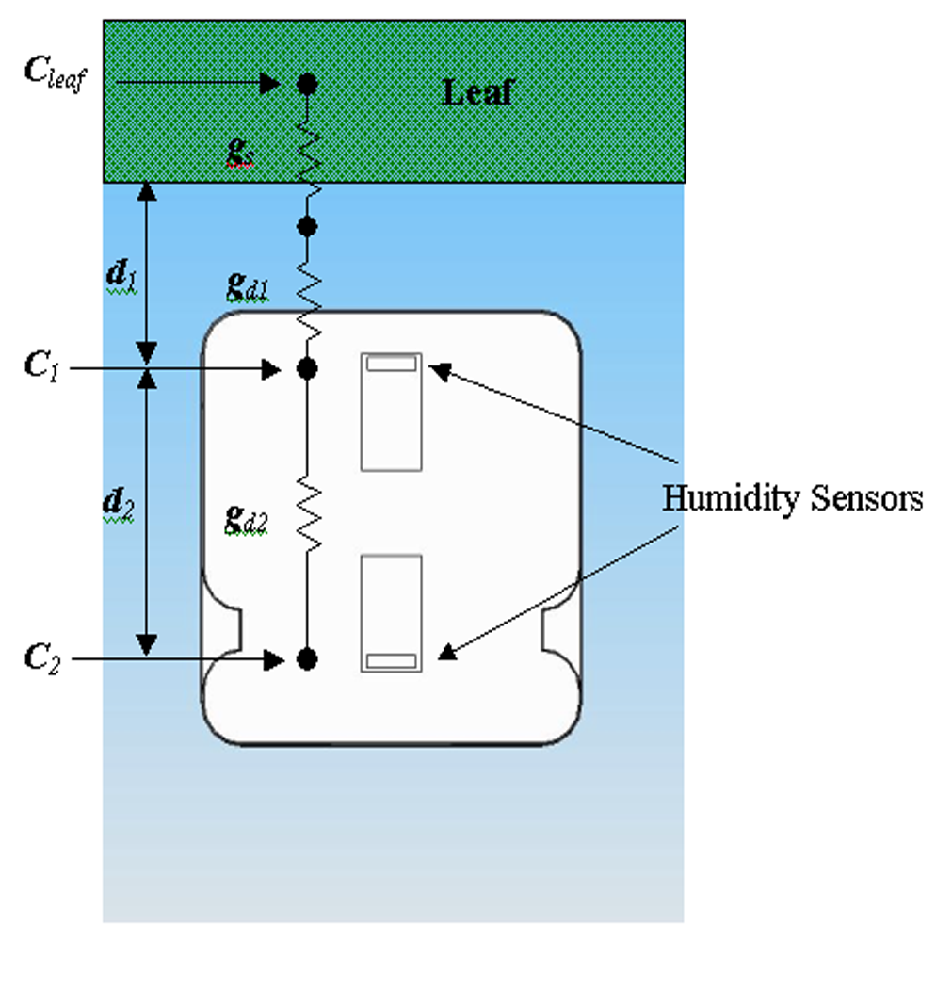
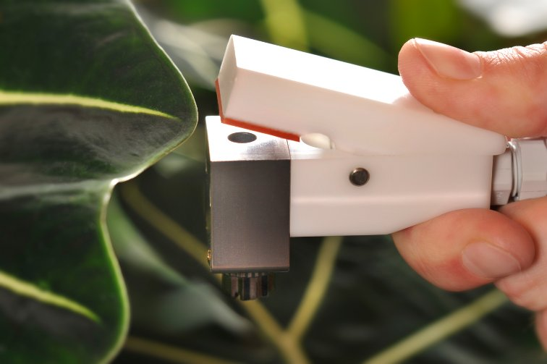
How does it work?
A chamber with a fixed diffusion path is clamped to the leaf surface
Steady-state technique; measures vapor pressure at two locations in a fixed diffusion path
Calculates flux and gradient from the vapor pressure measurements and the known conductance of the diffusion path.
Desiccant
Atmosphere

Slide 27
What can I do with a porometer?
Water use and water balance
Use conductance with Fick’s law to determine crop transpiration rate
Develop crop cultivars for dry climates/salt affected soils
Determine plant water stress in annual and perennial species
Study effects of environmental conditions
Schedule irrigation
Optimize herbicide uptake
Study uptake of ozone and other pollutants

Slide 28
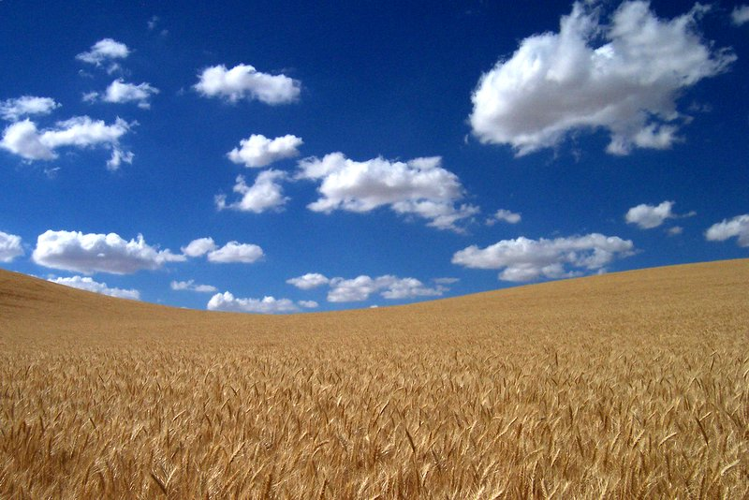
Case study: Washington State University wheat
Researchers using steady state porometer to create drought resistant wheat cultivars
Evaluating physiological response to drought stress (stomatal closing)
Selecting individuals with optimal response

Slide 29
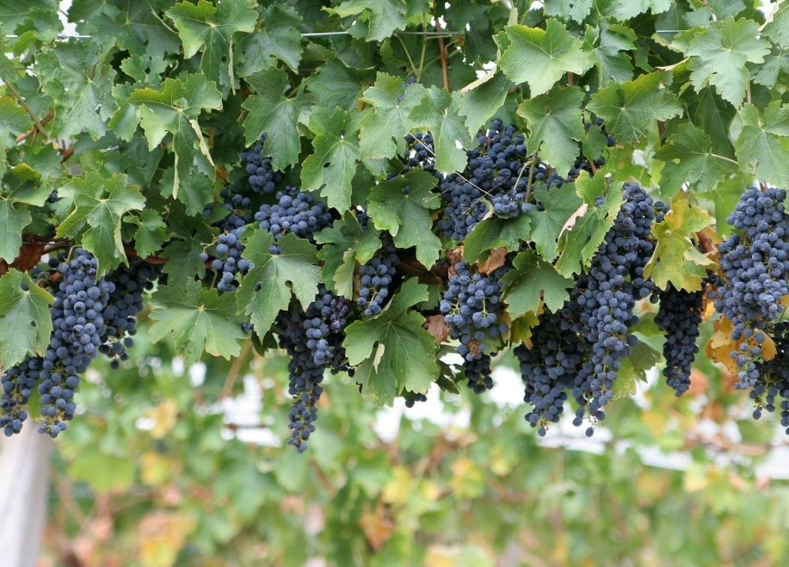
Case Study: Stress in wine grapes

Slide 30
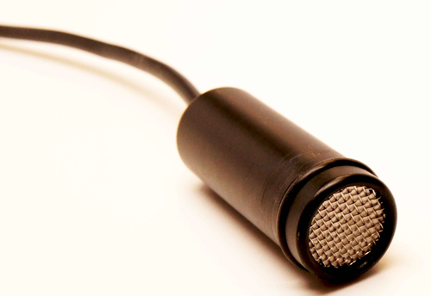
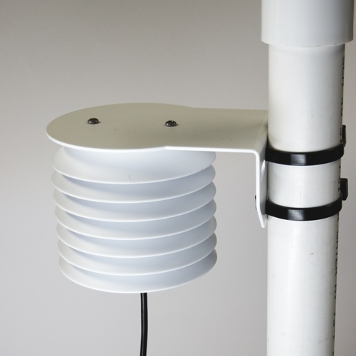
VP-4 RH/Temp/Barometric pressure Sensor
Digital sensor for use with Em50 loggers
Measures vapor pressure and temperature with a capacitance sensor and thermistor
Should be used with Decagon’s radiation shield for outdoor use

Slide 31
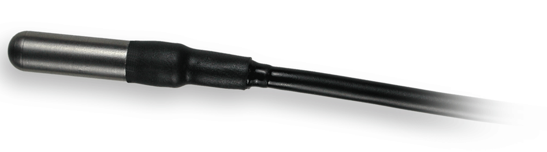
RT-1 Temperature Sensor
Measures from – 40°C to 60°C
Accuracy: ±0. 5 ° from 5 to 40°C; ±1°C outside this range
Can be used in air, soil, or liquid. If used in air, a radiation shield should be used.

Slide 32
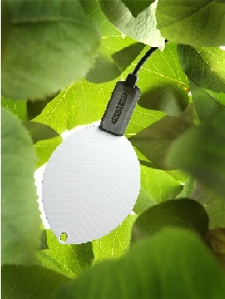
Leaf Wetness Sensor
Determines presence and duration of leaf moisture
Capacitance technology, does not require painting or maintenance
All probes are calibrated to same dryness baseline voltage
Water condenses and evaporates from the surface at the same rate as it does on leaves

Slide 33
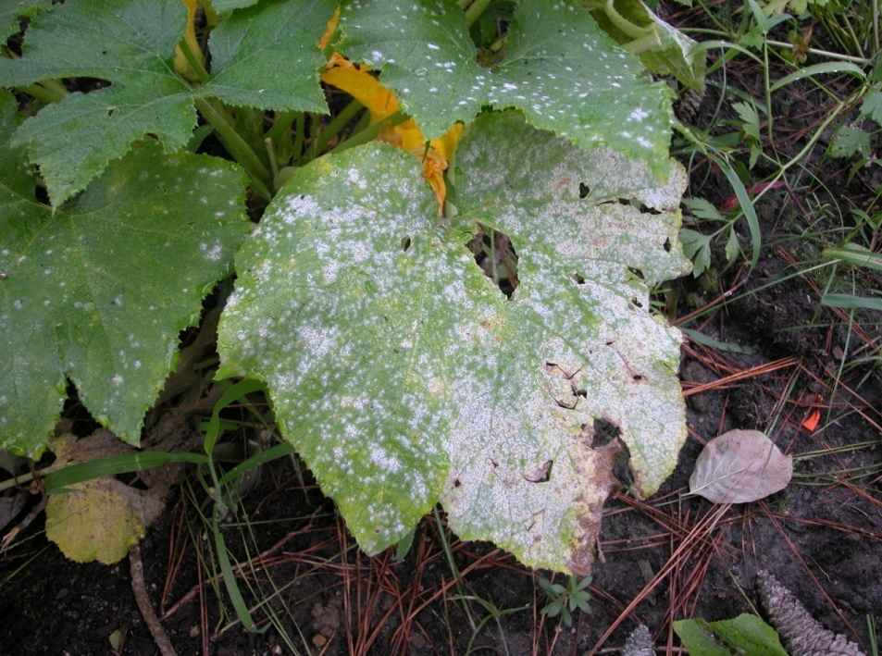
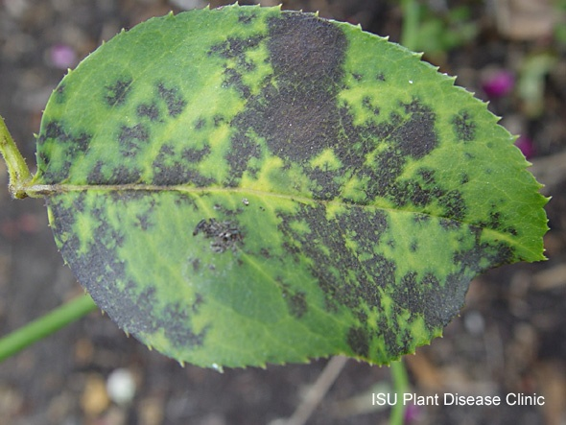
Leaf Wetness applications
Disease prediction

Slide 34
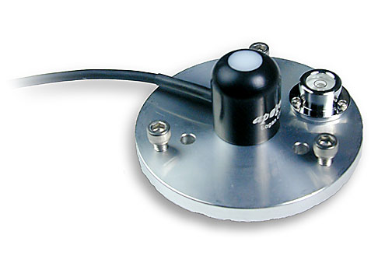
Pyranometer / PAR sensor
Manufactured by Apogee Instruments
Configured to connect to our Em50
Measures total solar radiation (W/m²), PAR sensor measures μmol/m²/s
Important for energy balance studies and micro-climate monitoring.
Comes with leveling plate

Slide 35
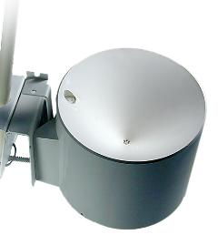
ECRN-100 Rain Gauge
Resolution : 0.2 mm
Double-spoon tipping bucket

Slide 36
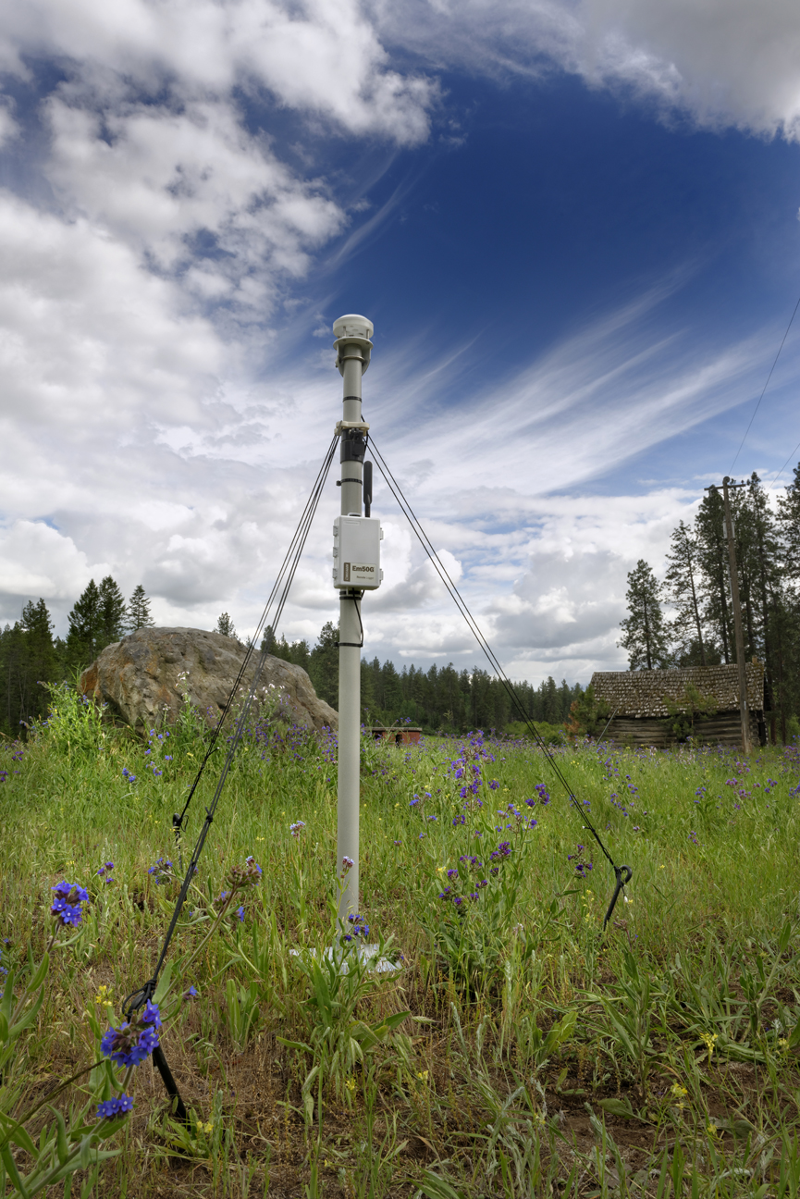
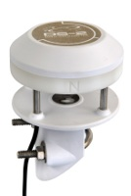
DS-2 Sonic Anemometer
For micro-climate monitoring for plant studies
0-30 m/S range
0.01m/S resolution
Direction: 0-359°, ±3°

Slide 37
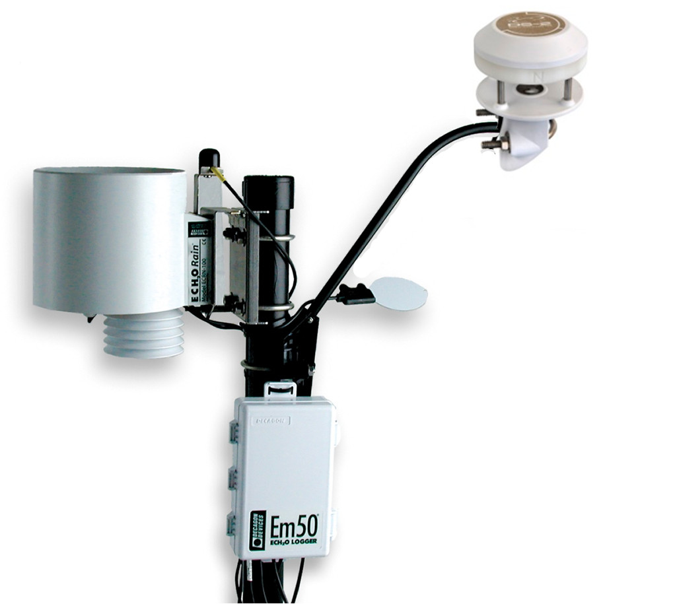

Slide 38
Soil Water Content /Water Potential

Slide 39
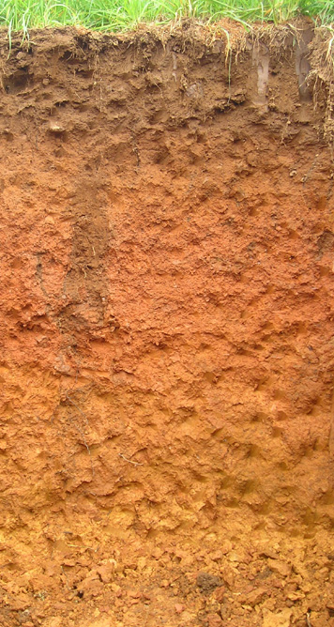

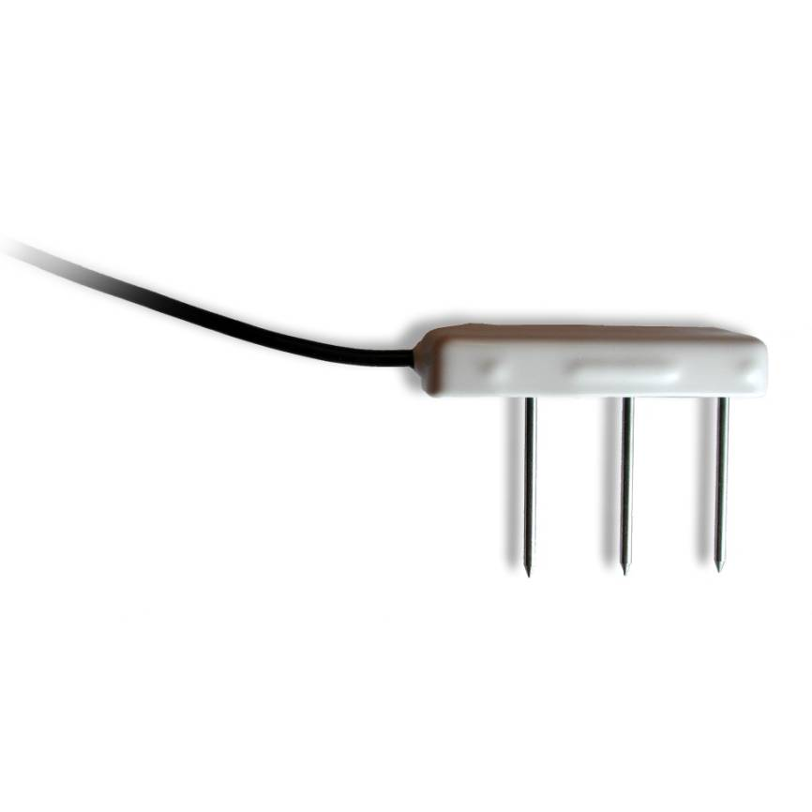
Dielectric Soil Moisture Sensors
Hi-frequency capacitance (FDR)
-- Measures the dielectric constant of the soil
Designed to be buried in soil for long-term monitoring of soil moisture
Measurement is made by processor inside probe head

Slide 40
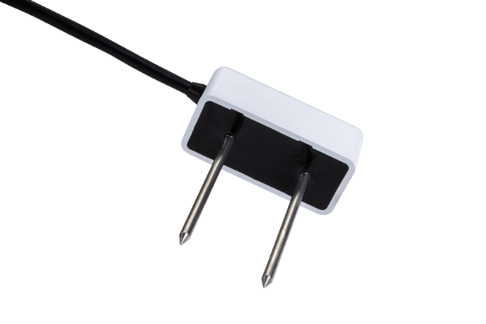
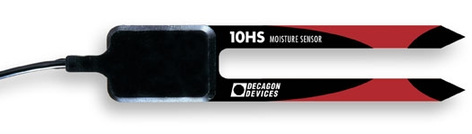
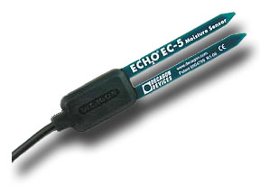
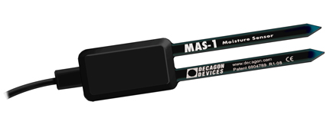
Analog soil moisture sensors
GS1: Ruggedized sensor, 5cm steel needles, 3-15 VDC
10HS: 10 cm probe length, 3-15 VDC — large sample area (~1 liter)
EC-5: 5cm probe length, 2.5-3 VDC
MAS-1: 4-20 mA sensor, 5cm probe length

Slide 41
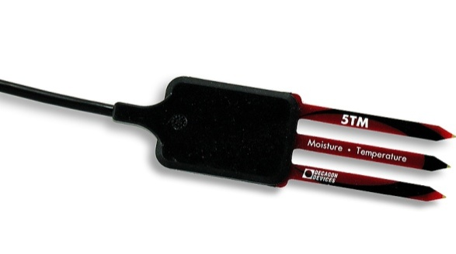
Digital Sensors
GS3: Water content, EC (0-23 dS/m) and temperature. For soil or soil-less substrates
5TE: Water content, EC (0-23 dS/m) and temperature. For field soils only.
5TM: Water content and temperature. For field soils
All digital sensors are SDI-12 compatible

Slide 42
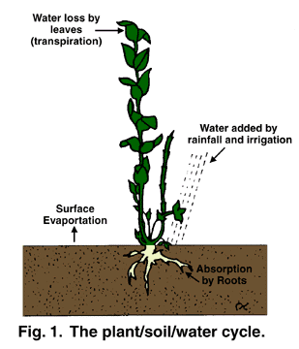
Applications: Plant–water relations
Courtesy Texas A&M Horticulture

Slide 43
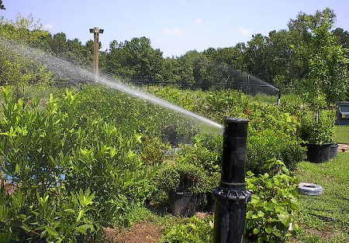
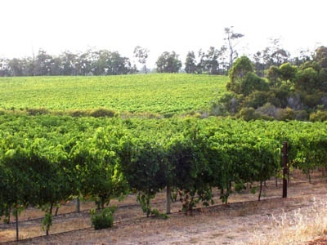
Applications: Irrigation Scheduling

Slide 44
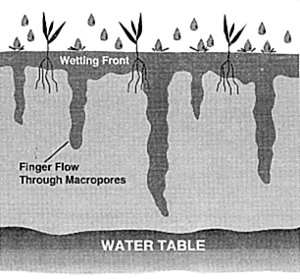
Applications: Hydrologic monitoring

Slide 45
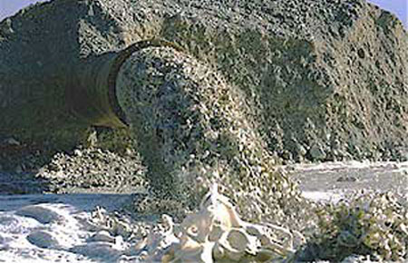
Applications: Hazardous waste monitoring

Slide 46
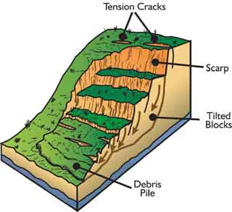
Applications: monitoring slope stability

Slide 47
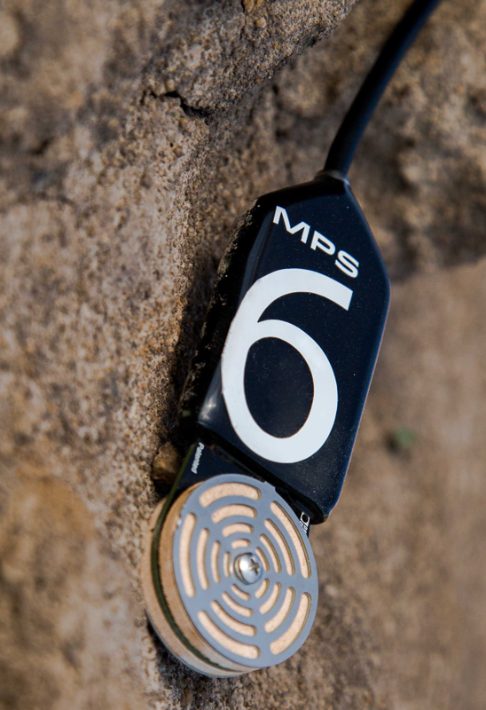
MPS-6 Matric Potential Sensor
For in-situ monitoring of water potential
Range: -10 to -500 kPa(pF 2 to pF 3.71)
Uses capacitance method to measure water content of a known ceramic matrix
Digital output

Slide 48

Sensor Theory
Measure water content of a known porous material with a pre-established SWCC, giving us matric water potential.
Matrix (Side View)
Sensor (Side View)
Metal Plate
Confined EM Field
Metal Plate
Notes:
48

Slide 49
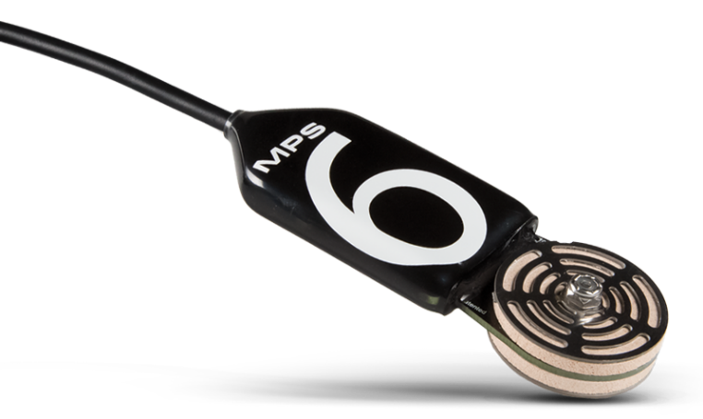
MPS-6 Advantages
No maintenance
Good accuracy in plant-available range
Each sensor individually calibrated at 6 points
Also measures soil temperature
Water Potential is a better indicator of plant available water than water content

Slide 50
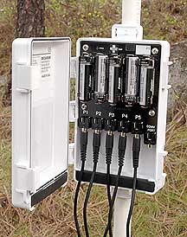
Em50 Data Logger
Weatherproof,-40° to 45°C measurement
5 ports
Uses 5 AA alkaline batteries, low power usage.
Programmed via RS232 cable connected to COM Port.
Measures every minute, then averages and stores readings according to how it’s programmed. It can store any interval between 1min. and 1 day.
Measures other micro-environment sensors that Decagon sells
Storage Capacity:
1MB non-volatile flash (28,672 scans on all 5 ports).

Slide 51
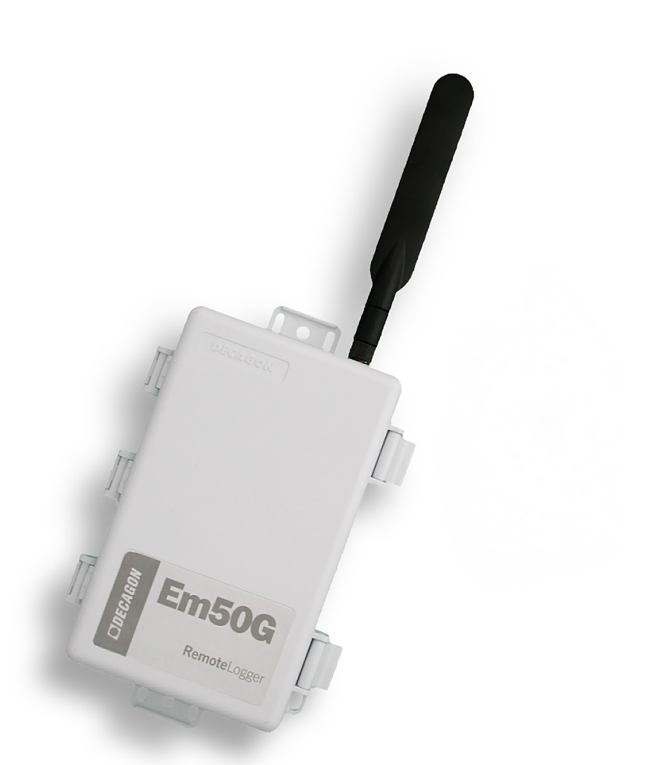
Em50G: Remote logger
4G/LTE-enabled logger, delivers data via mobile network providers to Decagon’s secure server
Data is available at any internet connection

Slide 52


How does it work?
GSM/GPRS Cell Tower
Decagon
Internet Server
Internet
Computer + Software
+ Internet
Em50G
Logger + Sensors

Slide 53






Slide 54

ECHO Utility
Free software that comes with any Em50 and Em5b purchase
You can:
Configure ports
Name logger
Set logging interval
Download data
Scan ports
- Does not graph
- Cannot apply calibrations in program

Slide 55

DataTrac

Slide 56
Hydrology Equipment

Slide 57

WP4C Dewpoint Water Potential Meter
Measures Water Potential of Soils, Seeds, Organic Matter, etc.directly MPa and Pf (log base 10 of MPa)
Easy to use, more robust than thermocouple psychrometers
Temp. controlled
Range: -0.05 to -300MPa

Slide 58
Chilled-mirror Dewpoint Technique
Mirror is chilled until dew is formed. The temperature at which saturation is achieved is determined by observing condensation on a chilled surface (mirror).
Fan
Optical Sensor
Mirror
Infrared Sensor
Advantages
Wide measurement range
Rapid measurement ~ 5 min.
High reliability
Low Maintenance
Sample

Slide 59

Moisture Release Curves

Slide 60
pF Plot to get Soil Swelling

Slide 61
Expansive Soil Classification from McKeen(1992)
Class | Slope | Expansion
I | > -6 | special case
II | -6 to -10 | high
III | -10 to -13 | medium
IV | -13 to -20 | low
V | < -20 | non-expansive

Slide 62


Vapor Sorption Analyzer (VSA)
Auto-generated moisture release curves
Static humidity feature to watch how soil adsorbs water over time
Range: -10 to -475 MPa.
Accuracy: ±1MPa or ±1%
Operating Temperature: 15 to 40°C

Slide 63
VSA data

Slide 64
Vapor Sorption Analyzer
Static humidity feature to watch water adsorption vs. time

Slide 65

Mini-Disk Infiltrometer
Measures Soil Hydraulic Conductivity for:
Soil Hydrology Studies
Erosion Studies
Classroom Instruction
FEATURES:
Adjustable suction rate (0.5 to 6cm)
Sintered stainless steel disk
Removable parts

Slide 66

Dual-head Infiltrometer
For In-situ saturated hydraulic water content
Automated falling-head method, measures flux rate at a set water level and 2 pressure heads to calculate infiltration rate
Hydrologists, civil and geotech engineering
EPA/pollution monitoring
Automated!

Slide 67

Design
Maintain constant water level at 5 cm
Capacitance water level sensor
Use air pressure to simulate different pressure heads

Slide 68


Setup in Field
Configure test
Walk away

Slide 69
How we use the data?
Pressure
Flux

Slide 70

CTD Sensor (conductivity, temp., depth sensor)
Water Depth
Range 0 -5 or 0-10 m
Accuracy ±0.2 % of span
Resolution 1 mm from 0-5, 2mm from 5-10
Electrical Conductivity
Range 0 to 120 dS/m (mS/cm)
Accuracy ±5% of reading
Resolution 1.2% of reading
Temperature
Range -40 to + 50 °C
Accuracy ±1 °C
Resolution 0.1 °C

Slide 71


CTD Uses
Streambeds
Piezometer wells

Slide 72

ES-2: EC and T sensor
For monitoring EC and temperature in liquid water
Range:
Electrical Conductivity: 0 to 120 dS/m
Temperature: -40 to 50°C
Resolution:
Electrical Conductivity: 0.001 dS/m
Temperature: 0.1°C
Accuracy:
Electrical Conductivity: + 0.01 dS/m or + 10 % (whichever is greater)
Temperature: + 1°C

Slide 73

Drain Gauge: Passive Capillary Lysimeter
Purpose: to measure deep drainage (flux and solute analysis) below the root zone
Model G3

Slide 74


Slide 75
Thermal Properties

Slide 76

KD2 Pro
Thermal Properties Analyzer
Thermal Conductivity/Resistivity
Thermal Diffusivity
Specific Heat Capacity
Liquid or Solid Samples, manually or unattended measurement.

Slide 77


KD2 Pro Applications:
Soil heat flux for biological processes

Slide 78

KD2 Pro Applications:
Insulation

Slide 79

KD2 Pro Applications:
Nanofluids

Slide 80

KD2 Pro Applications:
Petroleum products

Slide 81

KD2 Pro Applications:
Thermal Backfill

Slide 82


