Slide 1

Decagon European Distributor Conference, 2012
Lisbon, Portugal

Slide 2
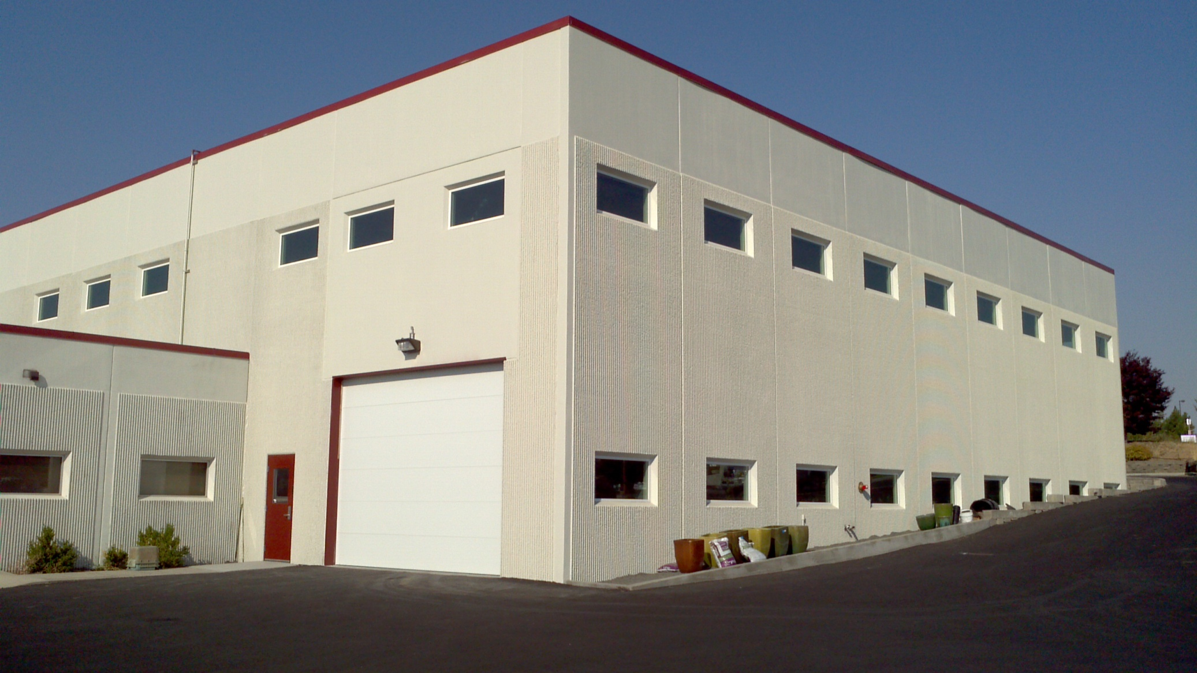
Events at Decagon
New addition

Slide 3
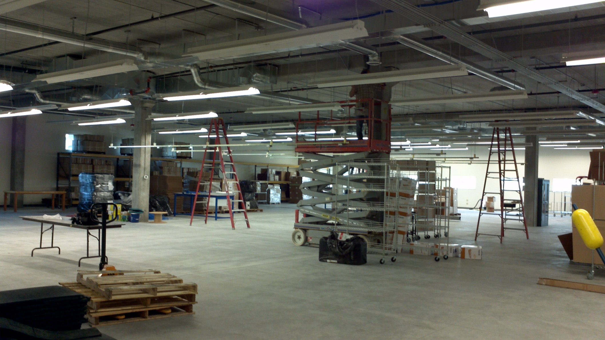

Slide 4
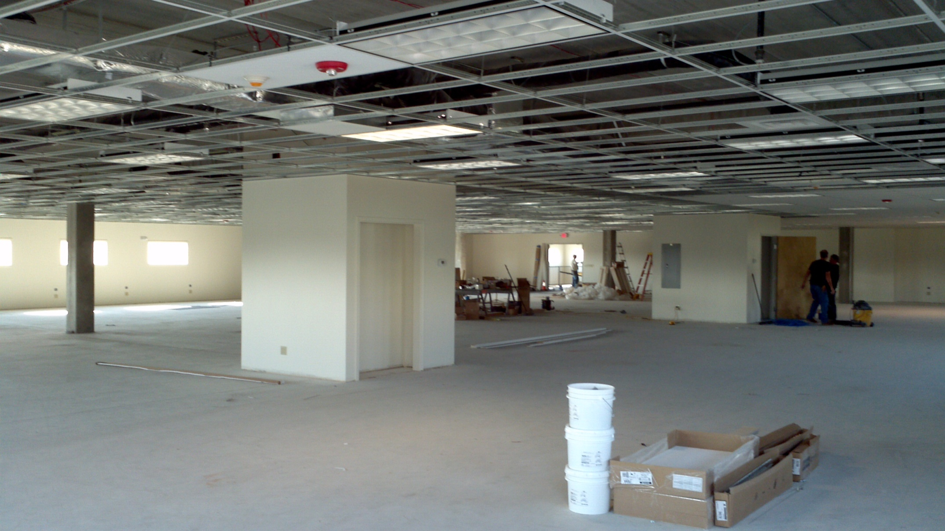

Slide 5
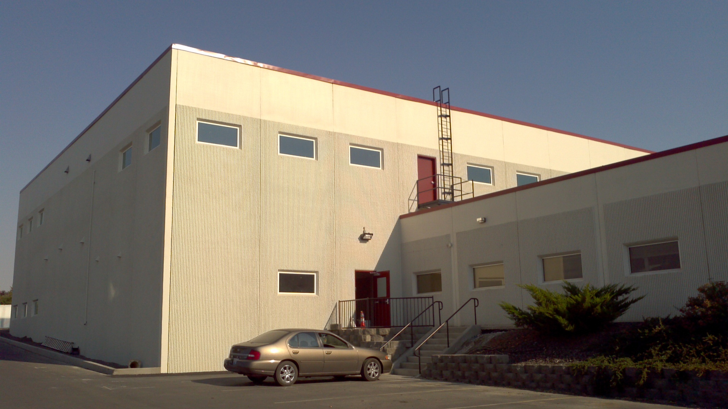

Slide 7
NEW PRODUCTS
CTD (Conductivity, Temperature, Depth)
G3 Drain Gauge
GS3 (Ruggedized soil/substrate sensor)
VSA (Vapor Sorption Analyzer
KD2 Pro RK-1 sensor (rock probe)

Slide 8
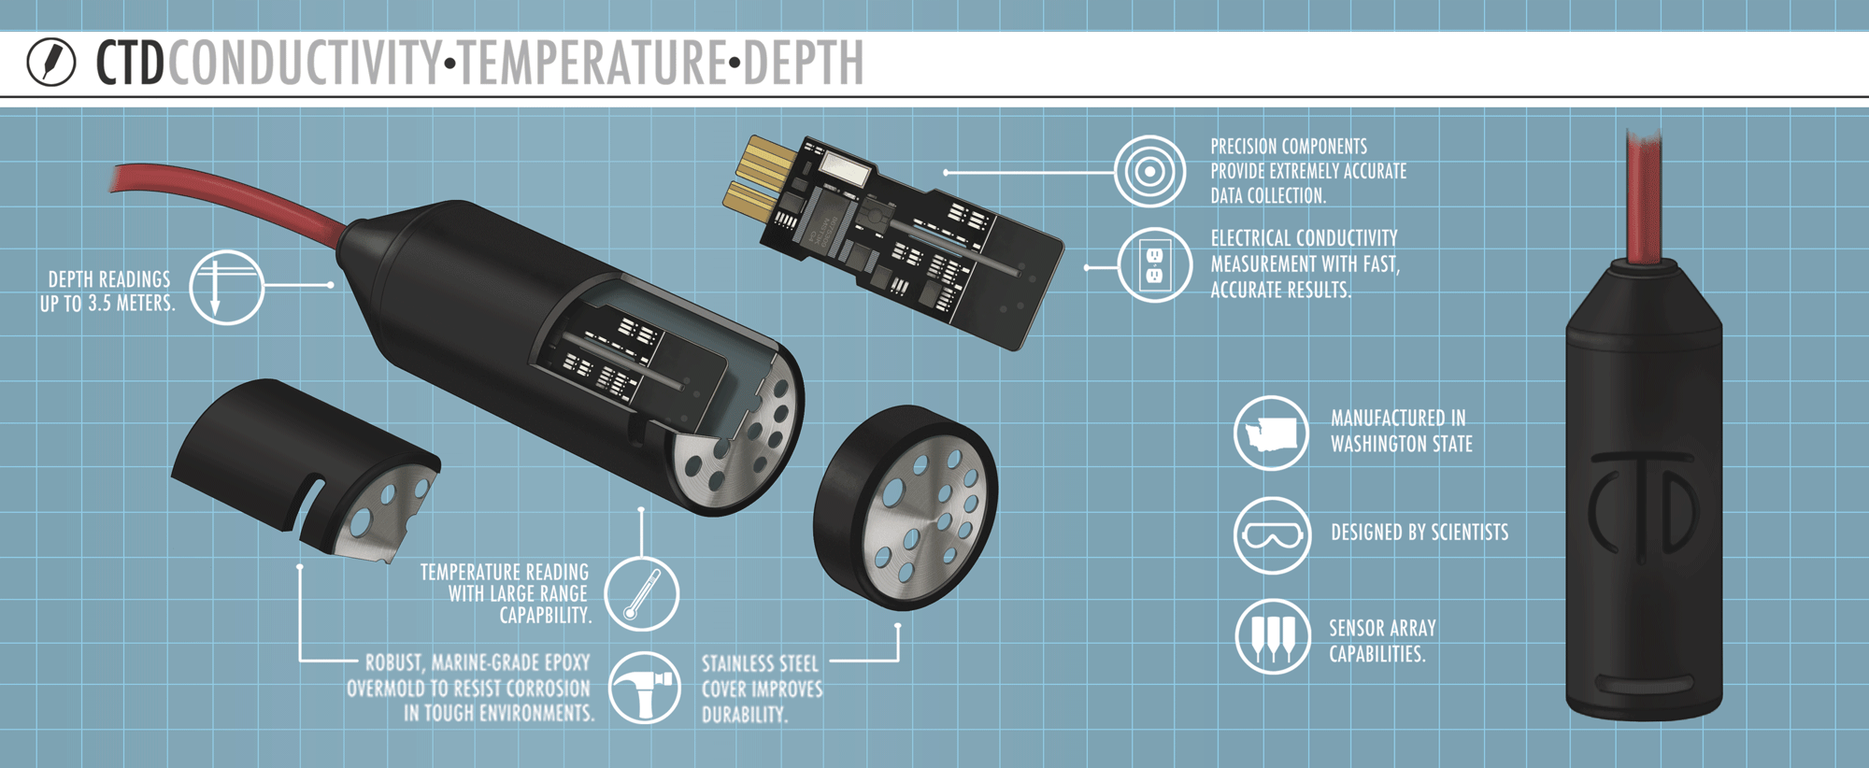
CTD (conductivity, temp., depth sensor)
Water Depth
Range: 0 to 3.5 m
Accuracy: ±0.2 % of span
Resolution: 1 mm
Electrical Conductivity
Range: 0 to 120 dS/m (mS/cm)
Accuracy: ±5% of reading
Resolution: 1.2% of reading
Temperature
Range: -40 to + 50 °C
Accuracy: ±1 °C
Resolution: 0.1 °C

Slide 9
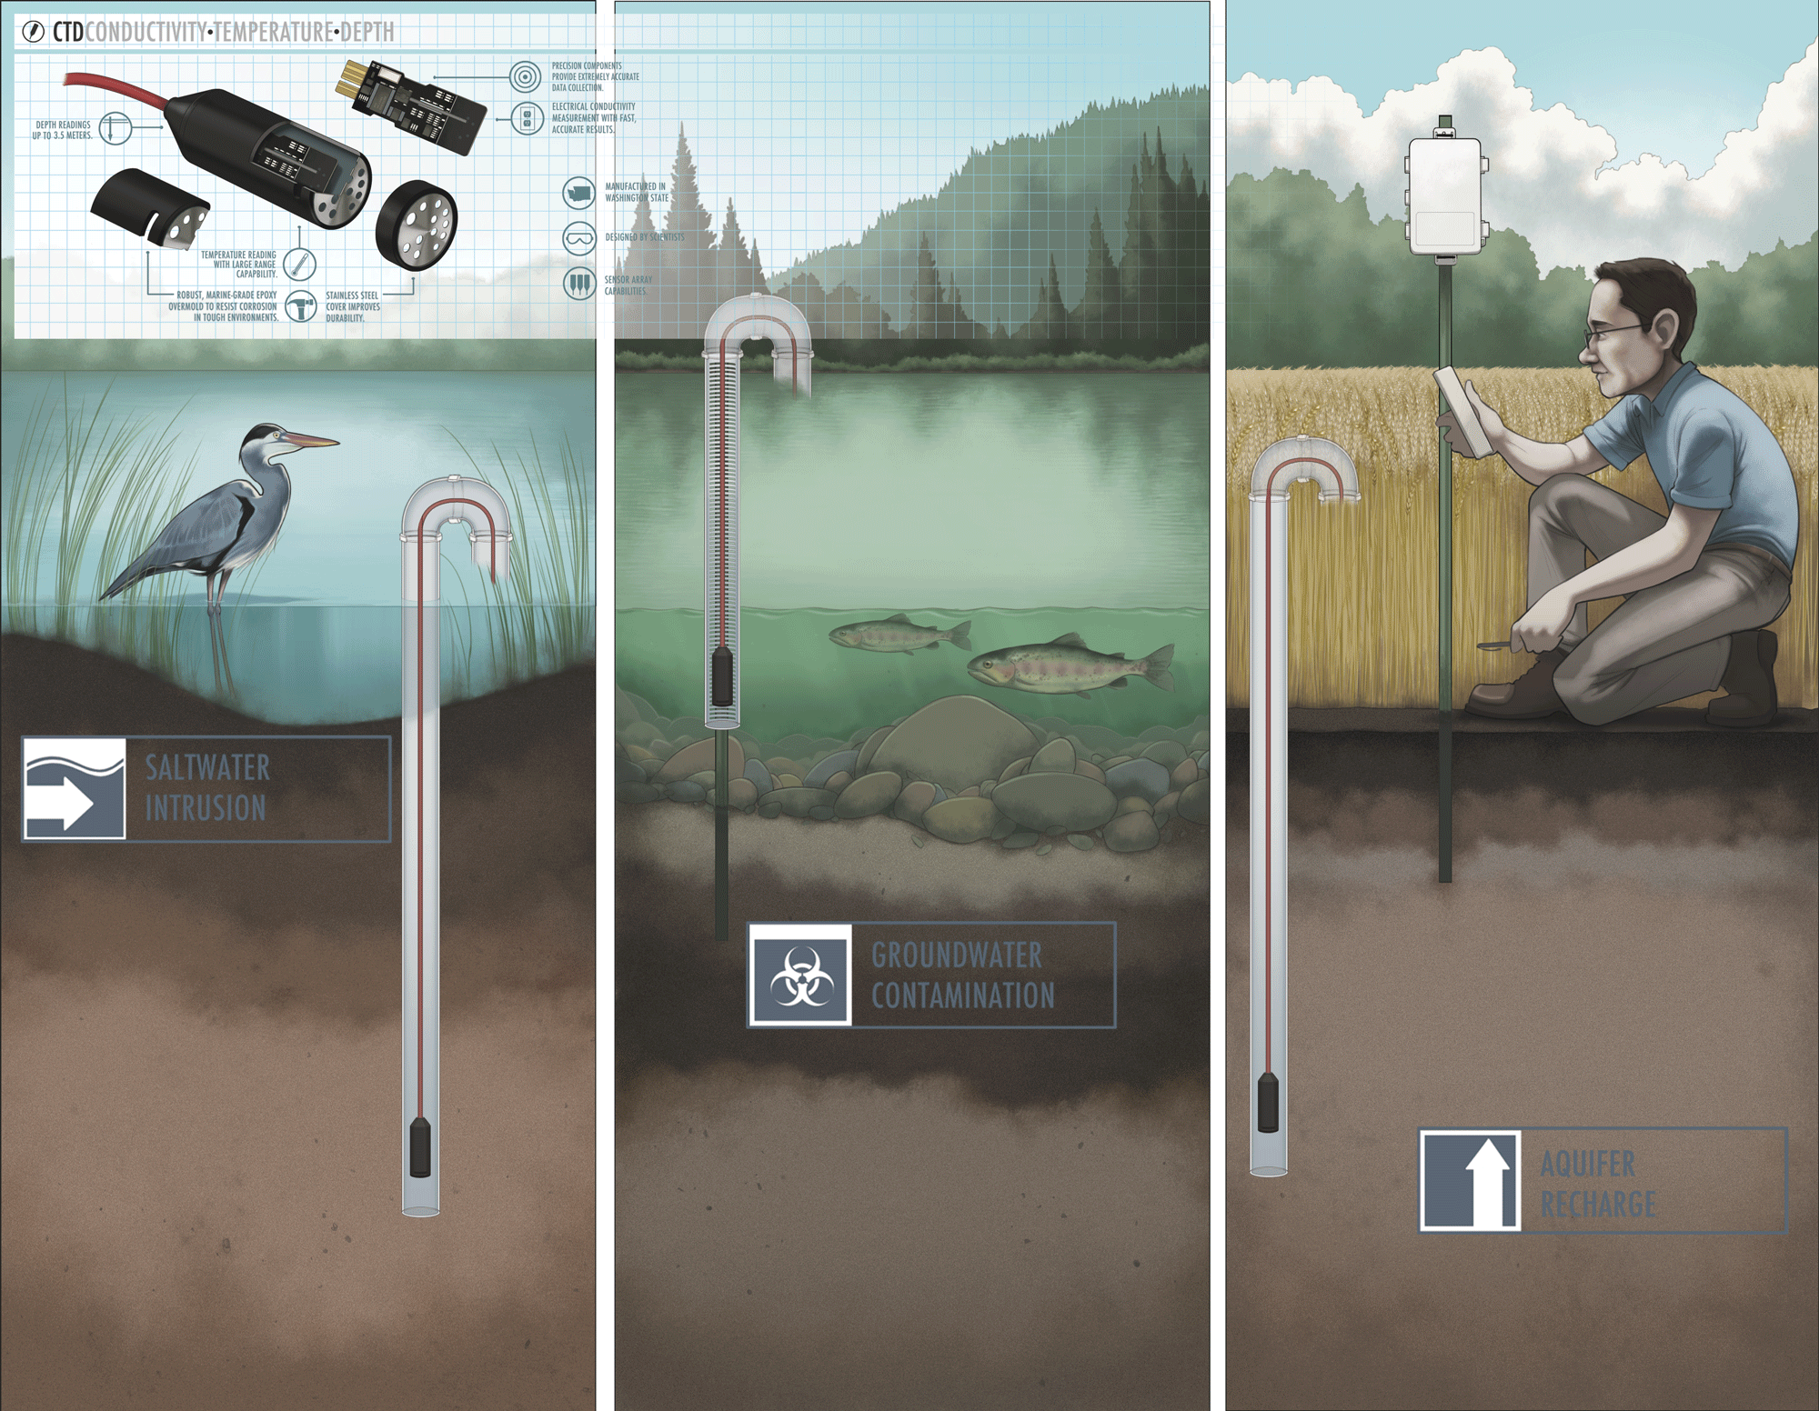
CTD Uses

Slide 10
Filling the CTD transducer

Slide 11
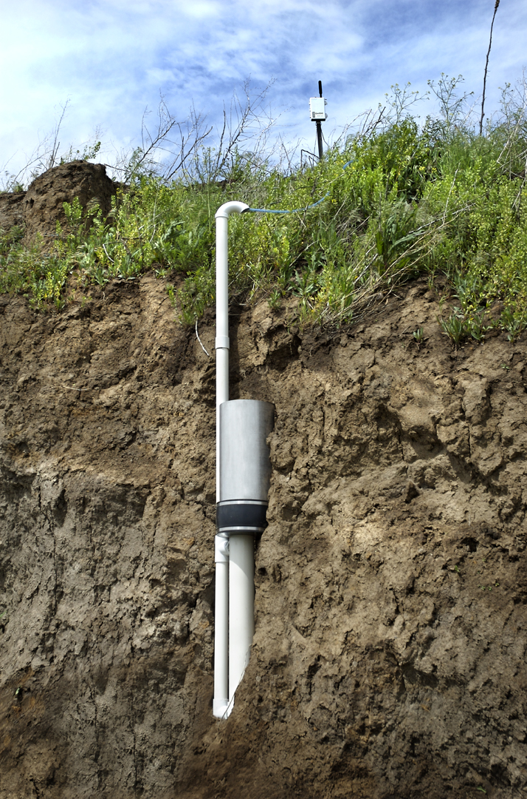
Drain Gauge G3
Measure deep drainage flux
(past the root zone)
Analyze water samples
Also measures EC and Temp.
Sealed lower portion
Sampling Reservoir Volume: 3 L
Total Length: 1.5m
Divergence Control Tube (DCT) Length :60 cm
Construction Material: Stainless Steel or PVC DCT

Slide 12
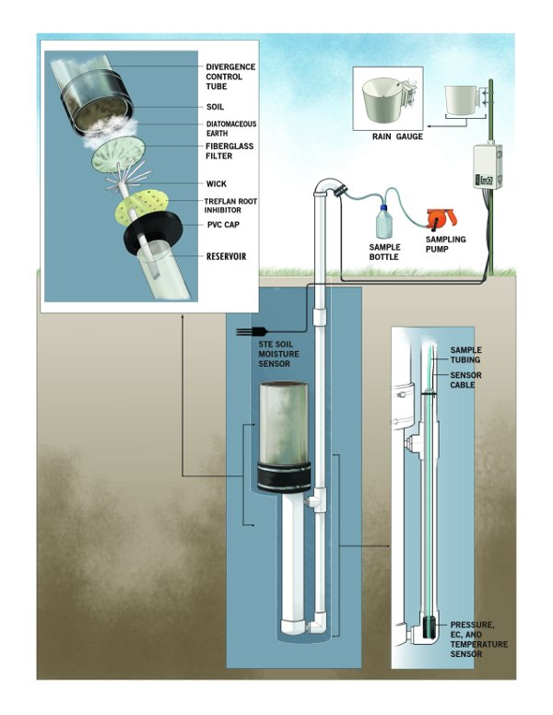

Slide 13
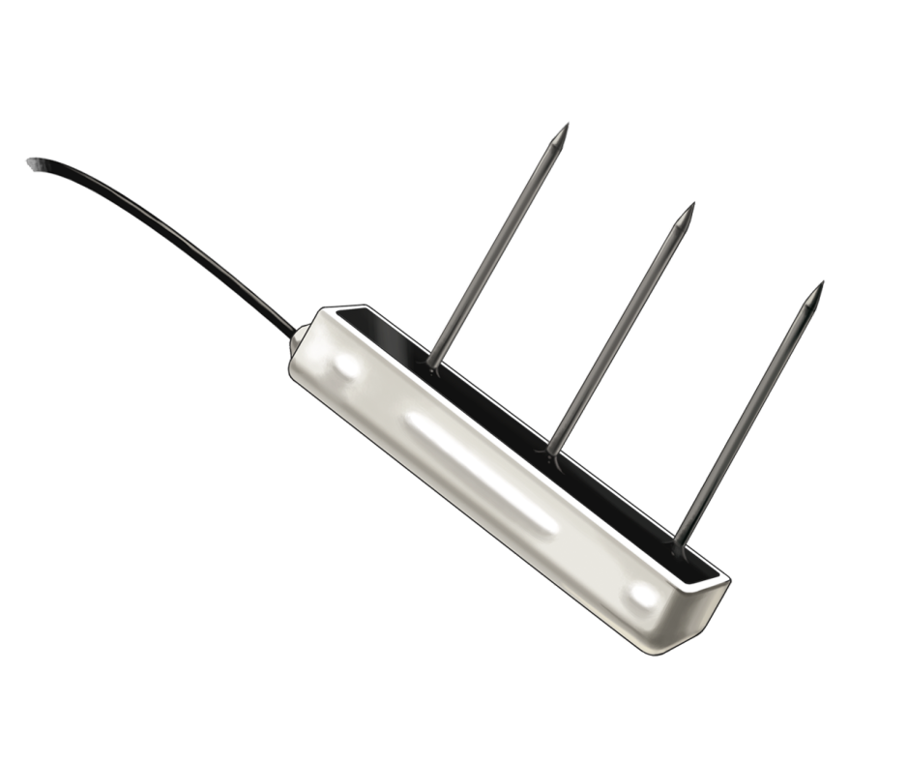
GS3 Sensor: VWC, EC, and Temp.
ACCURACY:
ε_{a}: ±1ε_{a} (unitless) from 1-40 (soil range), ±15% from 40-80
VWC 3% typical in mineral soils that have solution electrical conductivity <10 dS/m .
1-2% VWC using media-specific calibration
Electrical Conductivity (EC): ±10% from 0 to 7 dS/m, user calibration required above 7 dS/m
Temperature: ±1°C
RESOLUTION:
ε_{a}: 0.1ε_{a} (unitless) from 1-20, <0.75ε_{a} (unitless) from 20-80 VWC: 0.0008m³/m³ (0.08% VWC) from 0 to 50% VWC
EC: 0.01 dS/m from 0 to 7 dS/m, 0.05 dS/m from 7 to 23.1 dS/m
Temperature: 0.1°C
RANGE:
ε_{a}: 1 (air) to 80 (water) VWC: 0 to 100% VWC with media specific calibration EC: 0-23 dS/m (bulk)
T: -40 to 50 degrees C
Designed for use with soilless substrates
Also good in soil, rugged design
0-23 dS/m EC range

Slide 14
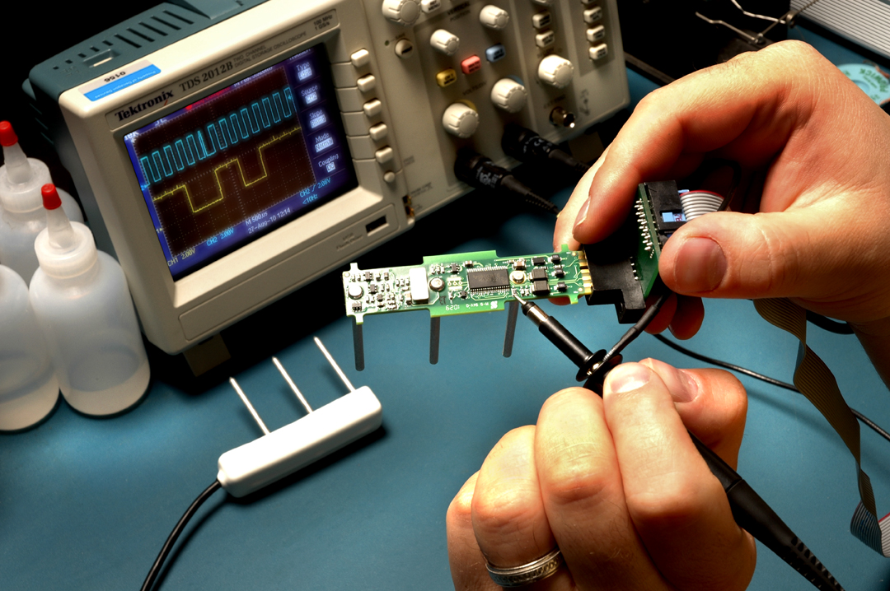

Slide 15
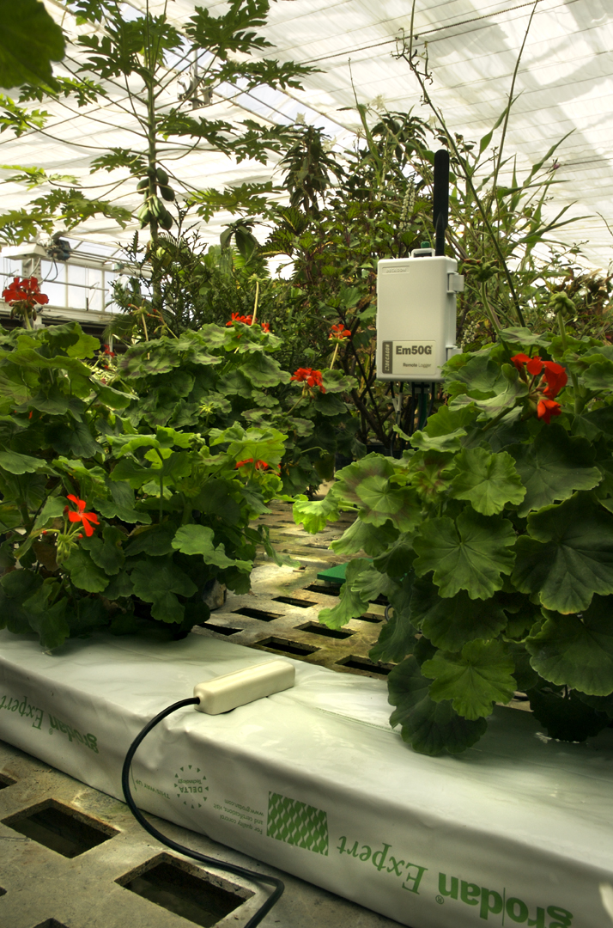
GS3 Applications: stonewool
Improved EC sensitivity allows for good range in soil-less substrates

Slide 16
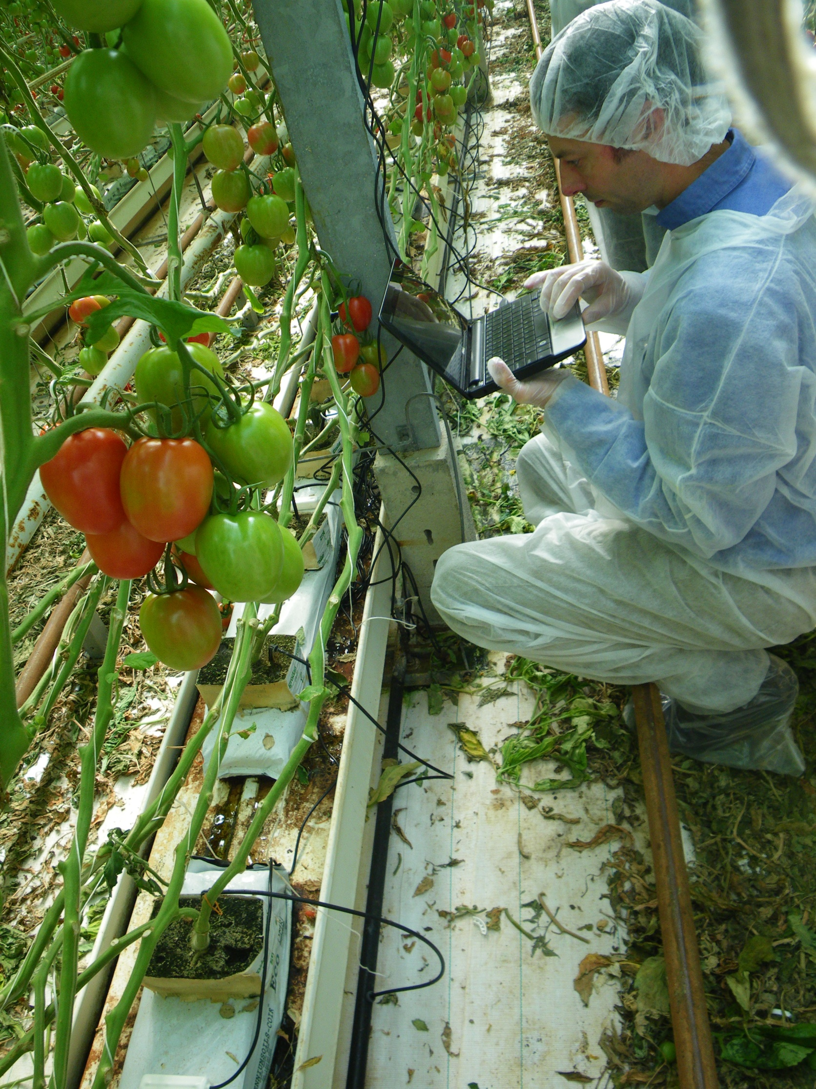


Slide 17
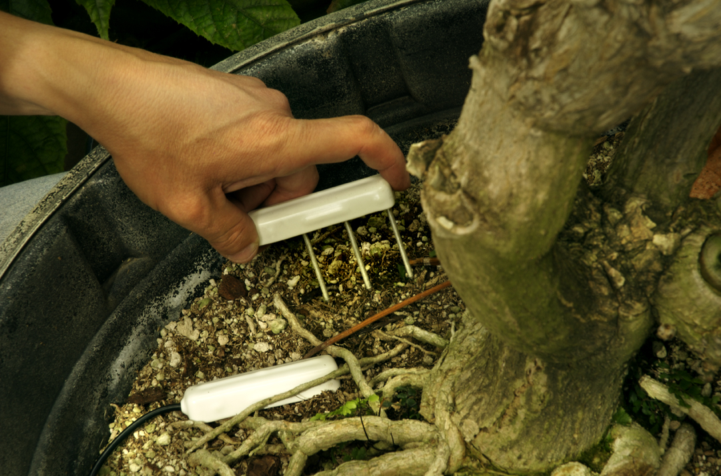
GS3 Applications: Potting soil

Slide 18
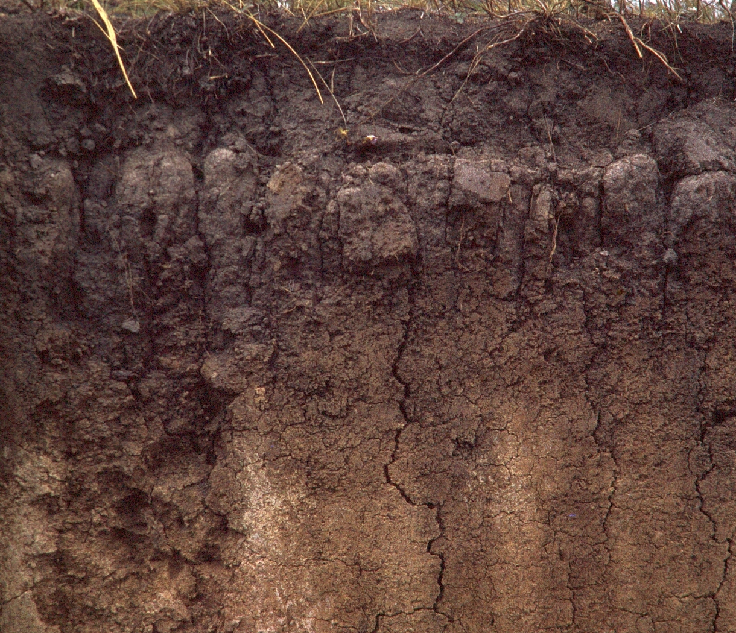
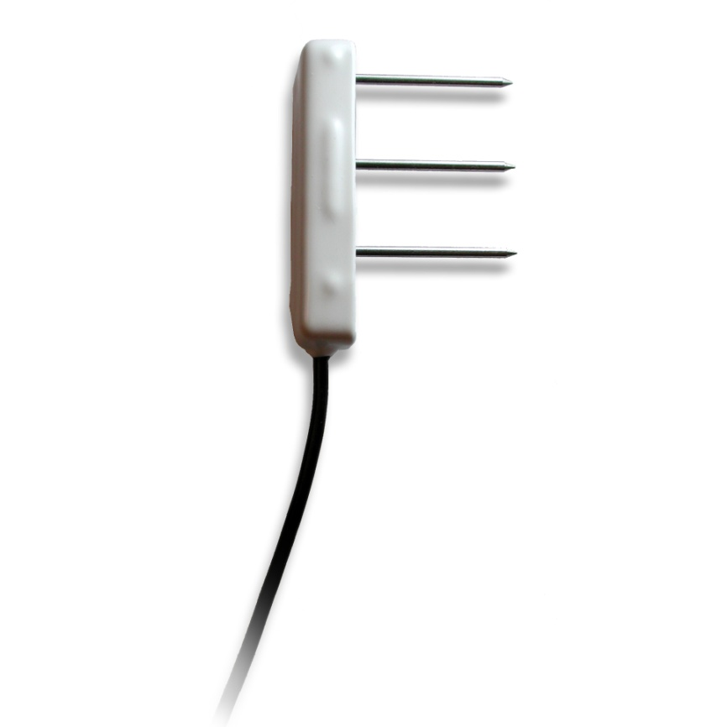
GS3 Applications: Mineral soil
Should be installed with cable coming off the top at different depths, with needles inserted into undisturbed soil

Slide 19
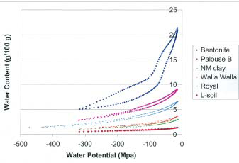
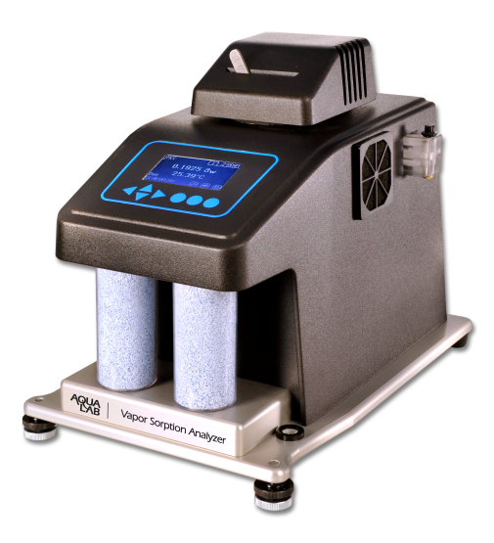
Vapor Sorption Analyzer
Auto-generated moisture release curves
Range: -10 to -500 MPa.
Accuracy: ±1MPa or ±1%
Operating Temperature: 15 to 40°C

Slide 20
Soil Moisture Characteristic Curve (SMCC)
Moisture release curve, water retention function, pF curve, moisture sorption isotherm
Relationship between water content and water potential (water activity, suction, pF, chi)

Slide 21
Generating SMCC
Measuring water content is easy
Gravimetric analysis (oven drying)
Measuring water potential is difficult
No single instrument can make accurate measurements from wet to dry

Slide 22
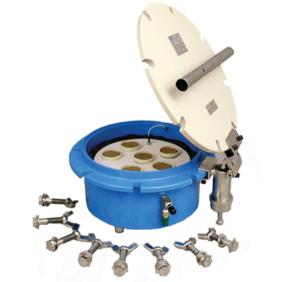
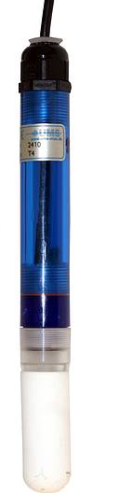
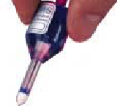
Wet end instruments (liquid equilibrium)
Wind-Schindler
(HyProp)
Pressure chamber
Tensiometers

Slide 23
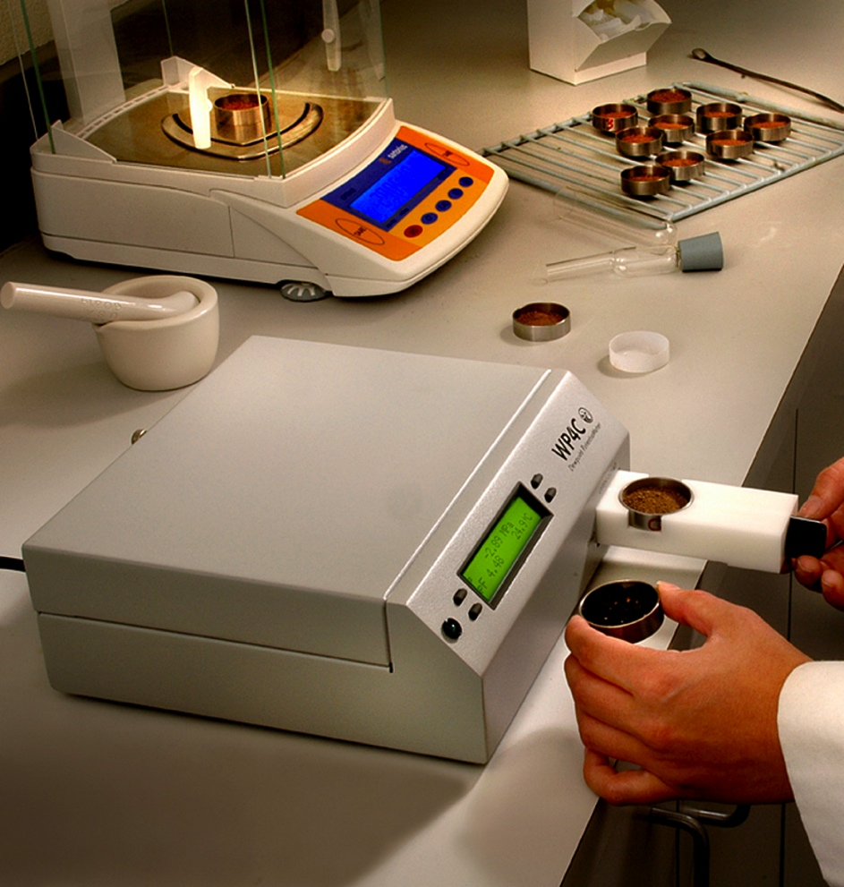
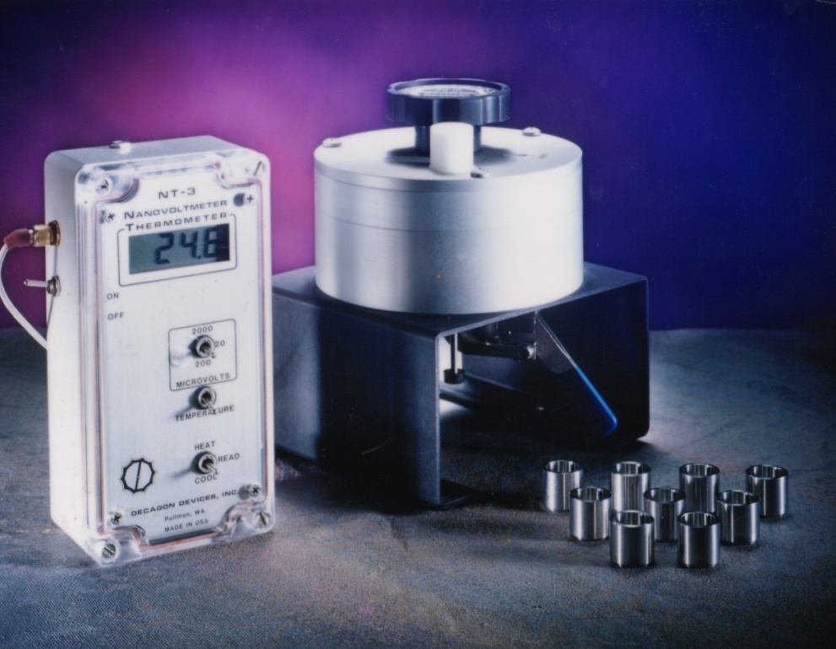
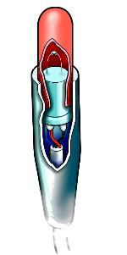
Dry end instruments (vapor equilibrium)
Chilled mirror dew-point
hygrometer
Thermocouple psychrometers
Relative humidity (h_{r}) and water potential (Ψ) related by the Kelvin equation:
R is universal gas constant
M_{w} is molecular mass of water
T is temperature

Slide 24
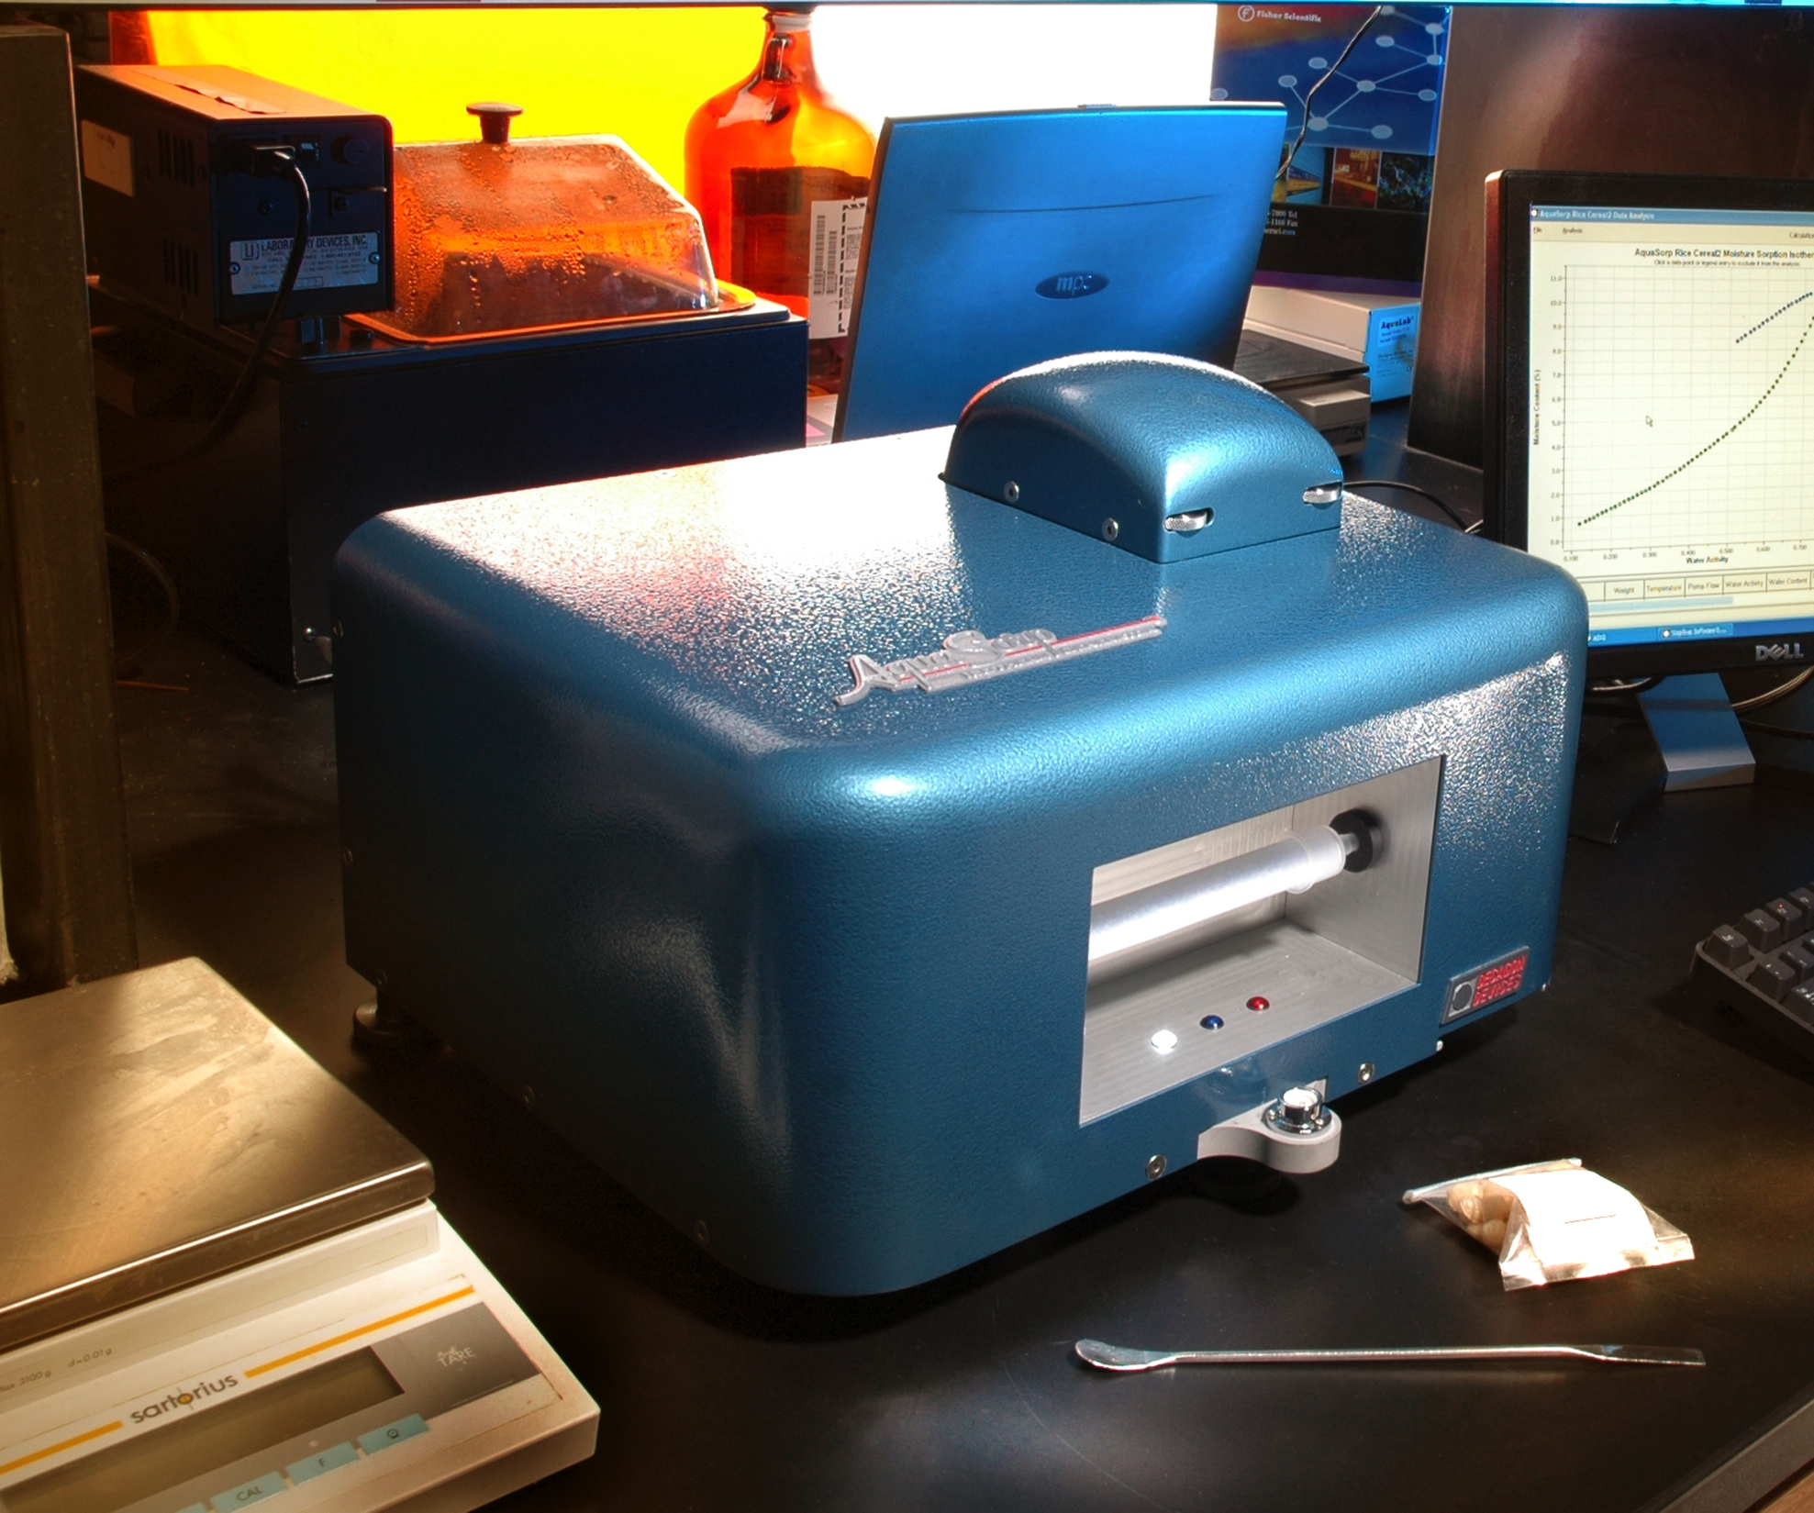
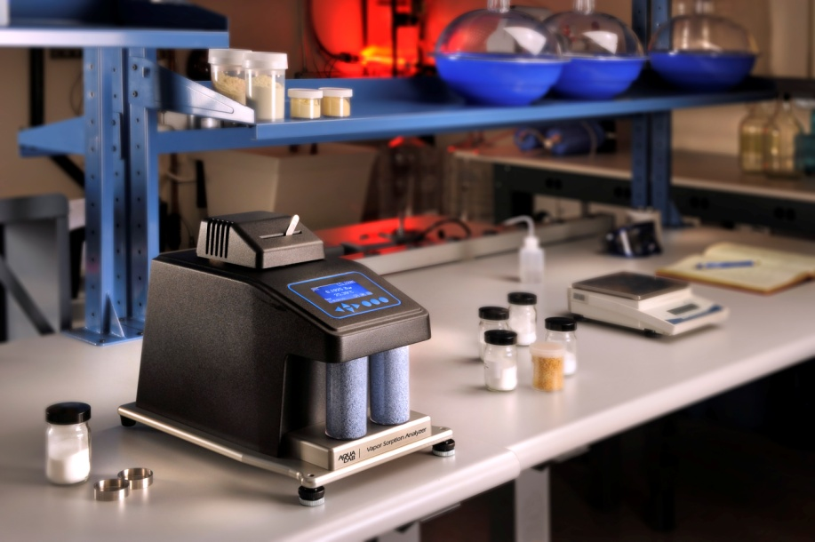
Dry end SMCC
Historically very difficult to obtain
Campbell and Shiozawa (1992) cited over 70 times and data used many by many authors
Introduction of WP4, WP4T, WP4C made dry end SMCC more accessible
Aquasorp/VSA instruments are the next step

Slide 25
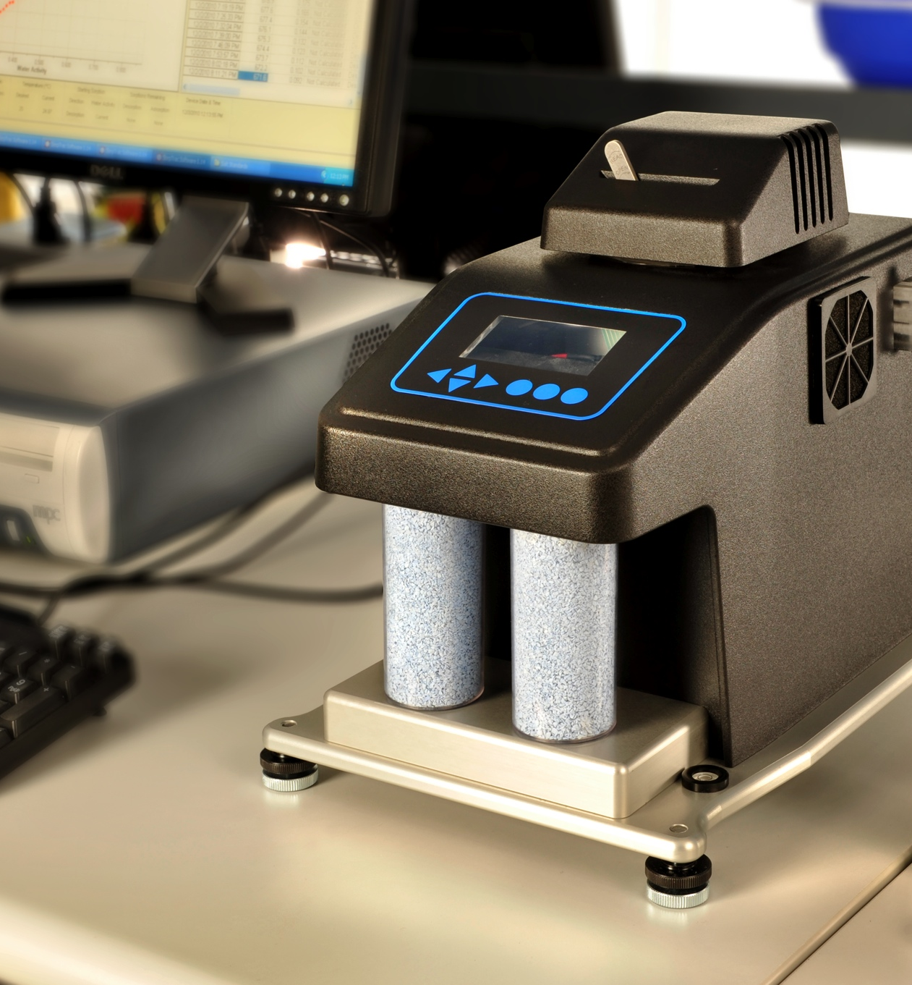
VSA (Vapor Sorption Analyzer)
Generates dry end SMCC
Fully automated
Drying and wetting (hysteresis loop)

Slide 26
VSA limitation
Limitation: only works drier than -7 MPa (95% relative humidity)

Slide 27
VSA (how it works)
Dry Air
Wet Air
Dynamic mode
Wet (~99% rh) or dry (~0%rh) air flows across sample
Flow stops and water activity/water potential and mass (water content) measured
Extreme resolution (> 200 points)
< 48 hours for wetting and drying loop (often < 10 hours)
Fan
Optical Sensor
Mirror
Infrared Sensor
Sample
Precision Balance

Slide 28
VSA (how it works)
Dry Air
Wet Air
Static mode
Humidity of chamber controlled at pre-determined level
Mass measured over time until no longer changing
Less resolution
Sorption kinetics
Sorption/desorption of other gases is possible
Fan
Optical Sensor
Mirror
Infrared Sensor
Sample
Precision Balance

Slide 29
Static vs. Dynamic

Slide 30
Static method (kinetics)

Slide 31
Dynamic method

Slide 32
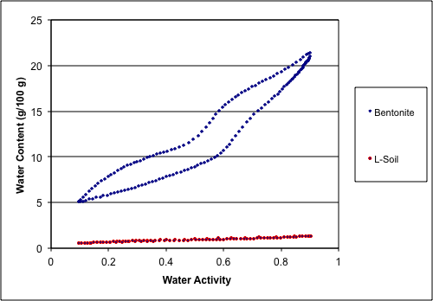
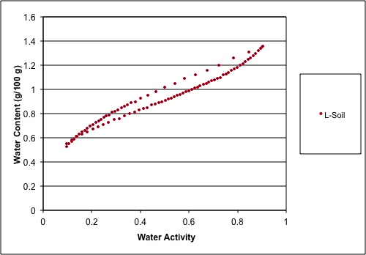
What can you do with VSA data? Hysteresis

Slide 33
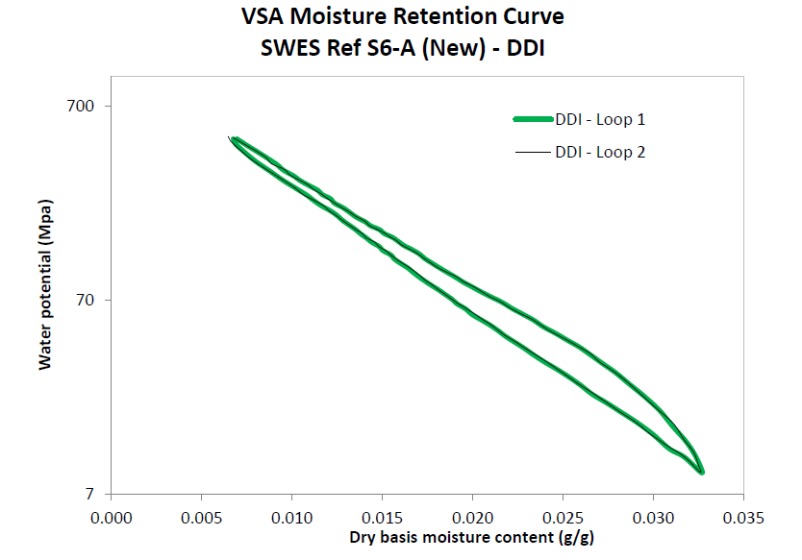
Markus Tuller, Arizona coarse soil

Slide 34
Slope of semi-log plot
Logarithm of water potential vs. water content
Plot becomes straight line in dry (VSA) region
Slope of plot contains much useful information

Slide 35
What can you do with VSA data? Swelling potential (expansiveness)
McKeen (1992) showed that the slope of pF vs. water content is related to soil swelling potential
Class | Slope | Expansion
I | > -6 | special case
II | -6 to -10 | high
III | -10 to -13 | medium
IV | -13 to -20 | low
V | < -20 | non-expansive

Slide 36
VSA: Other possibilities
Specific Surface Area calculation
Cation-exchange capacity
Clay Activity
Modeling of gas transport in soil
Sorption kinetics (not even explored yet)

Slide 37
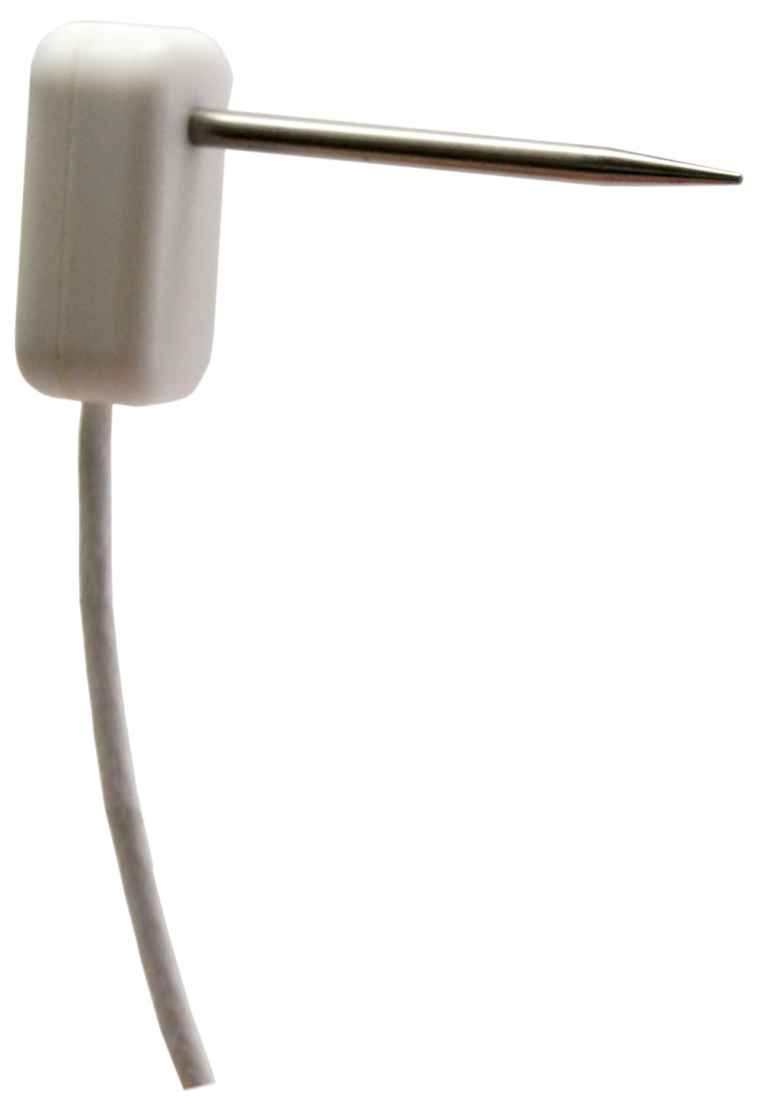
RK-1 Sensor
For use with stone and rock
5/32 (2.38mm) roto-hammer bit
Measures thermal conductivity/ resistivity
List price: $400

Slide 38
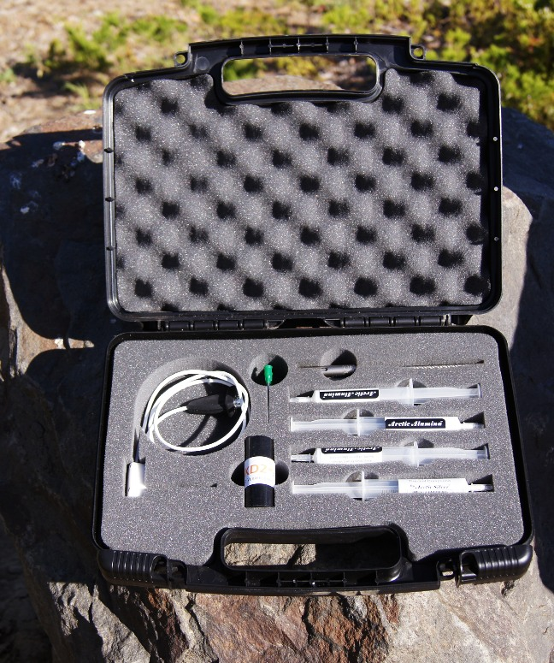
RK-1 kit
Comes in a kit with :
4 drill bits
4 tubes of thermal grease
verification block

Slide 39
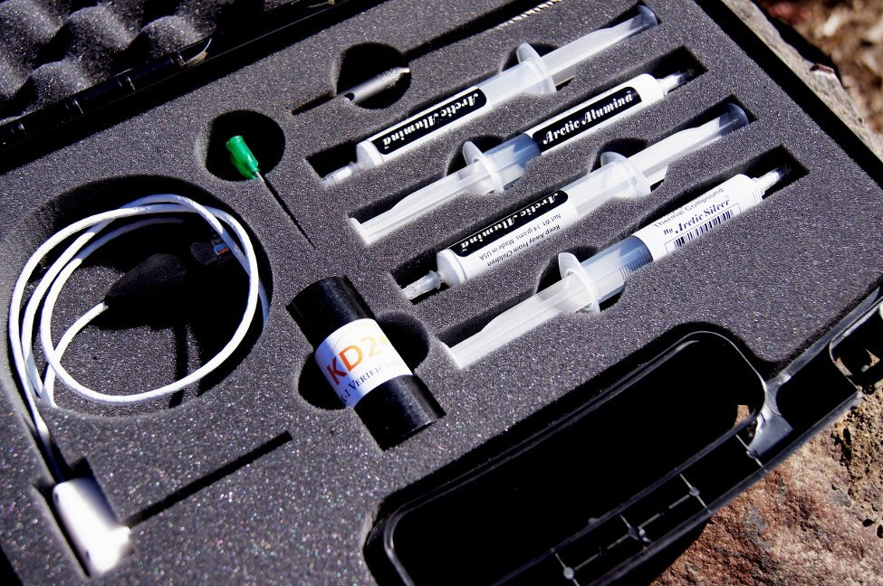

Slide 40
Updates
MPS-2 matric potential sensor
RT-1 ruggedized temp sensor
ProCheck
WP4C
Em50G, DataTrac, and growing tools

Slide 41
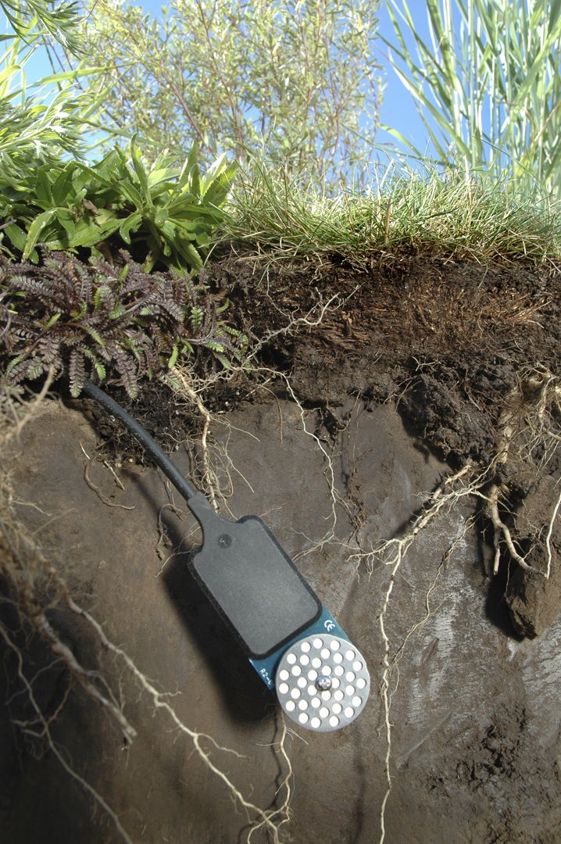
MPS-2 Matric Potential Sensor
For in-situ monitoring of water potential
Range: -10 to -500 kPa(pF 2 to pF 3.71)
Uses capacitance method to measure water content of a known ceramic matrix

Slide 42

Sensor development
Idea
Use dielectric to measure volumetric water content of a porous material
Matrix (Side View)
Sensor (Side View)
Metal Plate
Confined EM Field
Metal Plate
Notes:
42

Slide 43
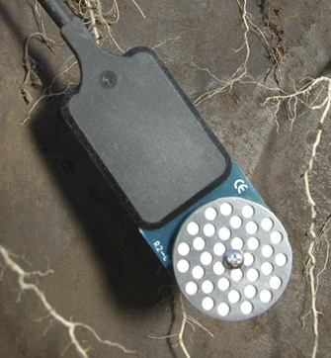
MPS-2 Advantages
No maintenance
Good accuracy in plant-available range
Each sensor pre-calibrated
Also measures temperature
Better accuracy available with calibration service for additional fee
Water Potential is a better indicator of plant available water than water content

Slide 44
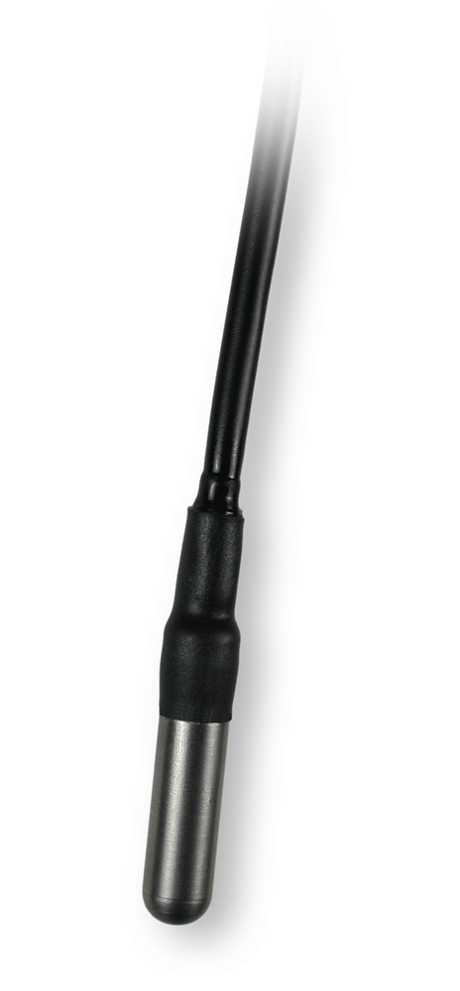
RT-1 rugged temp. sensor
Ruggedized version of the ECT sensor, thermistor potted in epoxy and encased in steel
-40 to 80°C range
Best between 5 to 40°C (± 0.5°C), otherwise ±1 °C
0.1 °C resolution

Slide 45
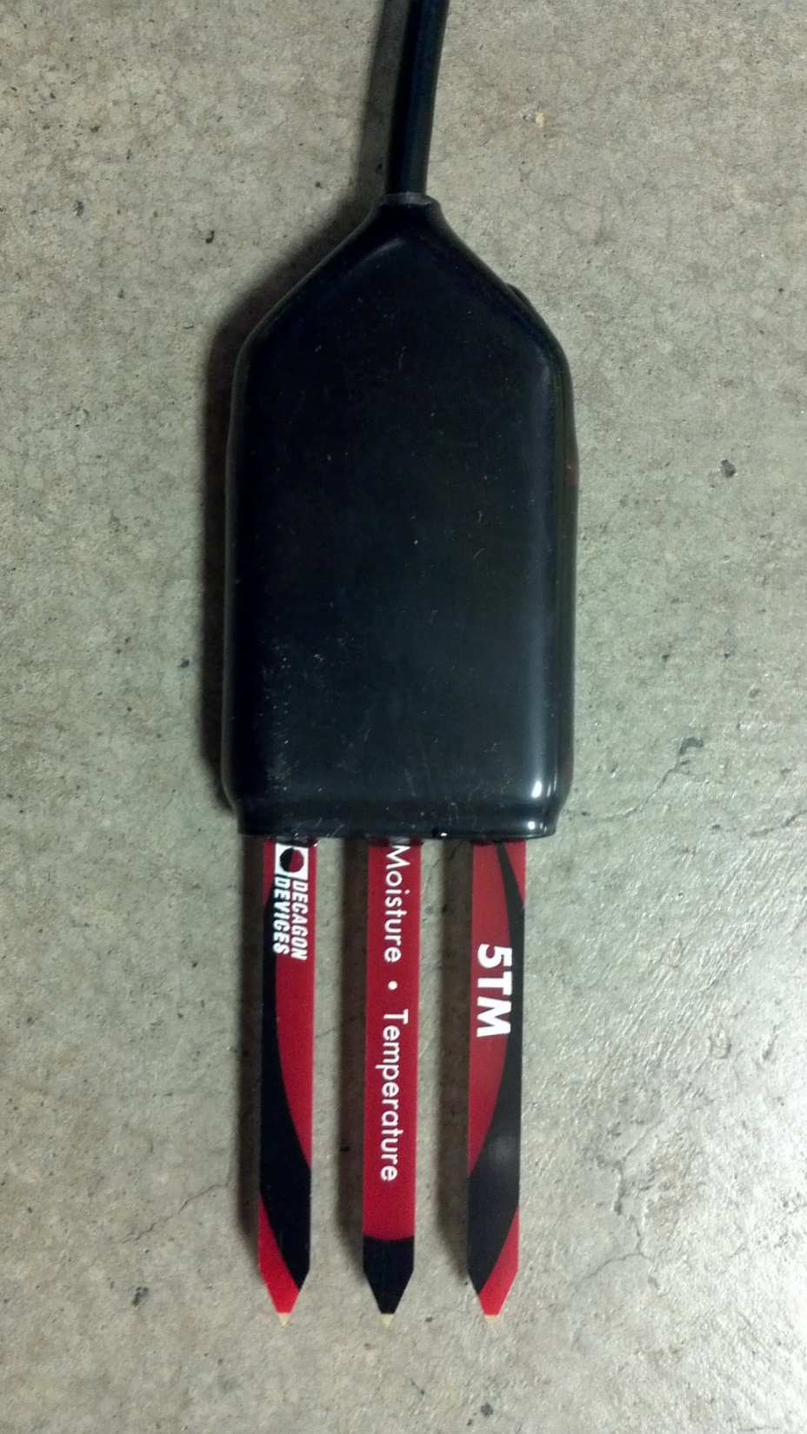
Resin-molded 5TM
Initially made for Biosphere 2
Polyurethane/epoxy resin molding
May be better for warm, saturated conditions

Slide 46
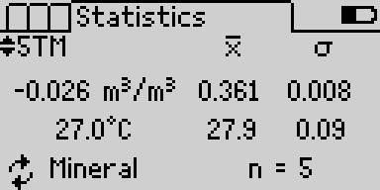
Updated ProCheck
Problem: Too many new sensors and limited memory space!
Solution: New processor and code to support current and future sensors
Bonus: Statistics feature
ProChecks with the “C” designation at the end of their code version will have this ability

Slide 47
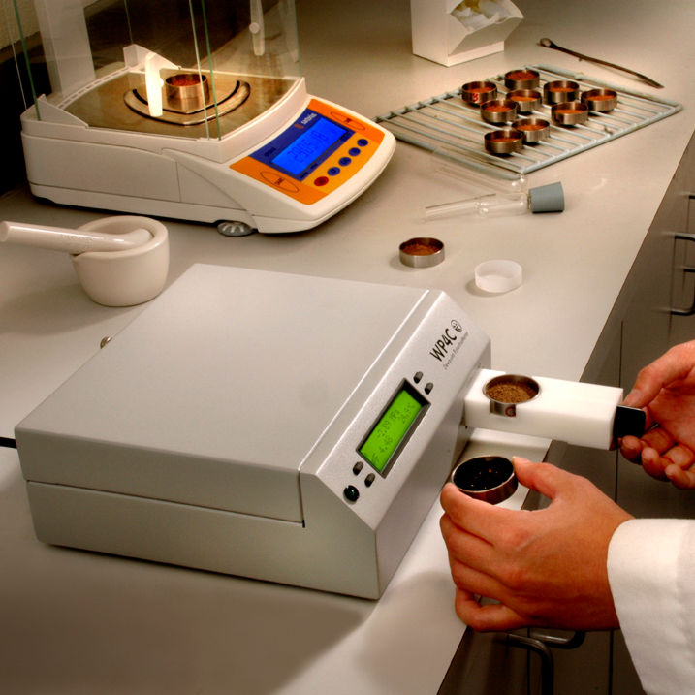
WP4C
What’s changed:
Higher temp. resolution
Increased range in the wet end (to -0.1 Mpa)
New modes: (fast, precise)

Slide 48
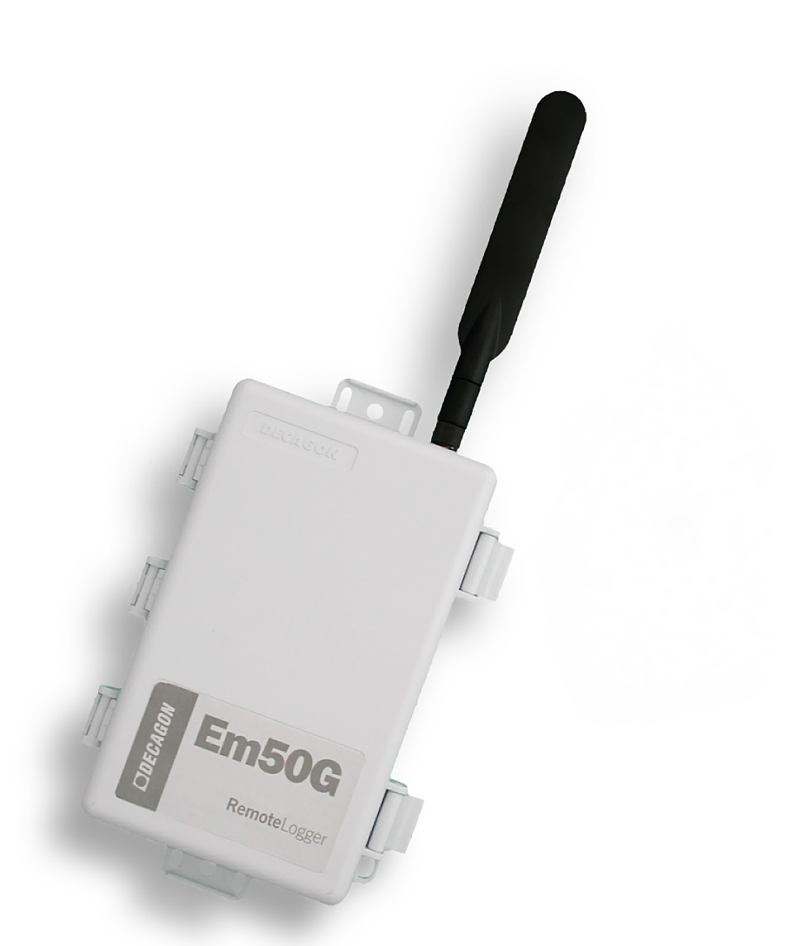
Em50G
GSM-enabled logger, delivers data via GSM providers to Decagon’s server
Data is available at any internet connection
Introduced in middle 2010,
~ 1300 units sold

Slide 49

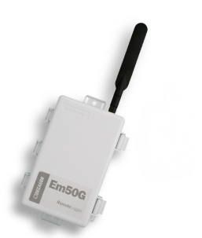
How does it work?
GSM/GPRS Cell Tower
Decagon
Internet Server
Internet
Computer + Software
+ Internet
Em50G
Logger + Sensors

Slide 50
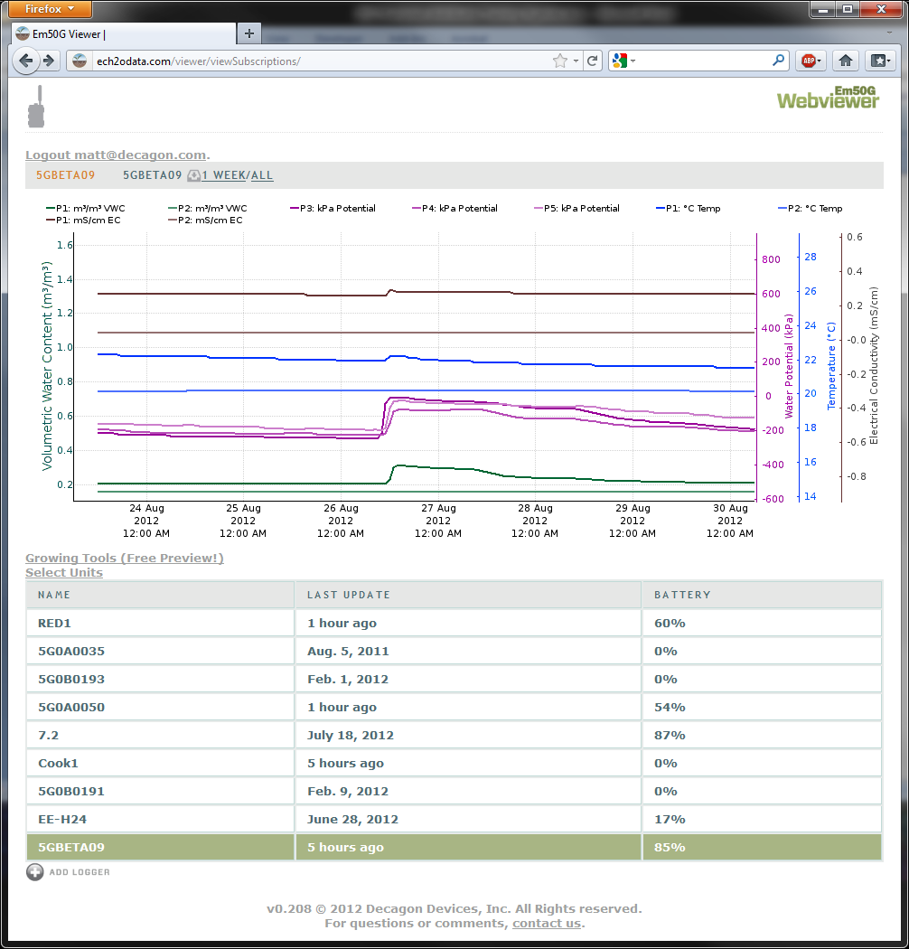
Webviewer for Em50G
Replaces Em50G downloader
Eventually will have more versions that can be used by growers/consultants

Slide 51
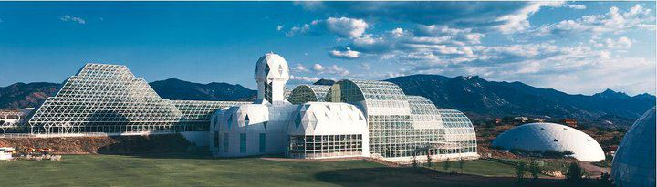
Case Study: Biosphere 2 LEO Project
Land-Earth-Observatory project in Arizona
Purchased 1500 5TM and 1500 MPS-2 sensors

Slide 52
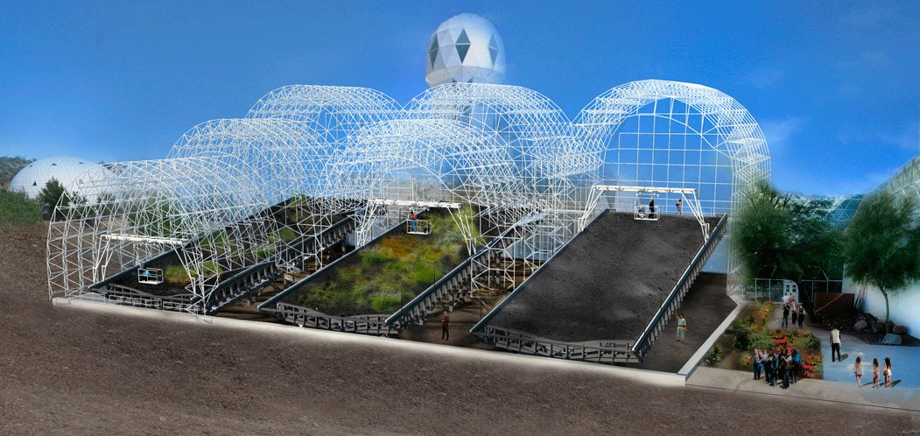
Monitor hydrological processes in the regolith

Slide 53
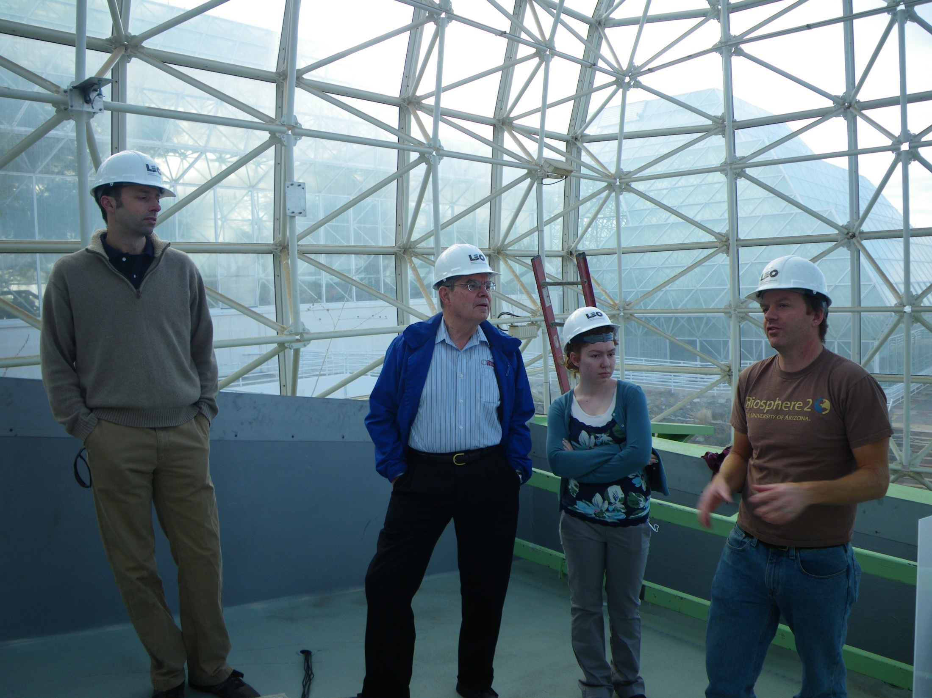

Slide 54
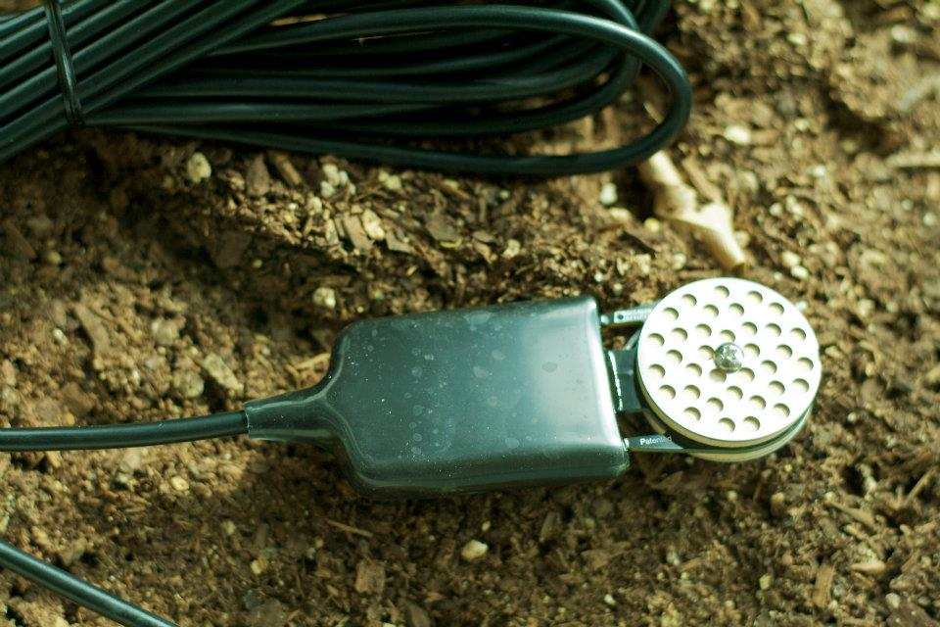
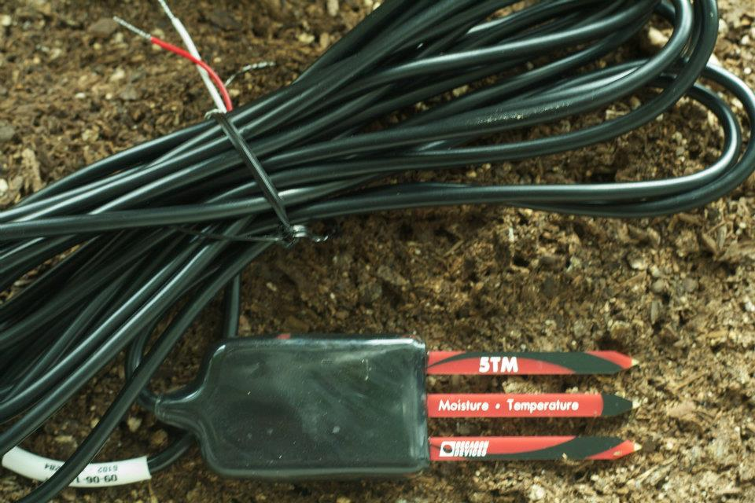
Pictures from Biosphere 2 Facebook page

Slide 55
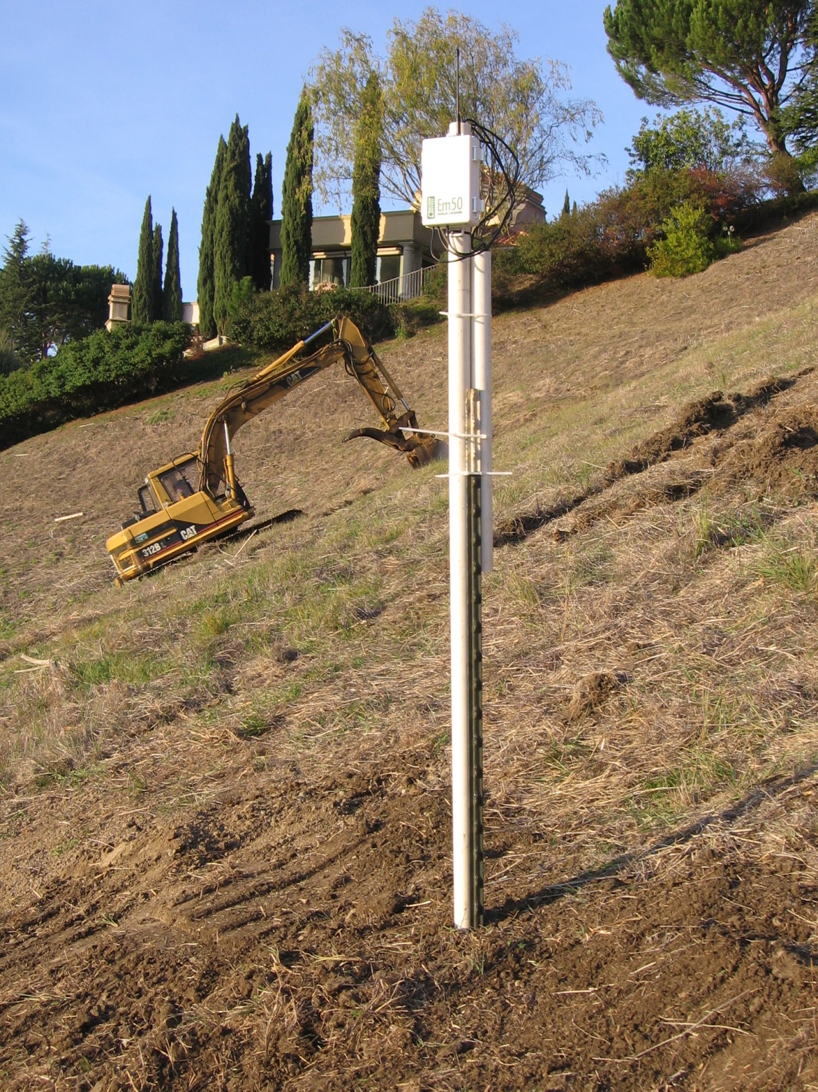
Slope stability study, California

Slide 56
Recent Marketing Resources
Microbial Growth Chart (water potential)
H2O convert app for iPhone and Android
Sensor quickstart guides
Product videos, Webinars, e-brochures -we can provide the footage and script if you want to translate
www.decagon.com/repag2/images

Slide 57
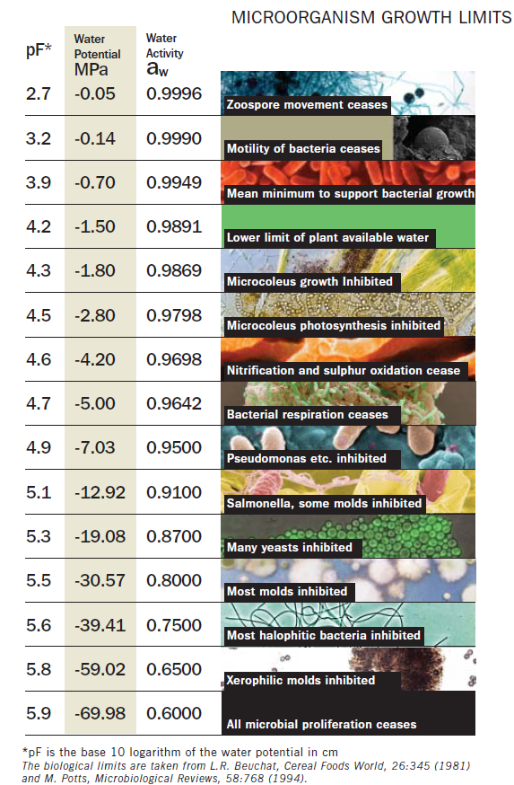
Microbial limits table (in catalog)

Slide 58
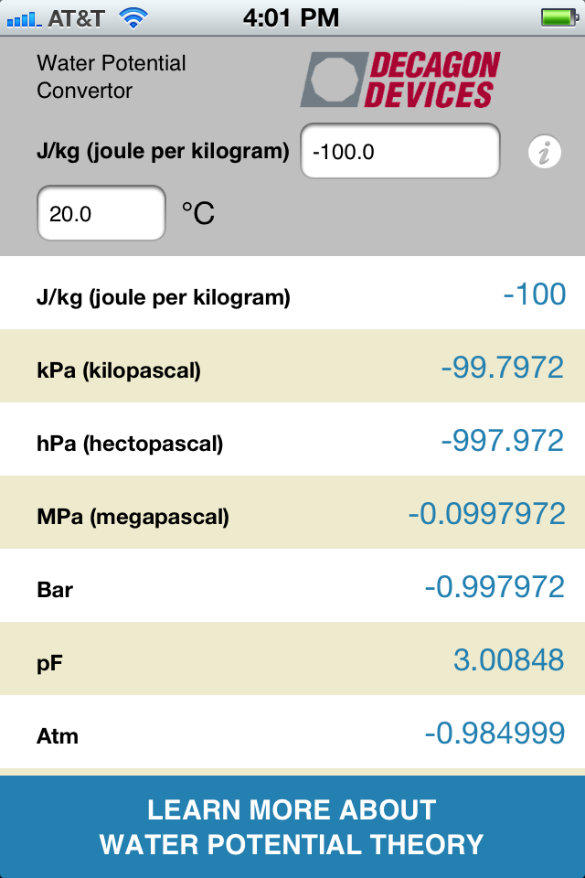

Slide 59
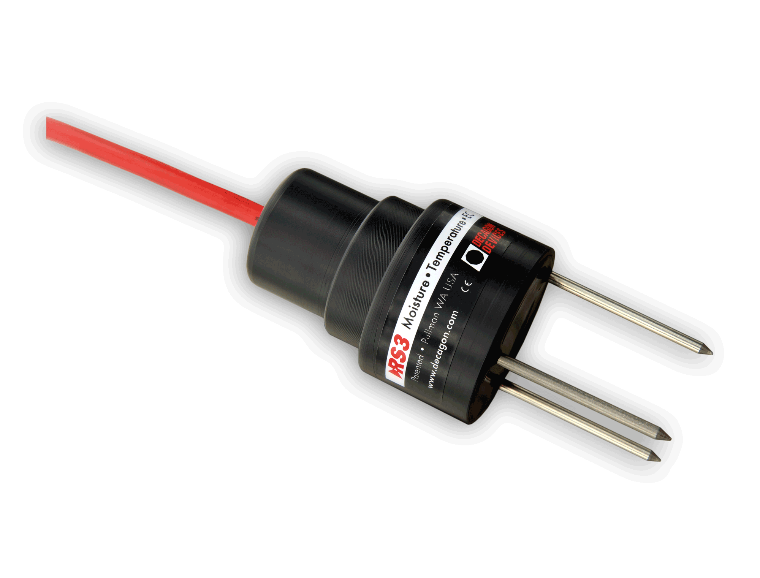
Coming Soon:
RS3 (Rugged Sensor)
No moving parts Rain Gage
“ “ sonic anemometer
SRS (spectral reflectance sensor)
PRI (absorbed vs. reflected PAR)
NDVI version
EC sensor
Multi-port logger
In-Situ Soil Profile moisture sensor
New RH/T sensor

