Slide 1
Decagon Instrument Assessment
Chris Chambers

Slide 2
Basic Troubleshooting
Power?
Signal?
Accuracy?

Slide 3
EM50 troubleshooting flow chart
Is the Status light blinking?
Connection made?
No
Yes
Yes
Attempt to connect to logger
No
Replace batteries and press reset button
Ports?
Sensors?
Communications?
Correct Com port selected?
Device Driver installed?
Cable ok?
Error message?
Status light comes on?
Contact Decagon for an RMA
No

Slide 4
EM50G Telemetry
If you can connect to the logger, but cannot remotely download data from an EM50G:
  Run a telemetry test. Note any messages returned.
  If test failed, launch Ech₂o Utility, go to Actions and select “List cellular carriers”. Is there any carrier compatible with your SIM plan?
  Contact support@decagon.com and provide:
    Device ID
    Approximate location of logger
    Error messages returned by telemetry test

Slide 5
Sensor Troubleshooting
There are no known cases of our sensors drifting over time.
They usually either work or they do not.
#1 cause of sensor problems is cable damage

Slide 6
Soil moisture Sensors
Sensor | Air reading | Water
EC5 | 323 | 1300
10HS | 470 | 1550
5TE/5TM* | 1 | 80
GS3* | 1 | ~75
GS1 | 1380 | 3150

Slide 7
If the customer is using a non-Decagon logger
Check wiring!

Slide 8
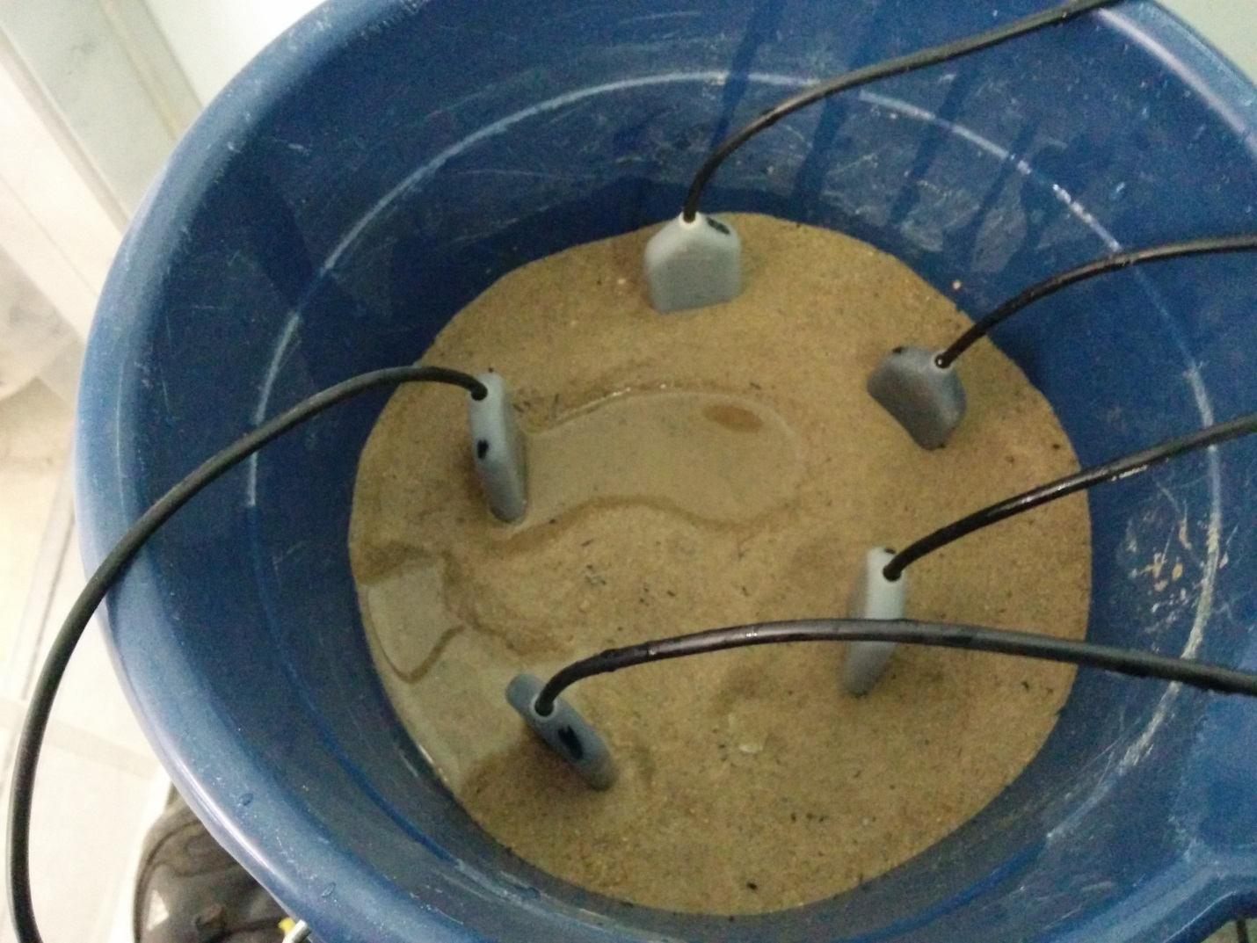

Slide 9
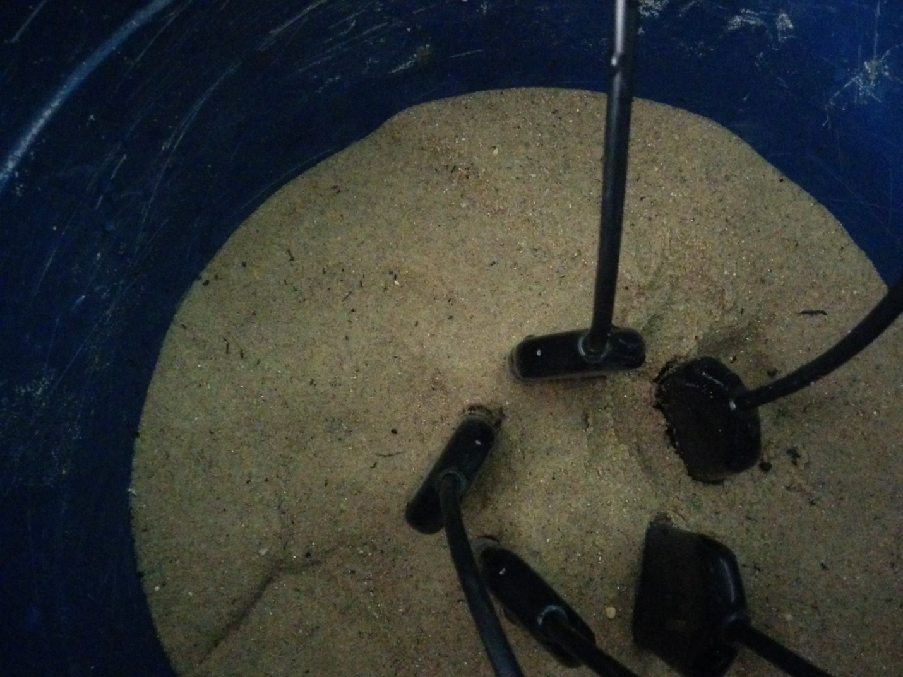

Slide 10
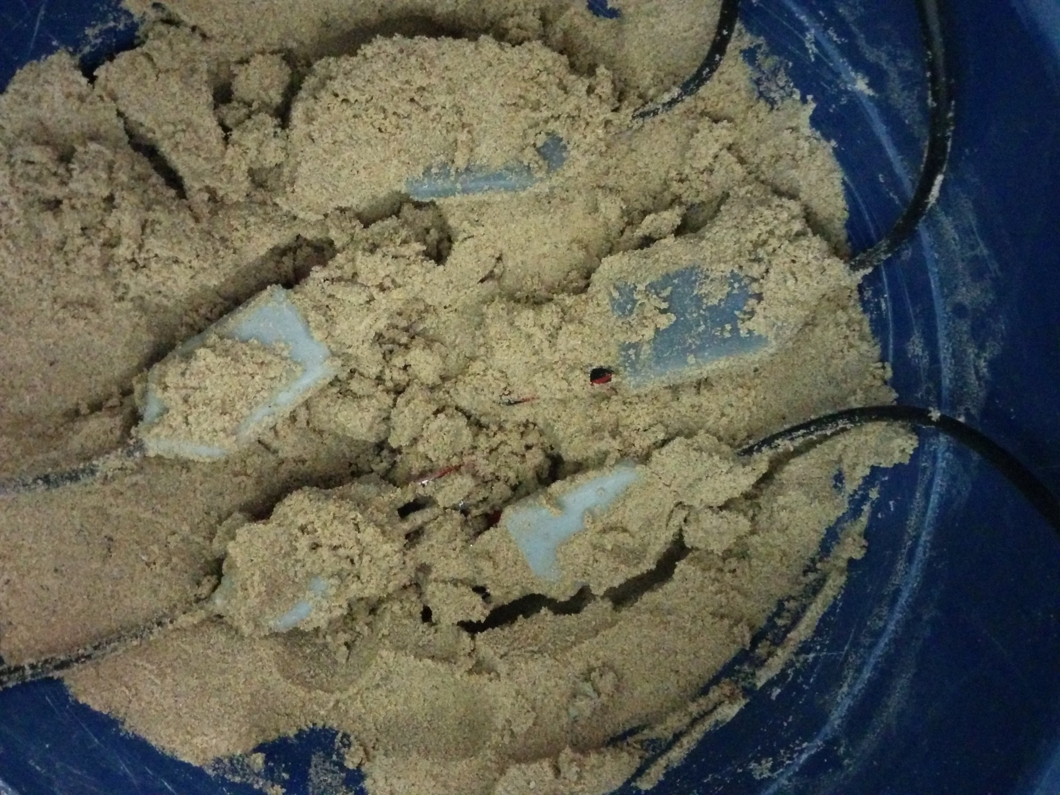

Slide 11
Firmware updates
I absolutely recommend regular firmware updates for:
  Loggers
  Instruments (LP-80, SC-1, ProCheck, etc.)
I do not recommend sensor updates unless there is a known problem that it may solve

Slide 12
Other troubleshooting advice
Check the manual!
A correct date and time and location is critical for some instruments
  LP-80
Calibrations need to be done correctly and regularly
  LP-80
  SC-1

Slide 13
Return Material Authorization (RMA)
support@decagon.com, ponczoch@decagon.com
We need:
  Name/model of instrument
  Quantity
  Symptoms exhibited by the instrument
  Serial number(s) where applicable

Slide 14
Decagon Tech update list
https://groups.google.com/a/decagon.com/forum/?hl=en#!forum/decagontechupdates

