Slide 1
Calibration and Installation of Soil moisture sensors
Matt Galloway

Slide 2
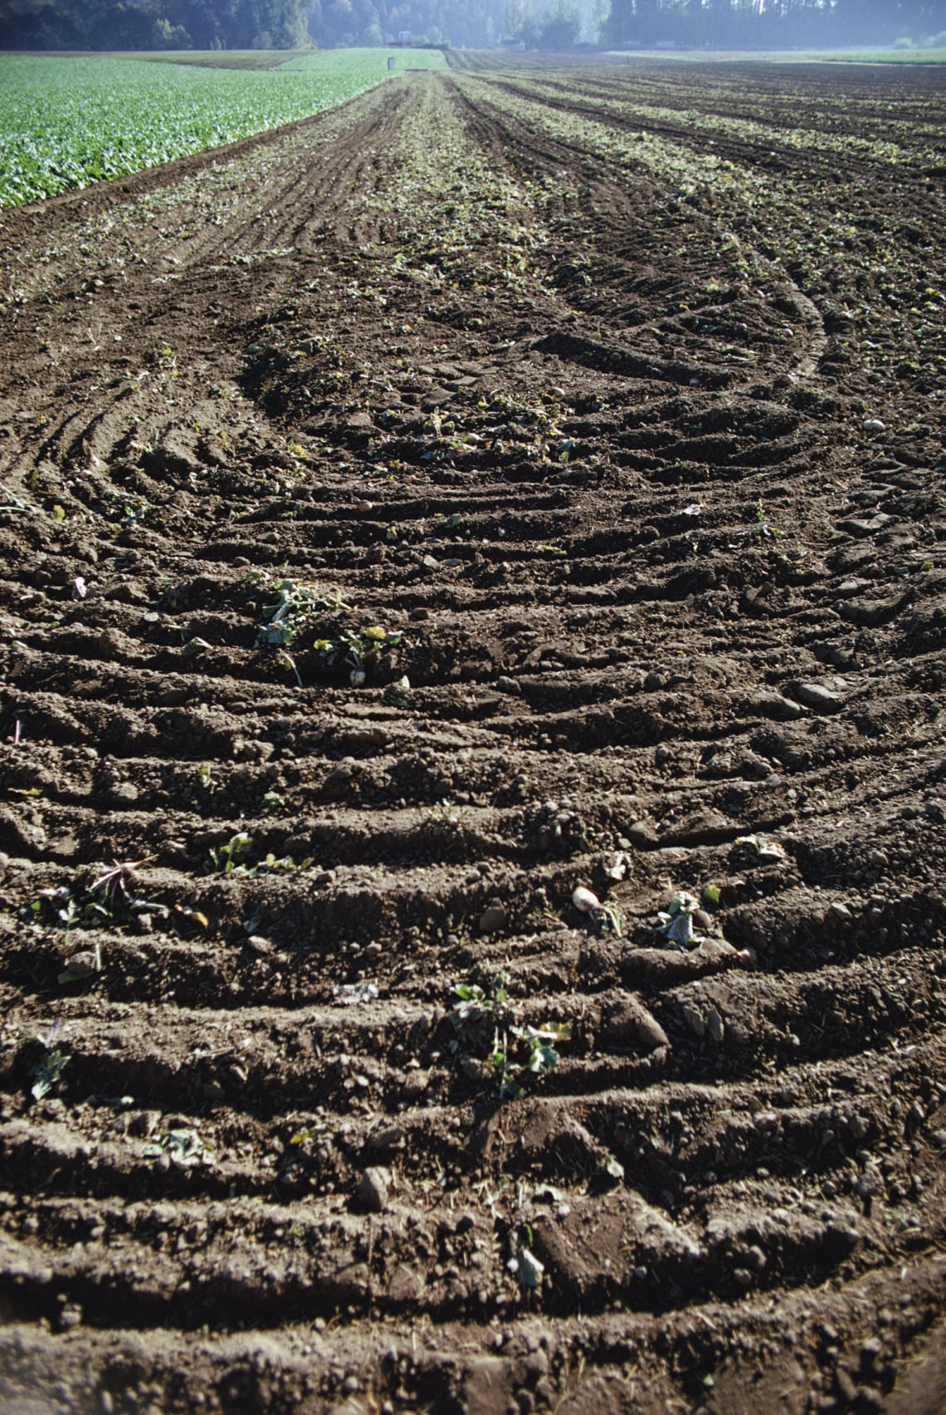
Volumetric water content sensors measure volumetric water content, right?

Slide 3
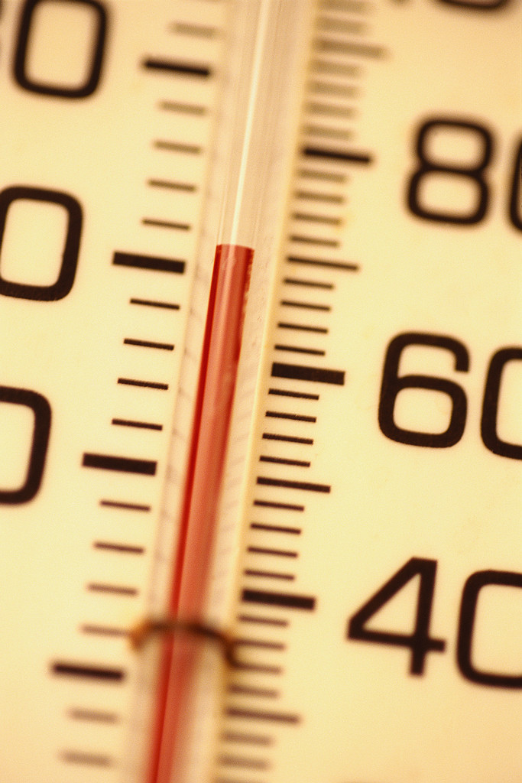
Do thermometers measure temperature?
Temperature is measured by its effect on the physical properties on some substance
Example: Mercury changes volume with temperature change in a predictable manner
The effect is calibrated with various scales (Fahrenheit, Celsius, Kelvin)
Thermometers do NOT measure temperature

Slide 4
So what do water content sensors measure?
VWC sensors measure the dielectric permittivity of the soil (ability of the soil to hold an electric charge)
Dielectric permittivity changes in a predictable manner
Volumetric water content is measured by its effect on the dielectric permittivity of the surrounding medium

Slide 5



Volumetric vs. Gravimetric Water Content
Volumetric Water Content (VWC): Symbol - θ
Gravimetric Water Content (GWC): Symbol - w
Air
15%
35%
Water
50%
Soil
Notes:
I am going to go through a few “reminder” slides to make sure we’re all on the same page about volumetric water content. This slide has been in almost every virtual seminar we have had regarding soil moisture. Today we will be talking about volumetric water content, which is the ratio of the volume of water to the total volume. Gravimetric water content, another water content measurement, is the ratio of the weight of the water to the total weight. If you want to know the gravimetric water content of your soils, you can calculate it from the volumetric water content data that you collect from your sensors if you also know the bulk density of your soils.

Slide 6
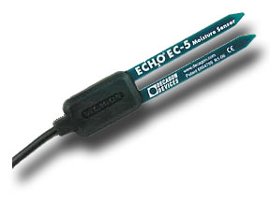
Example: How Capacitance Sensors Function
2 cm
Sensor (Side View)
1 cm
EM Field
0 cm
Notes:
Decagon’s dielectric sensors work by treating the soil as a capacitor. I am not going to go into too much detail about this, but know that the sensor creates an electromagnetic field which surrounds the sensor to measure the capacitance of the soil.

Slide 7
Dielectric Theory: How it works
In a heterogeneous medium (such as soil):
  Volume fraction of any constituent is related to the total dielectric permittivity
  Changing any constituent volume changes the total dielectric
  Because of its high dielectric permittivity, changes in water volume have the most significant effect on the total dielectric
Material | Dielectric Permittivity
Air | 1
Soil Minerals | 3 - 7
Organic Matter | 2 - 5
Ice | 5
Water | 80
Notes:
I also just want to spend about two minutes talking about how dielectric soil moisture sensors work. Dielectric soil moisture sensors do not actually measure water in the soils. Instead, the sensors measure the dielectric permittivity of whatever they are placed in. Dielectric permittivity is a material property that tells you how well something can hold an electric charge. This value is a unitless value. For instance, the dielectric permittivity of air is 1. The dielectric permittivity of soil is typically between 3 and 7 while the dielectric permittivity of water is 80. In heterogeneous medium, the volume fraction of the constituents is related to the total dielectric permittivity. Any changes to the volume fractions of any of the constituents will result in a change to the total dielectric. Because of its high dielectric permittivity and the low variability of the dielectric permittivity of soil minerals, changes in water volume has the most significant effect on the total dielectric. So, in essence, dielectric soil moisture sensors measure the dielectric permittivity of the surrounding medium and use some sort of calibration to relate the dielectric permittivity read by that sensor to volumetric water content.

Slide 8
Dielectric/VWC Relationship
ε is the relative dielectric permittivity
x is the volume fraction
the subscripts b, a, m, and w refer to bulk, air, mineral and water
The permittivity of air as 1.
The permittivity of soil minerals can range from 3 to 16, but a value of 4 is often used.
Notes:
We have already said Dielectric sensors do not sense water content; they measure the bulk dielectric permittivity of the soil. Two elements are therefore involved in determining accuracy: the accuracy with which the sensor is able to determine the bulk dielectric constant and the accuracy of the relationship between the dielectric constant and the soil water content. We have already talked about the variables that can affect measuring bulk dielectric permittivity. Now, let’s look at the relationship between dielectric permittivity and volumetric water content. We can analyze this by using a typical dielectric mixing model.
On the left side of the equation, we have our bulk dielectric permittivity. On the right side, we have the components that affect bulk dielectric permittivity along with their volume fractions. The first component is air, the second component is mineral soil, and the third component is water. We’re going to spend a few minutes talking about how variations in the air component and the mineral component may affect the accuracy of our measurements.

Slide 9
Dielectric/VWC Relationship
To get an equation relating water content to measured permittivity
substitute for x_{a} the expression 1 - θ - x_{m},
Substitute x_{m} the ratio of bulk to particle density of the soil, ρ_{b}/ρ_{s}
Notes:
We can look at these different components by rearranging our equation a little bit. We know we really want to know the water content so we’re going to put that on the left side of the equation. . We also know that the fraction of soil that is air is 1 minus the fraction that is water minus the fraction that is minerals. Finally, we know the volume fraction of soils if we divide the bulk density by the particle density. Long story short, This equation can be used to determine the sensitivity of predicted water content to uncertainties in the various parameters that determine water content.

Slide 10
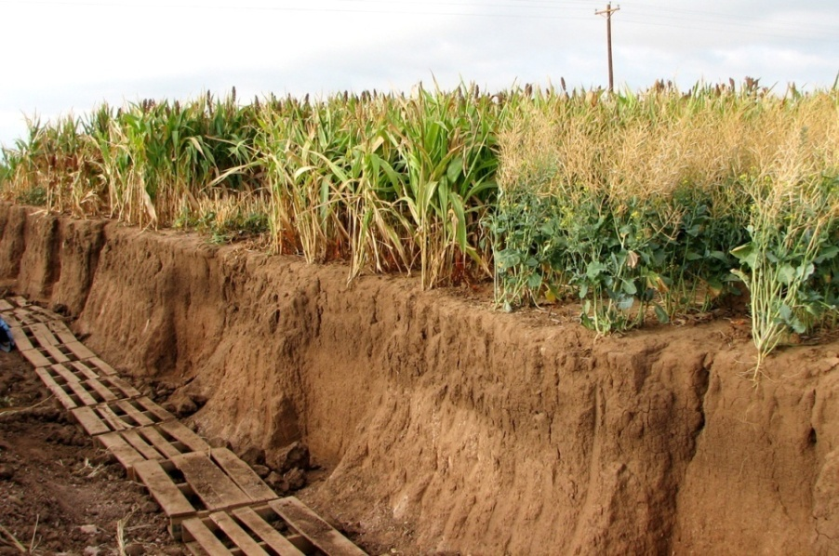
Factors affecting accuracy
Sensor’s ability to measure bulk dielectric permittivity accurately
Installation quality
Relationship between bulk dielectric permittivity and VWC (Calibration)
Notes:
The only accuracy that the sensor, and thus the manufacturer, has any control over is the sensor’s ability to measure bulk dielectric permittivity accurately. We’ll talk about why this is on the next few slides. We’ll also talk about how the relationship between bulk dielectric permittivity and volumetric water content may affect the accuracy of your measurements. Last, I am just going to talk about the things you can do to increase the accuracy of your sensors just by installing them correctly.

Slide 11
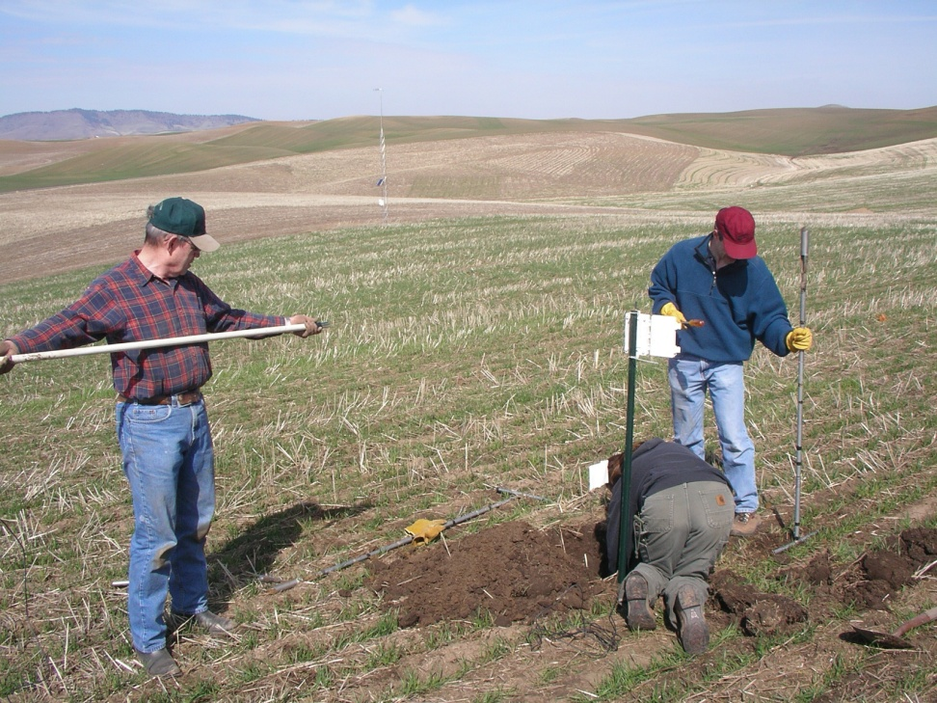
Installation Quality
Effect of installation technique
Air gaps= Biggest loss of accuracy
Air gaps= Biggest loss of accuracy!
Rocks in close vicinity of the sensor
Best to push sensor into undisturbed soil
Notes:
The last major variable in measurement accuracy is how the sensors are installed. I did not unintentially put air gaps on here twice. Air gaps between the sensor and the soil cause the sensor to measure the dielectric permittivity of air (rather than soil and water).
Rocks in close vicinity of the sensor may cause sensor to underestimate the volumetric water content of the surrounding soil. You may have the perfect sensor and the perfect calibration for your soil, but if the quality of your installation is poor, then your numbers will be junk.

Slide 12
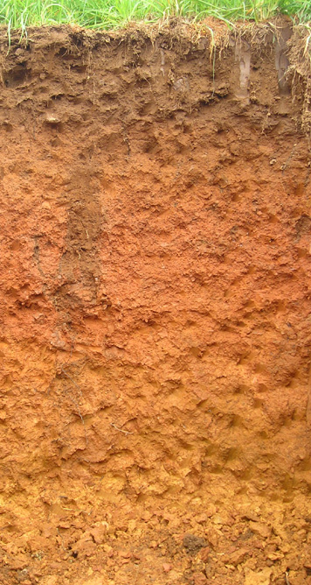

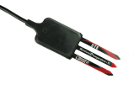
Installation
4
2
3
Many techniques for sensors installation
  Trench wall
  5 cm diameter auger hole: bottom
  10 cm diameter auger hole: side wall
  45º angled 5 cm auger hole: bottom
Sensor insertion
  Sensor orientation must be vertical, not horizontal
1
Install video:
http://www.decagon.com/education/video-index/
Notes:
I will not be spending a lot of time on installation.
It is important, but was covered in another virtual seminar.
Still, I would like to discuss some techniques to give some background to our case studies.

Slide 13
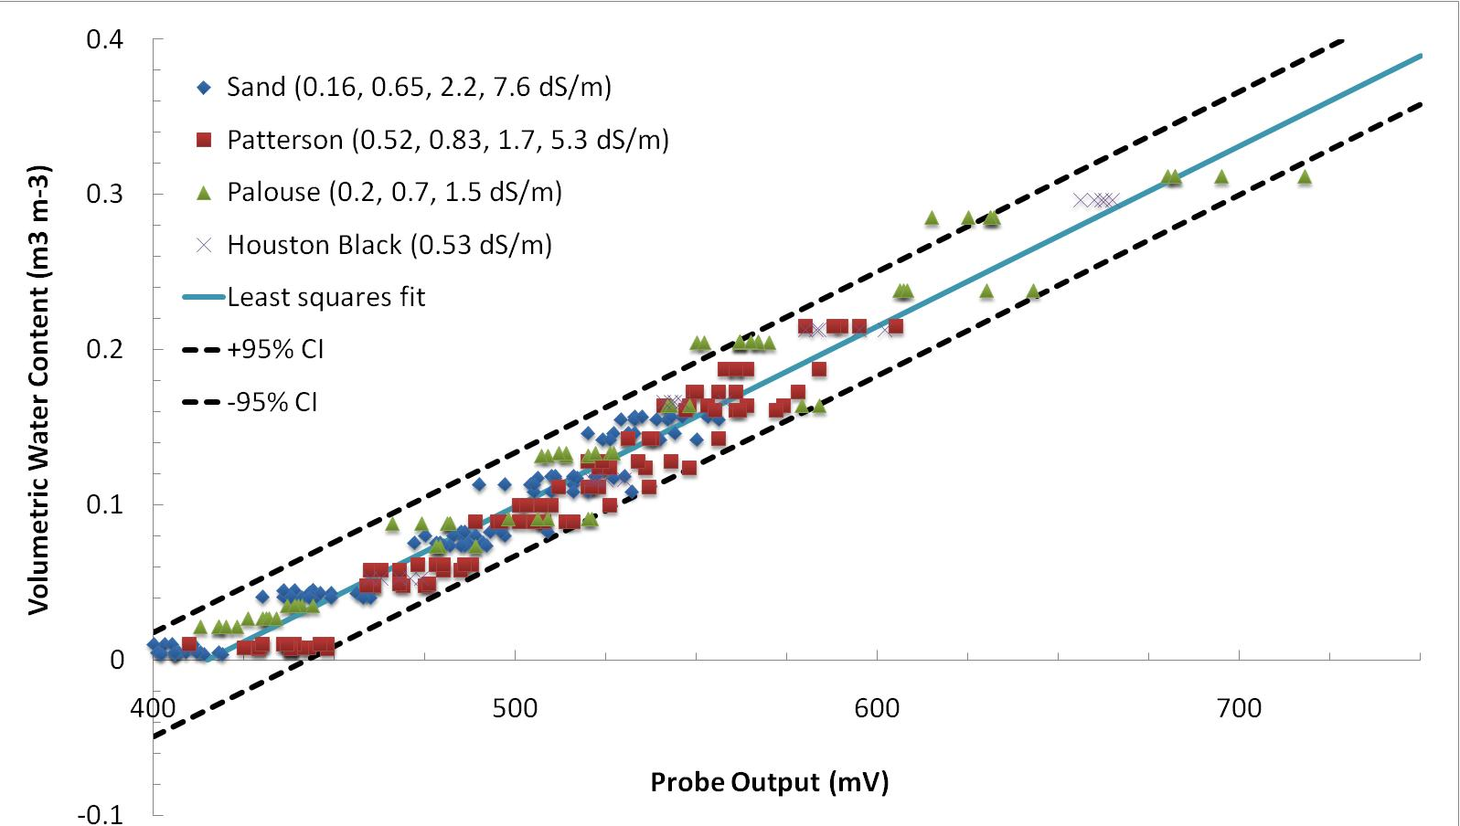
Decagon’s Factory Calibrations
Mineral Soil Calibration
Results validated in the Journal of Hydrology paper: Kizito et. al (2008) Frequency, electrical conductivity, and temperature analysis of a low-cost capacitance soil moisture sensor. 352, 367-378
Notes:
Before I tell you about how we do your calibrations, I am going to show you our three factory calibrations so that you will know if you even need to sit through the rest of this talk. The factory calibrations are incorporated into our software and are displayed in application notes and manuals The first one, for mineral soil, was obtained experimentally using these data. I told you that it is only possible for manufacturers to give specs on how well a sensor measures dielectric permittivity. This is still true, but we try and estimate the accuracy in soils because we believe that this makes more sense to most people. We took a dune sand, a patterson silt loam, a palouse silt loam, and a houston black clay and ran a homogenize soil calibration on each soil using 5 different sensors and solutions with differing electrical conductivity. This graph demonstrates that the EC-5 sensor’s factory calibration is not affected by soil texture differences or soil electrical conductivities up to about 8 dS/m. These results were validated in this journal of hydrology paper from Kizito et al last year. If you are publishing data using our sensors and want to reference a peer reviewed paper regarding our factory calibration, you can use this paper depending on what sensor you are using.

Slide 14
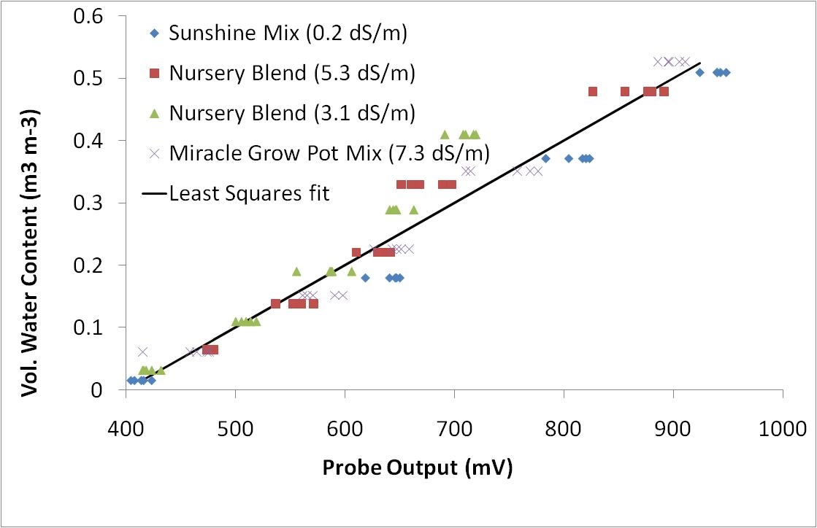
Decagon’s Factory Calibrations
Potting Soil Calibration
Notes:
This is our second factory calibration, which can be used when you are measuring the volumetric water content of potting soil. We found that the mix of potting soils did not have an effect on the calibration.

Slide 15
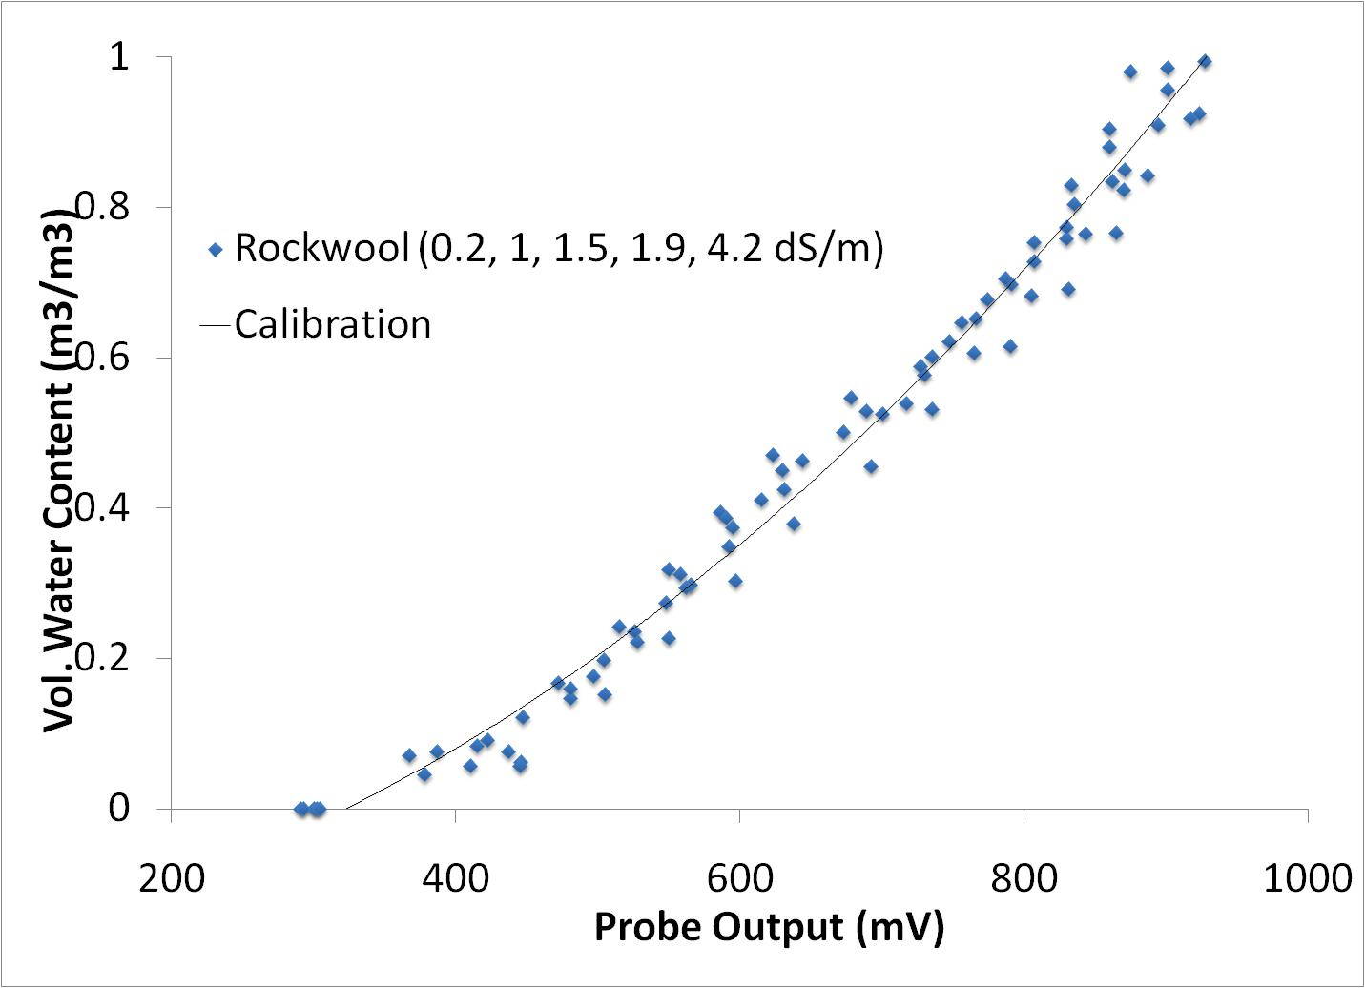
Decagon’s Factory Calibrations
Rockwool Calibration
Notes:
The last factory calibration is our rockwool calibration. Rockwool is a substance with high porosity used in greenhouses. All of the equations for each sensor’s factory calibrations can be found in each of the sensor’s manual. If you have questions about them, please call Decagon.

Slide 16
Decagon’s Factory Calibrations
You probably want to calibrate your sensors when…
Bulk EC levels are higher than 10 dS/m
Your soils are not “typical” soils
  High titanium soils
  Volcanic or low-density soils
  Unusually high organic matter in soils, high litter content
  Heterogeneous bulk densities (such as those found in peat)
  You are measuring the water content of a different medium
You are using the sensors in a manner for which they weren’t designed
Your study requires better than 3% VWC accuracy
Notes:
(custom calibration assumes that the EC does not change too much)
(ex: lab experiment where overmolding is not fully penetrating soil)

Slide 17
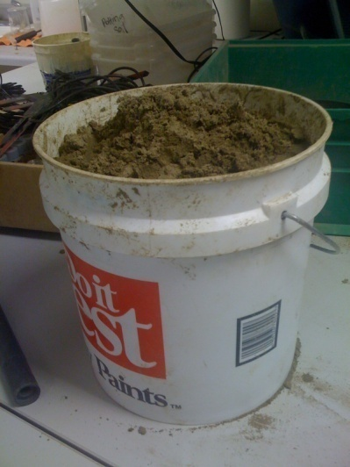
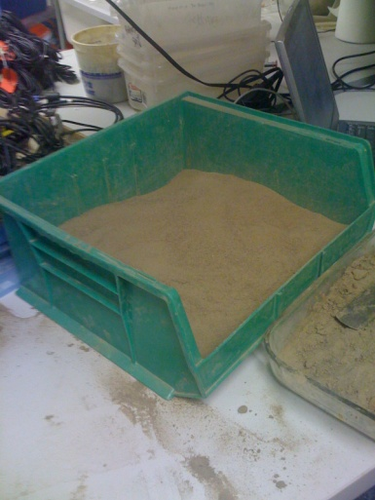
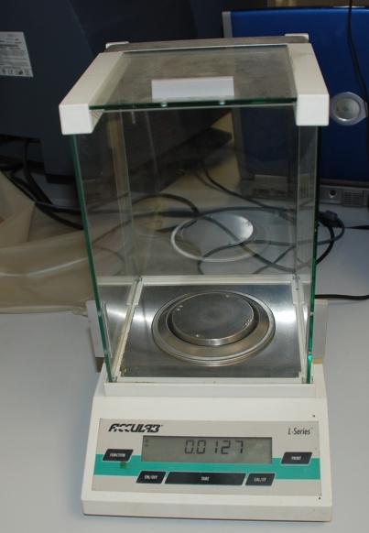
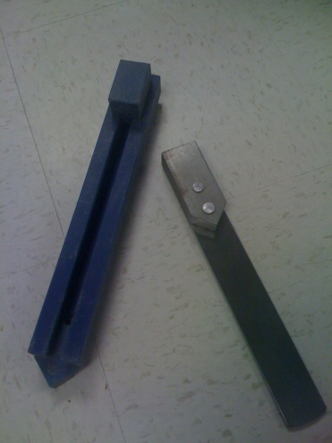
Custom Calibrations
Homogenized Soil Method-Materials Needed
Container with the size and shape to accommodate the sensor’s zone of influence
Larger container used for homogenizing soil
Sensors
The read-out device you will be using with your sensor
Balance (with resolution 0.01 g or greater)
Oven
Decagon insertion tool
Vials for soil subsamples
Soil sampling device
Notes:
The homogenized soil method is the method from SSSA’s Method’s of Soil Analysis Book, which everyone can either find in their lab or in the closest scientific library. We’ve modified it a little bit to be specific to our sensors. The benefit to this method is that you are, as close as possible, testing the sensor’s ability to measure a well-known volumetric water content. The limitation of this method is that you have to try and keep a consistent bulk density every time. For this calibration you will need two large containers, the sensors you will be using in the field, the read out device you will be using with your sensors, a balance, an oven, a decagon insertion tool if you are calibrating 10HS, EC-10, or EC-20 sensors, glass vials with lids for soil subsamples, and a soil sampling device with a known volume.

Slide 18
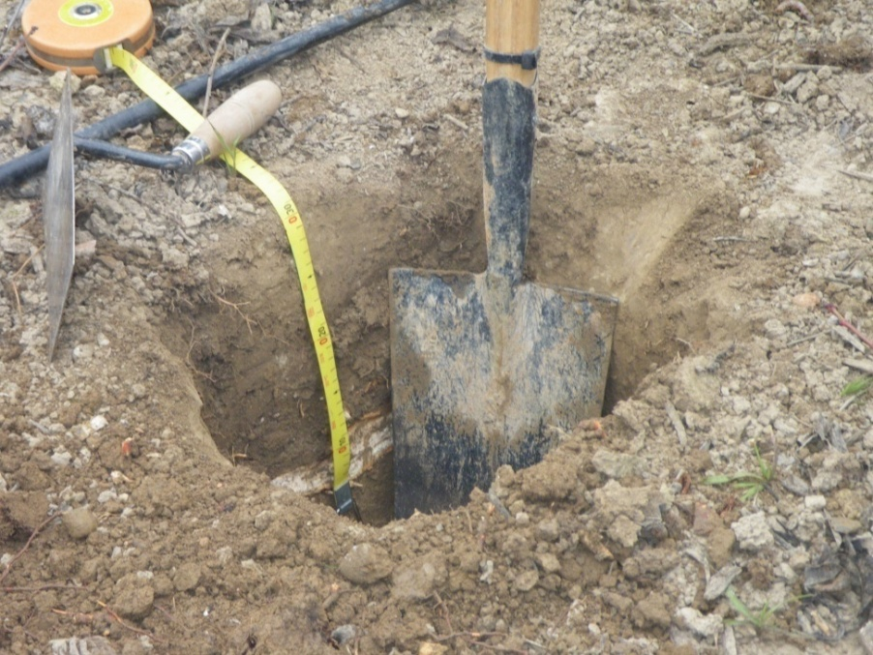
Custom Calibrations
Homogenized Soil Method-Soil Sample Collection
Collect approximately 4 L of soil from the area/depth that you want to use the sensors
Take samples for bulk density measurements as well (you can use your volumetric sampling device for this)
Notes:
Collect approximately 4 L of soil from the area/depth that you want to use the sensors
Take samples for bulk density measurements as well (you can use your volumetric sampling device for this). To do this, collect several soil cores of undisturbed soil using a sampling device of a known volume. Oven dry the soil cores and measure the mass of the dry soil. Calculate bulk density by dividing the dry mass of the soil by the volume of the soil.

Slide 19
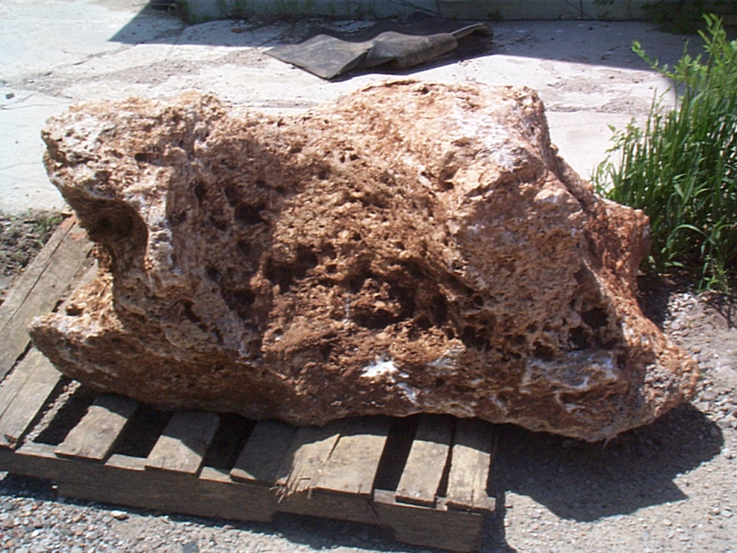
Custom Calibrations
Homogenized Soil Method-Sample Preparation
Air dry the soil
Remove large objects from the soil
Notes:
Air drying is quickest if the soil is spread in a thin layer and air is moved over the soil. The presence of large rocks or other objects can complicate the calibration process. Break up any large clods and pass soil through a 5 mm sieve before proceeding. Keep in mind that in some materials, it will not be possible to remove large particles without significantly altering the nature of the material. If this is the case for your soils, you may want to further explore the hanging water column method.

Slide 20
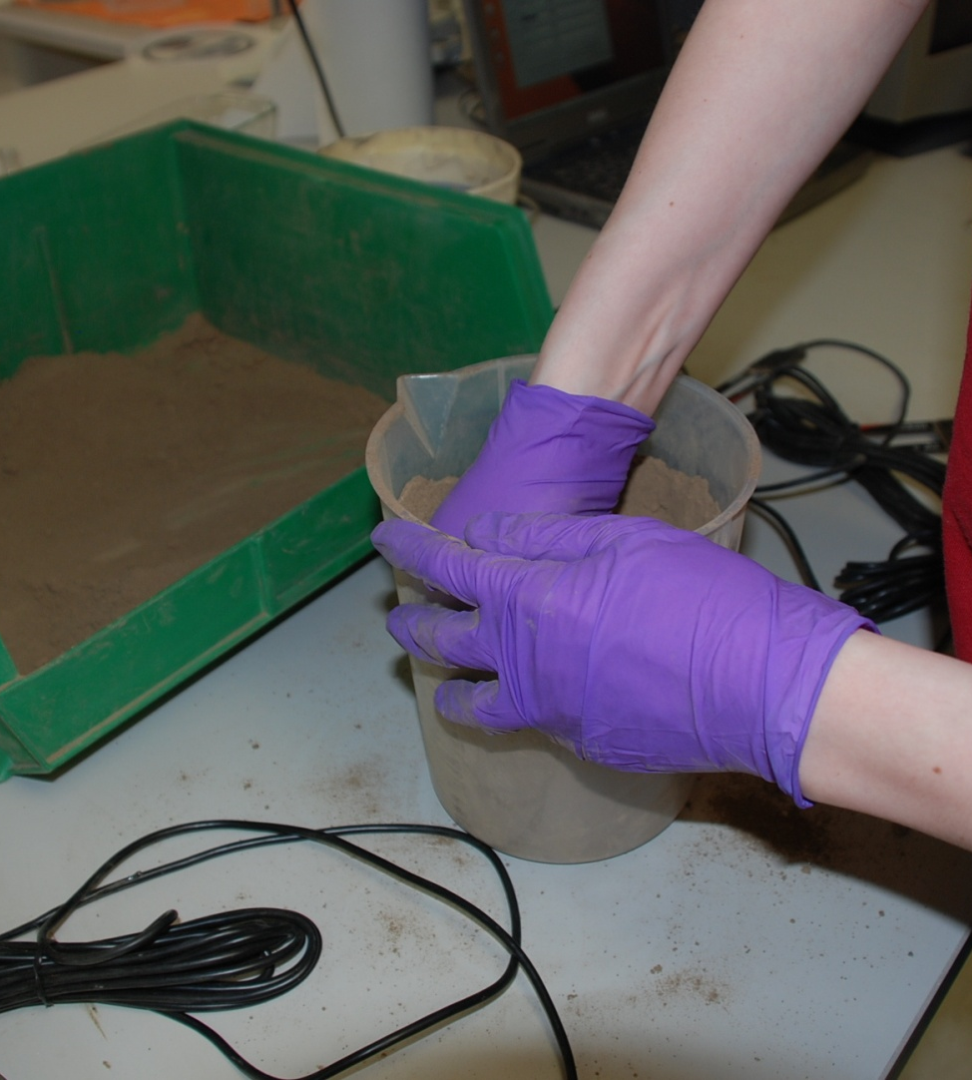
Custom Calibrations
Homogenized Soil Method- Calibration
Check to make sure container size is sufficient
Pack the soil into the calibration container
Notes:
First, you want to check and make sure the container size is sufficient. You can do this by packing the test container with soil, inserting the probe, recording the sensor output, and then setting the container with the soil and probe into a larger container with water filling the spaces between the container. Then, record the new water content. Only use the test container for the calibration if there is insignificant change between the two measured water contents. Pack the soil into the calibration container at approximately the field bulk density. It is generally necessary to add the soil in layers, packing each layer before adding the next. If you are using our older sensors such as the EC-10 and EC-20, you should pack the container halfway, place the sensor in the container, and then pack the soil around the sensor the rest of the way.

Slide 21
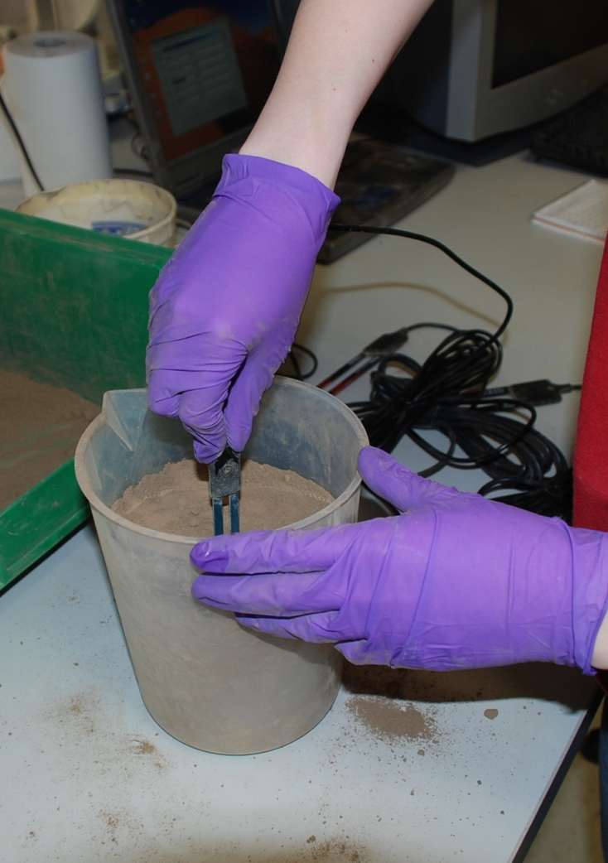
Custom Calibrations
Homogenized Soil Method- Calibration
Insert sensor
  When using the EC-5, 5TE, or 5TM, insert the sensor into the packed soil
Notes:
After the soil is packed into the container, insert the sensor verticaly. If you are using the EC-5, 5TE, or EC-TM, insert the sensor directly into the packed soil.

Slide 22
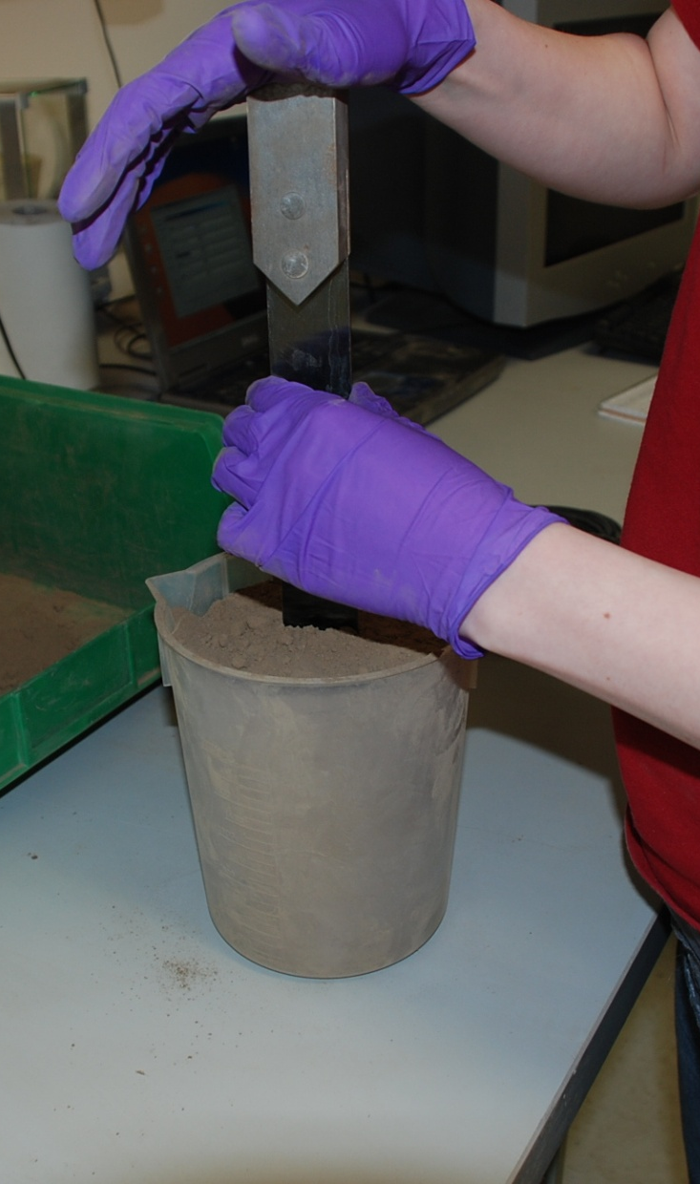
Custom Calibrations
Homogenized Soil Method- Calibration
Insert sensor
  When using the EC-5, 5TE, or EC-TM, insert the sensor into the packed soil
  When using the 10HS, use an insertion tool to create a pilot hole for the sensor.
Notes:
When using the 10HS, the EC-10, or the EC-20, use the insertion tool to create a pilot hole for the sensor

Slide 23
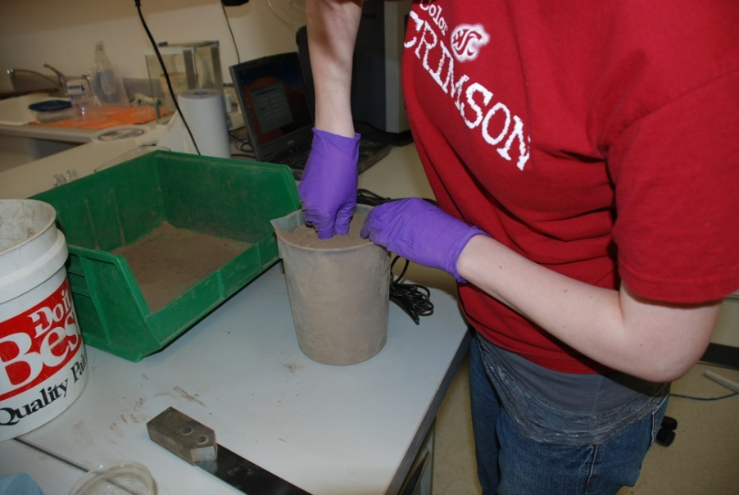
Custom Calibrations
Homogenized Soil Method- Calibration
After inserting sensor, prongs, continue to push sensor into soil until both the prongs and the top of the overmolding are covered.
Pack soil around remaining portion of probe base.
Take a probe reading.
Repeat steps 4-6
Notes:
Insert the sensor fully into the soil. This includes the black plastic base of the probe. If you cannot insert the black plastic portion fully into the soil, insert the probe as far as possible, and take some additional soil and pack it around the remaining portion of the sensor base.
Take a probe reading using the device that you will be using to log data in the field and collect the raw data. This is important because some data loggers will excited the sensors at a different voltage than other data loggers and some of the sensor outputs are dependant upon excitation voltage. At this point, you will either have raw counts if you are using Decagon data loggers or mv output if you are using CSI loggers for the analog sensors. If you are calibrating the 5TE or the EC-TM, which are digitials sensors, you will have unprocessed raw parts.
You’ll want to repeat steps 4-6 a few times to make sure you are getting consistent readings.

Slide 24
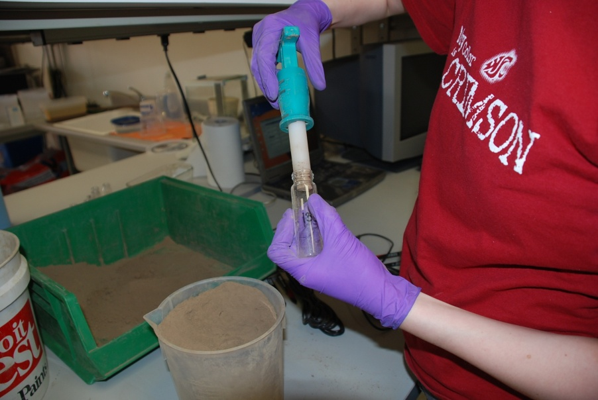
Custom Calibrations
Homogenized Soil Method- Calibration
Insert the volumetric soil sampler (such as the one shown: ESS Core N’ One available from Environmental Sampling Supply)
Remove sampler
Place in a drying container and replace the lid
Take at least three samples
Measure and record the mass of the wet soil.
Notes:
The next step is collecting a volumetric soil sample. Without removing the echo probe, insert the volumetric soil sampler fully into undisturbed soil near the probe. Remove the sampler making sure that the soil core inside is intact. Shave excess soil from the end with a flat edge. Place the sample a oven-proof container with a lid, such as a babyfood jar, and recap the lid.

Slide 25
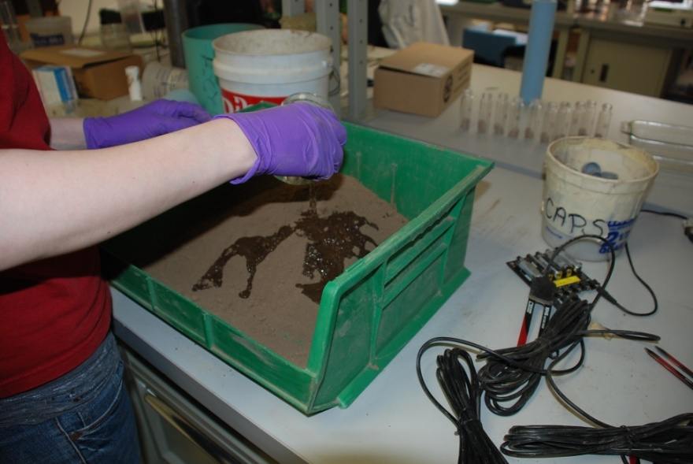
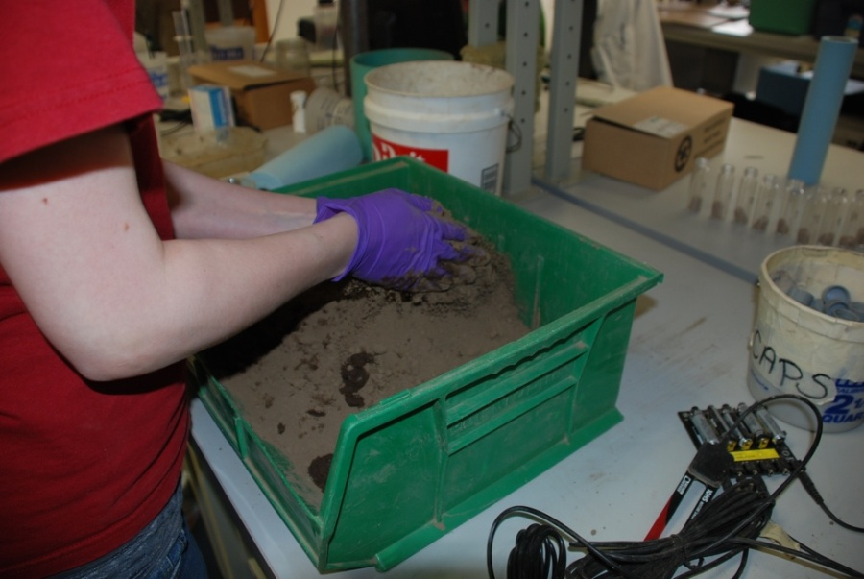
Custom Calibrations
Homogenized Soil Method-Calibration
Add about 200-300 mL of water to larger container and soil
Thoroughly mix the soil with your hands or a trowel
Repeat steps 2-14 until soil nears saturation.
Dry all soil samples at 105 C for 24 hours (60-70 C for 48 hours for high organic soils)
Weigh and record all dry soil sample weights
Notes:
Now, you’re ready to make another point on your calibration curve. Dump your soil from your calibration container into the large mixing container and add 200-300 mL of water to the soil as evenly as possible. Thoroughly mix the soil with your hands or a trowel until the mixture is homogeneous. Then, repeat steps 2-13 until soil nears saturation. This generally yields 5-7 calibration points.

Slide 26
Custom Calibrations
Homogenized Soil Method-Calibration Calculations
Notes:
This is an example of what your data set will look like.

Slide 27
Custom Calibrations
Homogenized Soil Method-Calibration Calculations
  θ = V_{w}/V_{t} where θ is volumetric water content (cm³/cm³)
  m_{w} = m_{wet} – m_{dry} where m_{w} is the mass of the water.
  ρ_{w} (density of water) is 1 g/cm³
Notes:
Now we want to calculate the actual volumetric water content of the samples that we took. θ is volumetric water content (cm³/cm³), V_{w} is the volume of water (cm³) and V_{t} is the total volume of bulk soil sample (cm³). You already know the total volume of your sample, because you used a volumetric sampler to collect your soils samples. To find V_{w}, we calculate the volume of the water that is lost from the soil sample during oven drying, using equation 2. The density of water is 1 g/cm3

Slide 28
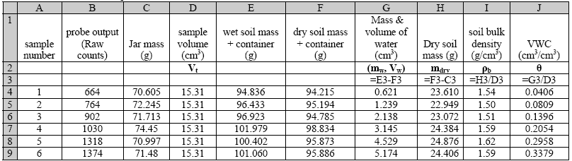
Custom Calibrations
Homogenized Soil Method-Calibration Calculations
Notes:
So now we have a complete data set. This is an example of what your data set should look like.

Slide 29
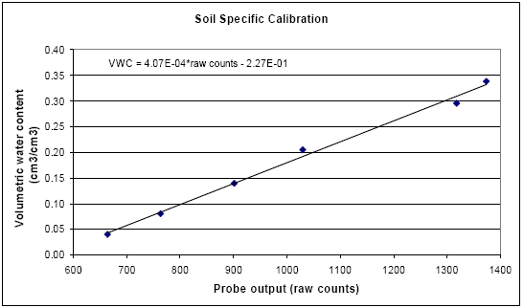
Custom Calibrations
Homogenized Soil Method-Calibration Calculations
Notes:
You can graph your probe output, either in mv or raw counts, against the actual volumetric water content measurements you obtained from your samples. Then, just apply the appropriate functional relationship and obtain your calibration by regression. Then, apply this regression to your data.

Slide 30
Decagon Calibration Video
Detailed video on this procedure on Decagon’s website:
http://www.decagon.com/calibrate

Slide 31
Application Notes relevant to Calibrations
Calibration and Characterization of an Improved Low-Cost Soil Moisture Sensor (13492)
Calibrating ECHO Soil Moisture Probes (13393)
Correcting Temperature Sensitivity of ECHO Soil Moisture Sensors (13394)
Frequently Asked Questions about ECHO Probes (13390)
Calibration Equations for the ECH2O EC-5, ECHO-TE, and 5TE sensors (13392)
Calibration of ECHO Probes with a 5 V Excitation (13399)

