Slide 1
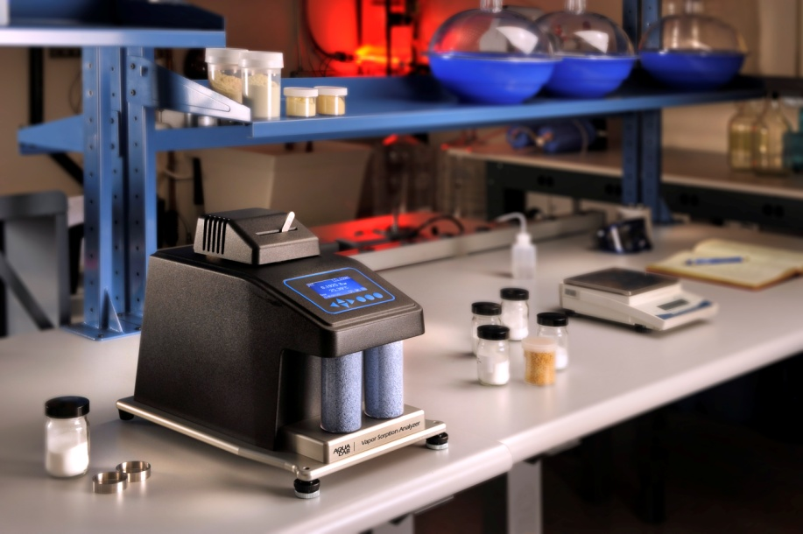
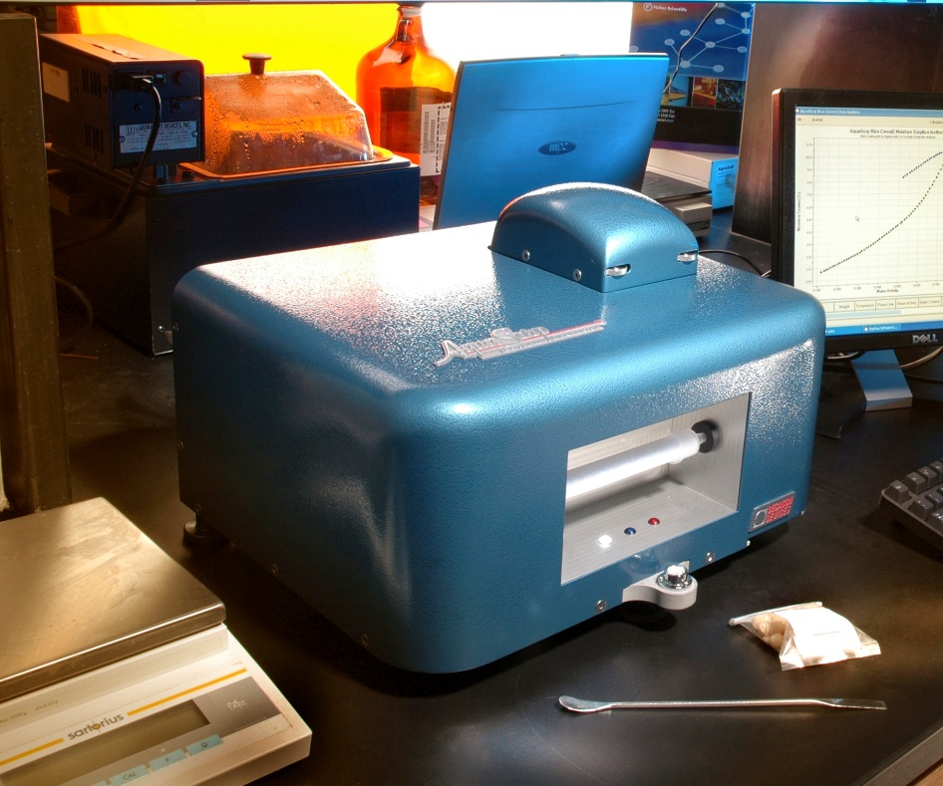
A first look at using the Vapor Sorption Analyzer in soils
Doug Cobos, Ph.D.
Decagon Devices and Washington State University

Slide 2
Soil Moisture Characteristic Curve (SMCC)
Moisture release curve, water retention function, pF curve, moisture sorption isotherm
Relationship between water content and water potential (water activity, suction, pF, chi)

Slide 3
Generating SMCC
Measuring water content is easy
  Gravimetric analysis (oven drying)
Measuring water potential is difficult
  No single instrument can make accurate measurements from wet to dry

Slide 4
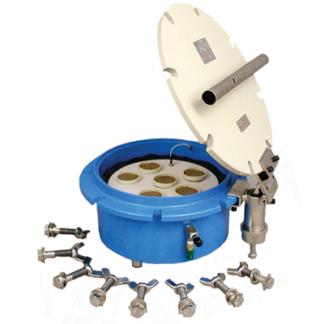
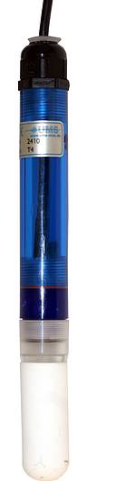
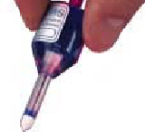
Wet end instruments (liquid equilibrium)
Wind-Schindler
(HyProp)
Pressure chamber
Tensiometers

Slide 5
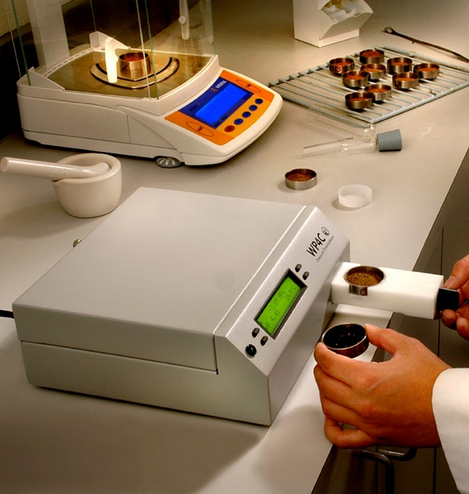
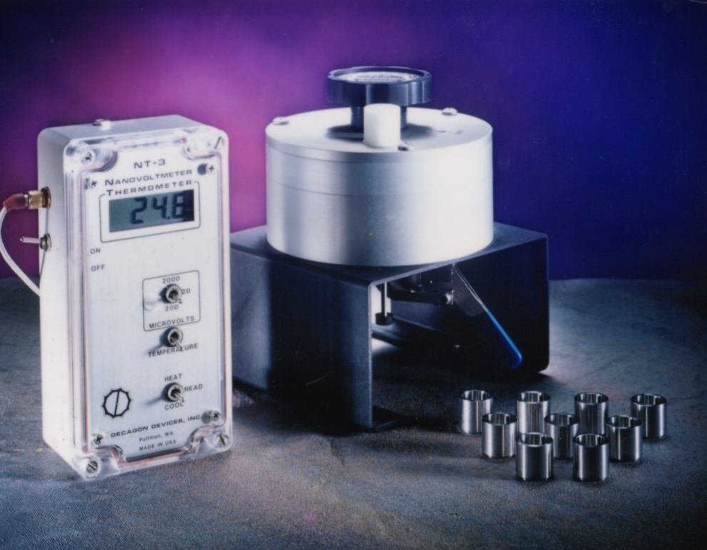
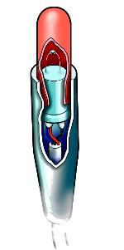
Dry end instruments (vapor equilibrium)
Chilled mirror dew-point
hygrometer
Thermocouple psychrometers
Relative humidity (h_{r}) and water potential (Ψ) related by the Kelvin equation:
R is universal gas constant
M_{w} is molecular mass of water
T is temperature

Slide 6
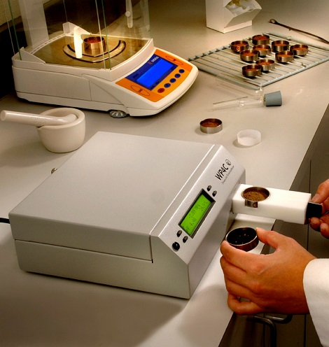

Dry end SMCC
Historically very difficult to obtain
  Campbell and Shiozawa (1992) cited over 70 times and data used many by many authors
  Introduction of WP4, WP4T, WP4C made dry end SMCC more accessible
Aquasorp/VSA instruments are the next step

Slide 7
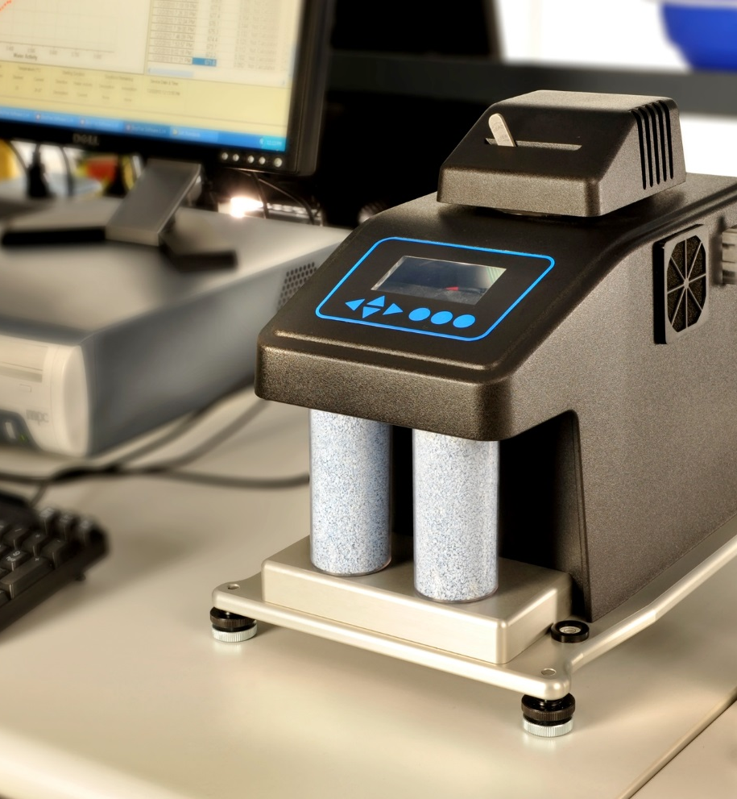
VSA (Vapor Sorption Analyzer)
Generates dry end SMCC
Fully automated
Drying and wetting (hysteresis loop)

Slide 8
VSA limitation
Limitation: only works drier than -7 MPa (95% relative humidity)

Slide 9
VSA (how it works)
Dry Air
Wet Air
Dynamic mode
  Wet (~99% rh) or dry (~0%rh) air flows across sample
  Flow stops and water activity/water potential and mass (water content) measured
  Extreme resolution (> 200 points)
  < 48 hours for wetting and drying loop (often < 10 hours)
Fan
Optical Sensor
Mirror
Infrared Sensor
Sample
Precision Balance

Slide 10
VSA (how it works)
Dry Air
Wet Air
Static mode
  Humidity of chamber controlled at pre-determined level
  Mass measured over time until no longer changing
  Less resolution
  Sorption kinetics
Sorption/desorption of other gases is possible
Fan
Optical Sensor
Mirror
Infrared Sensor
Sample
Precision Balance

Slide 11
Static vs. Dynamic

Slide 12
Static method (kinetics)

Slide 13
Dynamic method

Slide 14
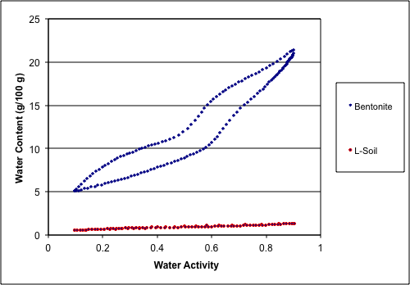
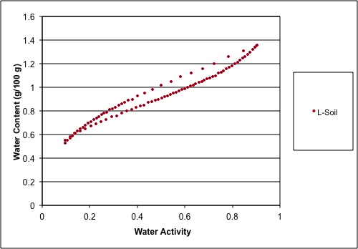
What can you do with VSA data?
Hysteresis

Slide 15
Slope of semi-log plot
Logarithm of water potential vs. water content
  Plot becomes straight line in dry (VSA) region
  Slope of plot contains much useful information

Slide 16
pF and Chi (Χ) Condon (2006), Orchiston, 1953
pF = log (Ψ) where Ψ has units of cm of water
  Common measure in Europe and in geotechnical engineering community
  Takes log of number with units (mathematical mistake)
  Increases with decreasing moisture (not intuitive)
Χ = −ln[-ln(a_{w})] where a_{w} is water activity (relative humidity)
  Mathematically correct, decreases with decreasing moisture

Slide 17
Slope of semi-log plot
Adsorption leg of semi-log plot extends through -1000 MPa at 0 water content
  pF 7.0, Chi = -2.00
  a_{w} = 0.0006, relative humidity = 0.06%
Slopes highly variable by soil type

Slide 18
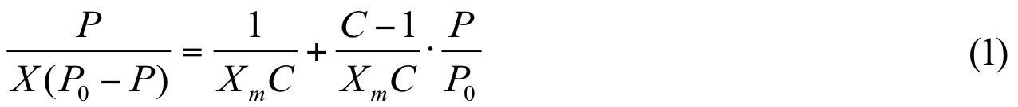
What can you do with VSA data?
Specific Surface Area (SSA)
BET model (Brunauer et al. 1938, Likos and Lu 2002)
  Physically based model for isotherms (SMCCs)
Water activity
Water content
offset
slope
X_{m} is water content when soil covered with monolayer of water

Slide 19
What can you do with VSA data?
Specific Surface Area (SSA)
  Slope of Chi plot (Condon 2006)
SSA= f*S*a
S is slope of Chi plot (g/g)
a is monolayer coverage (3500 m² g⁻¹)
f is factor of 1.84

Slide 20
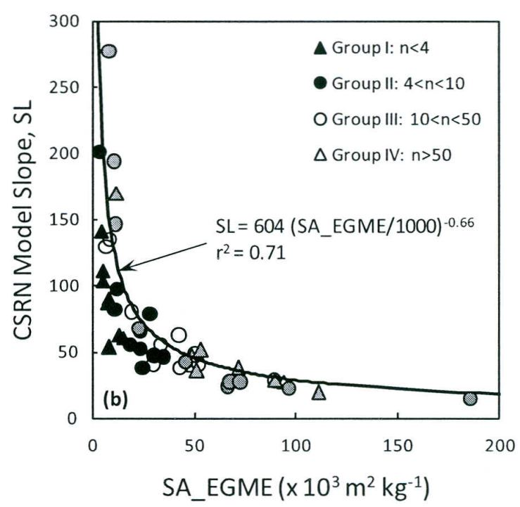
What can you do with VSA data?
Specific Surface Area (SSA)
Tuller and Or (2005)
  General scaling model for SSA from SWCC
  Mixed results in literature
Resurreccion (2011)
  Used slope of log water potential vs. water content function for SSA

Slide 21
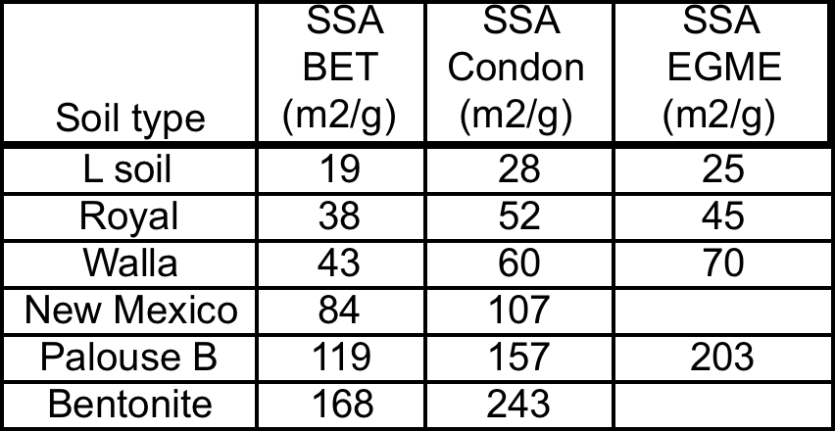
What can you do with VSA data?
Specific Surface Area (SSA)
Which SSA measure is the best?
Still much research to be done!

Slide 22
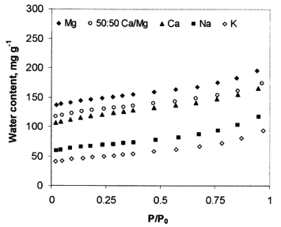
What can you do with VSA data?
Adsorbed cation type
Smectite exchanged to achieve homoionic state
Fundamentally different isotherms

Slide 23
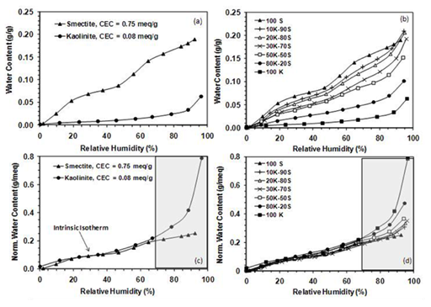
What can you do with VSA data?
CEC (cation exchange capacity)
“Intrinsic Isotherm” approach
  Water content normalized by dividing by CEC of soil
  All isotherms converge
  Maybe inverse relationship could be used to predict CEC?
  More research needed!

Slide 24
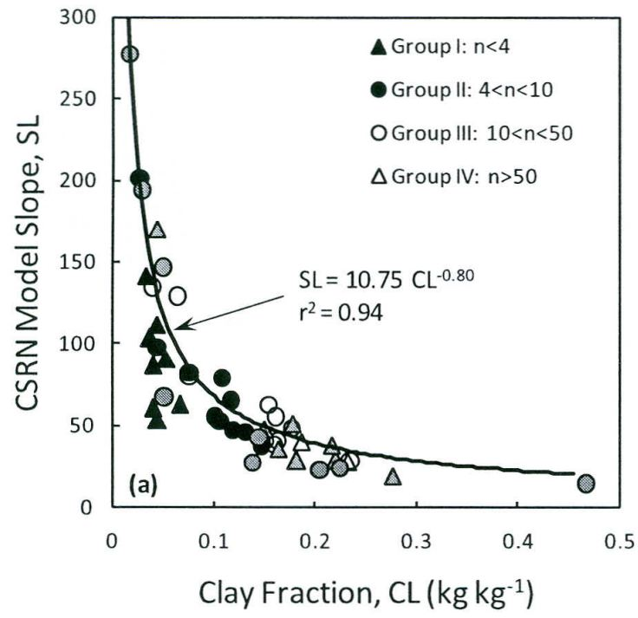
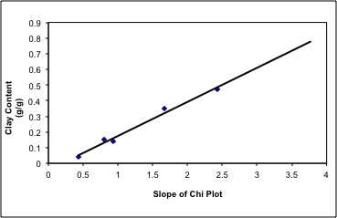
What can you do with VSA data?
Soil clay content (clay activity)
Resurreccion (2011)
  Used slope of log water potential vs. water content function for SSA
Decagon internal research
  Used slope of chi plot

Slide 25
What can you do with VSA data?
Gas movement in soil
Simulations of water vapor transport for pesticide volatilization (Chen et al., 2000)
Remediation of Volatile Organic Carbon compounds (Batterman et al., 1995)

Slide 26
What can you do with VSA data?
Swelling potential (expansiveness)
McKeen (1992) showed that the slope of pF vs. water content is related to soil swelling potential
Class | Slope | Expansion
I | > -6 | special case
II | -6 to -10 | high
III | -10 to -13 | medium
IV | -13 to -20 | low
V | < -20 | non-expansive

Slide 27
What can you do with VSA data?
Swelling potential (expansiveness)
Other possible swelling potential indicators
  Breadth and area of hysteresis loop?
  Monolayer coverage and heat of hydration from BET analysis?
  Equilibrium water content at specific relative humidity
  Sorption rate constants derived from step change in relative humidity (possible with new VSA)
  MUCH more research needs to be done!

Slide 28
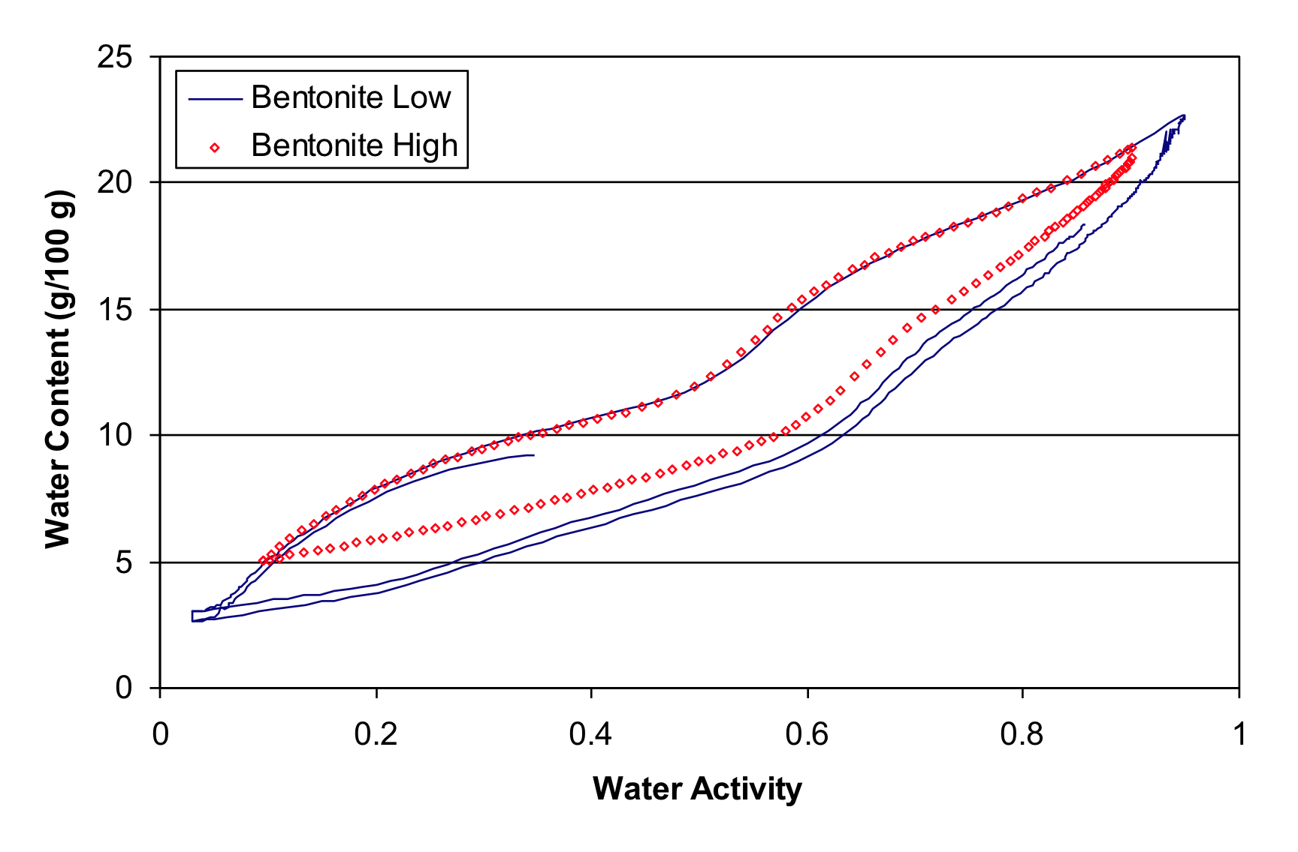
What can you do with VSA data?
Unexplained results
Bentonite SMCCs (isotherms)
  Desorption curve independent of starting water activity
  Adsorption curve totally dependent on starting water activity

Slide 29
Take-home points
Aquasorp/VSA data useful for
  Specific surface area
  CEC
  Clay activity
  Swelling potential
  Modeling of gas transport in soil
  Sorption kinetics (not even explored yet)
We have not even begun to understand the usefulness of dry end SMCC/isotherms

Slide 30
References
Batterman, S.A., A. Kulshrethsa, and H.Y. Chang. 1995. Hydrocarbon vapour transport in low moisture soils . Environmental Science and Technology 29: 171-180
Brunauer, S., P. H. Emmett, and E. Teller. 1938. Adsorption of gases in multi-molecular layers. J. Am. Chem. Soc. 60:309-319.
Chen, D., D.E. Rolston, and P. Moldrup. 2000. Coupling diazinon volatilization and water evaporation in unsaturated soils: I. Water transport, Soil Science 165: 681-689
Condon, J. B. 2006. Surface Area and Prorsity Determination by Physisorption: Measurements and Theory. Elsevier, Amsterdam.
Likos, W. J. and N. Lu. 2002. Water vapor sorption behavior of smectite-kaolinite mixtures. Clays and Clay Minerals 50: 553-561.
Orchiston, H. D. 1953. Adsorption of water vapor: I. Soils at 25 C. Soil Sci. 73:453-465
Resurrecction, A. C., P. Moldrup, M. Tuller, T.P.A. Ferre, K. Kawamoto, T. Komatsu, L. W. de Jonge. Relationship between specific surface area and the dry end of the water retention curve for soils with varying clay and organic carbon contents. Water Resources Research 47, W06522
Tuller, M. and D. Or. 2005. Water films and scaling of soil characteristic curves at low water contents. Water Resources Research 41, W09403.

Slide 31
Appendix: wet end measurements
Range can be extended further into wet end
  Start with saturated sample and dry down
  Can only get drying leg of hysteresis loop
    VSA can’t wet back up past about -10 MPa using vapor equilibration

Slide 32
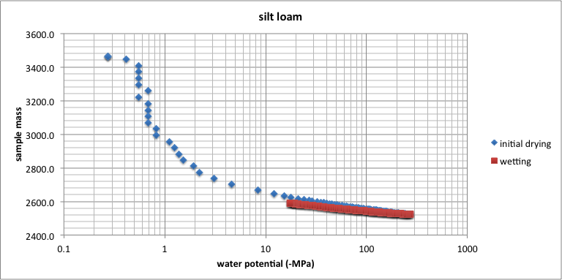
Appendix: wet end measurements

Slide 33
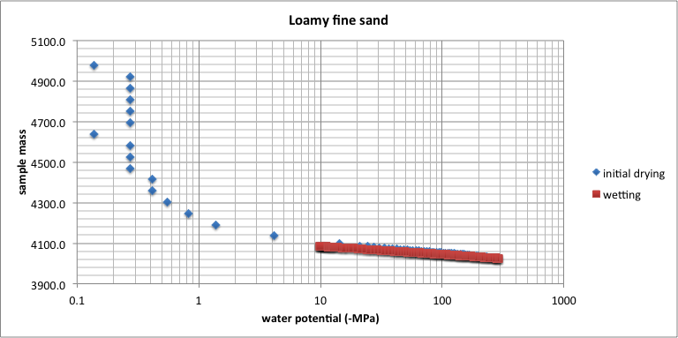
Appendix: wet end measurements

